Slide 1
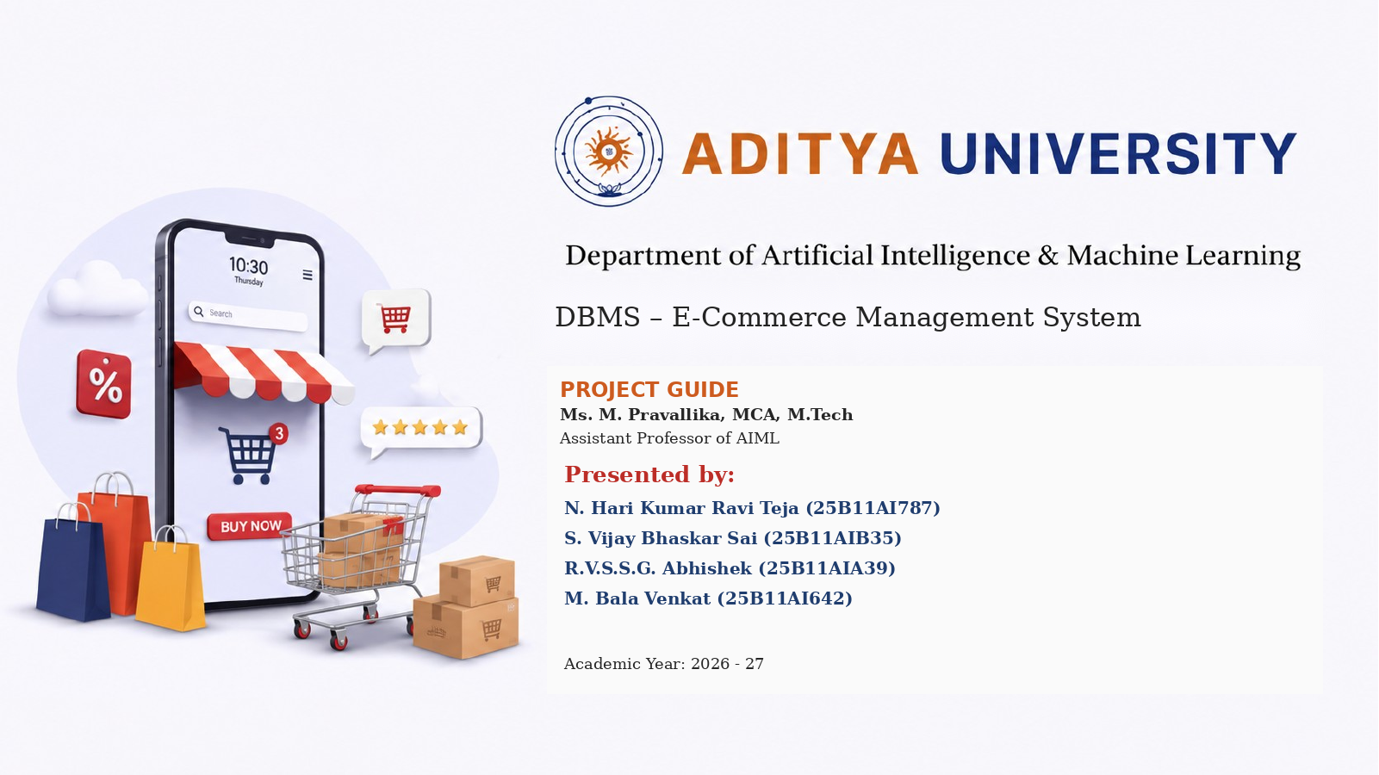
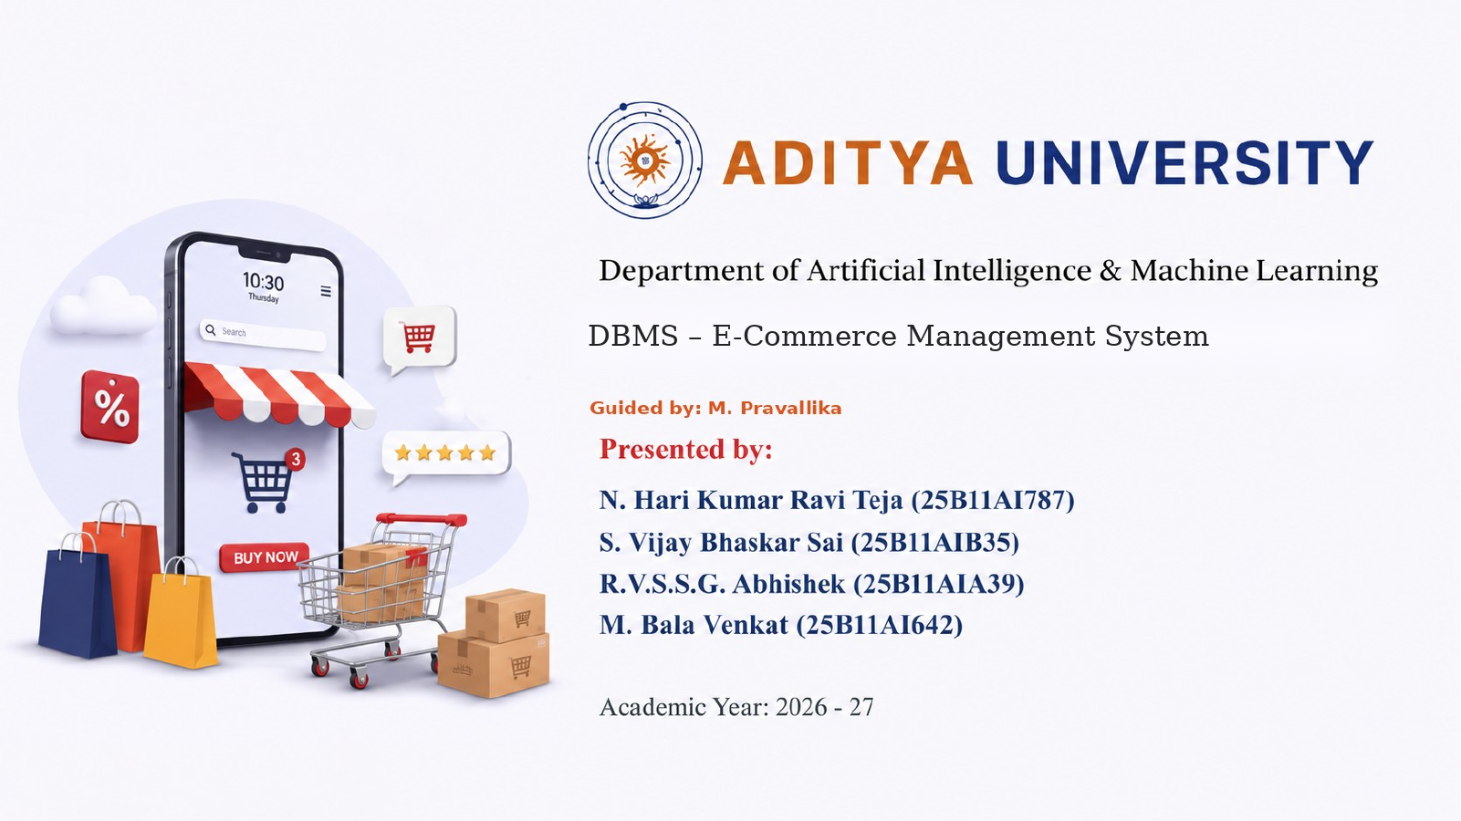

Slide 2

Presentation Outline
ROADMAP
Project Understanding
Keys & Constraints
01
10
Problem Statement
DDL
02
11
Objectives & Scope
DML
03
12
System Modules
DQL
04
13
Architecture & Data Flow
Joins & Views
05
14
Database Entities
Stored Procedures
06
15
ER Diagram
ACID & Transactions
07
16
Relational Schema
Implementation Evidence
08
17
Normalisation
Results • Future Scope • Conclusion
09
18
DBMS • E-COMMERCE MANAGEMENT SYSTEM
2

Slide 3
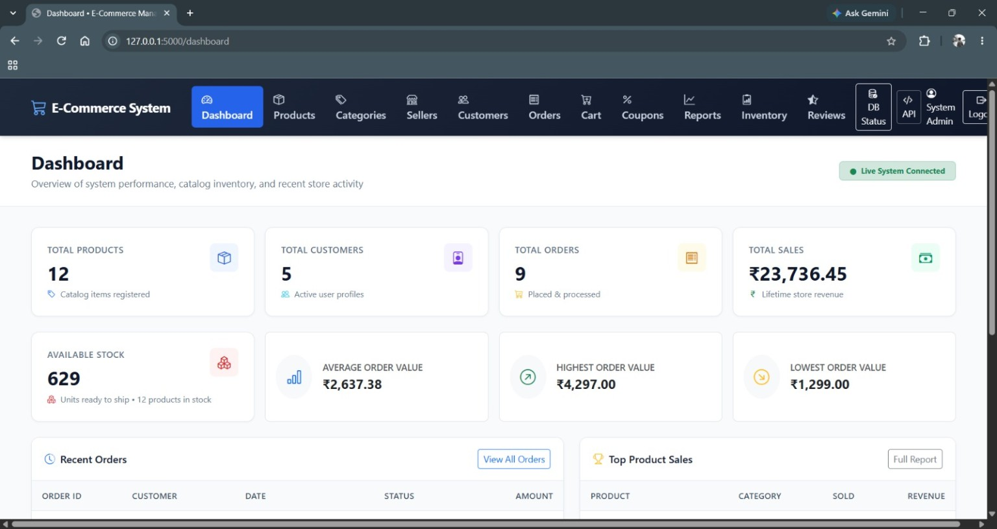
Project at a Glance
PROJECT UNDERSTANDING
A database-centric e-commerce management system built on a MySQL relational database.
The application manages connected customer, seller, category, product, cart, order, payment, shipping, coupon and review data.
13
12
5
Relational tables
Products
Customers
9
₹23,736.45
Orders
Total sales shown in reports
Actual dashboard output
DBMS • E-COMMERCE MANAGEMENT SYSTEM
3

Slide 4
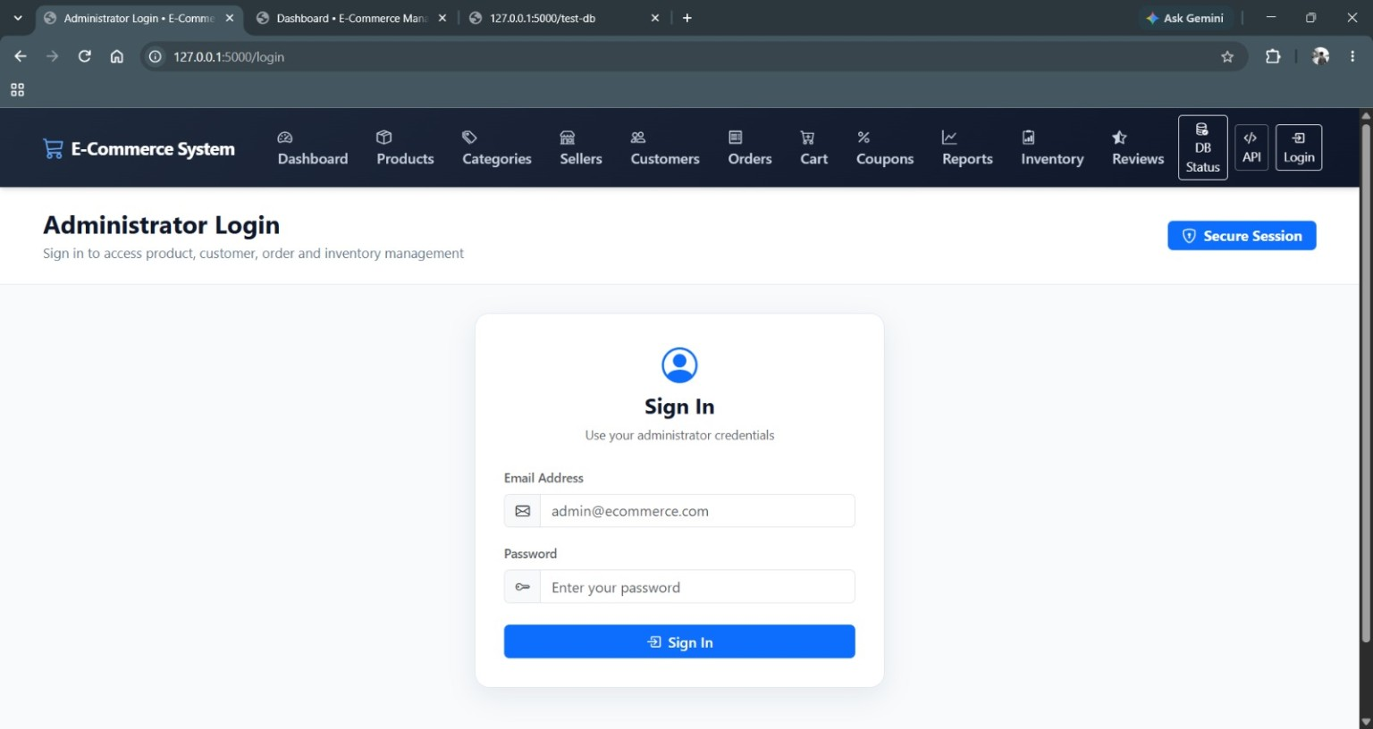
Problem Statement & Objectives
DESIGN CHALLENGE
THE CHALLENGE
DBMS PERSPECTIVE
E-commerce data is distributed across connected entities. The DBMS must maintain relationships, enforce integrity and support reliable retrieval and transactional updates.
DATA → customers / products / orders / payments
RULES → keys / constraints
ACCESS → SELECT / JOIN / views / procedures
CONTROL → COMMIT / ROLLBACK
01
Normalize
Structure related data with reduced redundancy.
02
Enforce integrity
Use PK, FK, UNIQUE, CHECK and NOT NULL rules.
03
Support operations
Manage products, customers, sellers, carts and orders.
04
Query & report
Retrieve and aggregate information through SQL.
05
Control transactions
Commit successful work and roll back failures.
Administrator login
DBMS • E-COMMERCE MANAGEMENT SYSTEM
4

Slide 5
System Modules & Core Workflow
CURRENT IMPLEMENTATION
Products
Categories
Sellers
Customers
catalog + stock
classification
seller records
customer records
Cart
Orders
Payments
Shipping
items + quantities
purchase lifecycle
payment tracking
delivery data
Coupons
Reviews
Inventory
Reports
discount records
ratings + feedback
stock control
analytics
Customer → Cart → Checkout → Order → Payment → Shipping
APPLICATION WORKFLOW • Cart → Checkout → Order is a business flow, not a direct ER foreign-key relationship.
DBMS • E-COMMERCE MANAGEMENT SYSTEM
5

Slide 6
System Architecture & Data Flow
ARCHITECTURE
USER / ADMIN
Browser interface
↓
FLASK APPLICATION
Routes • validation • sessions • business logic
↓
DB ACCESS
mysql.connector • cursors
↓
MYSQL DBMS
13 relational tables • constraints • SQL • views • stored procedures
TRANSACTION LAYER
Write operations use a database transaction helper with autocommit disabled: success → COMMIT; exception → ROLLBACK.
DBMS • E-COMMERCE MANAGEMENT SYSTEM
6

Slide 7
Relational Schema – 13 Tables
DATABASE DESIGN
Admins
Customers
Sellers
admin_id PK
customer_id PK
seller_id PK
Categories
Coupons
Products
category_id PK
coupon_id PK
product_id PK; seller_id FK; category_id FK
Cart
Cart Items
Orders
cart_id PK; customer_id FK
cart_item_id PK; cart_id FK; product_id FK
order_id PK; customer_id FK; coupon_id FK
Order Items
Payments
Shipping
order_item_id PK; order_id FK; product_id FK
payment_id PK; order_id FK
shipping_id PK; order_id FK
Reviews
review_id PK; customer_id FK; product_id FK
Database integrity
PK • FK • UNIQUE • CHECK • NOT NULL • ON UPDATE / ON DELETE rules • generated subtotal in Order Items
DBMS • E-COMMERCE MANAGEMENT SYSTEM
7

Slide 8
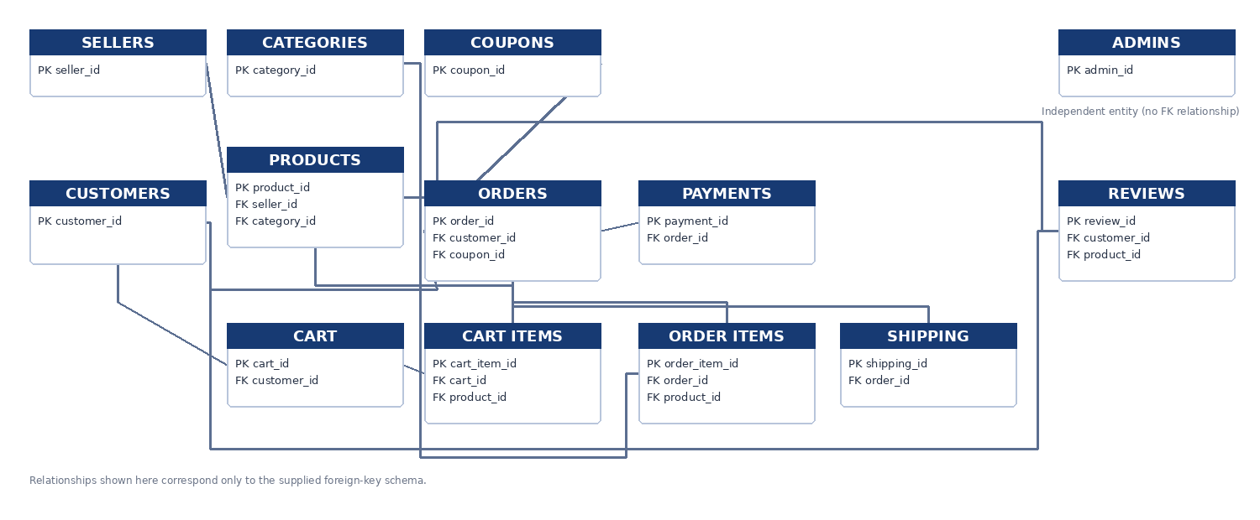
ER Diagram – E-Commerce Management System
RELATIONAL DESIGN
RELATIONSHIP LEGEND — matches the supplied foreign-key schema
1 : 1 → Customer–Cart • Order–Payment • Order–Shipping
1 : M → Seller–Product • Category–Product • Coupon–Order • Customer–Order • Customer–Review • Product–Review • Cart–Cart Items • Product–Cart Items • Order–Order Items • Product–Order Items
Admin has no FK relationship in the supplied schema. No direct Product–Order or Order–Review relationship is shown.
DBMS • E-COMMERCE MANAGEMENT SYSTEM
8

Slide 9
Normalisation – 1NF, 2NF & 3NF
DATABASE DESIGN
1NF
2NF
3NF
Atomic values • no repeating groups • one value per field
Satisfies 1NF • removes partial dependency • attributes depend on the whole key
Satisfies 2NF • removes transitive dependency • non-key attributes depend on the key
E-commerce example
Why it matters
Customer details are stored in Customers and order details in Orders / Order Items. Product and category data are stored separately instead of repeating them inside every order row.
Less duplication • better consistency • clear relationships • easier updates and retrieval
The project schema separates core entities rather than storing the entire transaction in one wide table.
DBMS • E-COMMERCE MANAGEMENT SYSTEM
9

Slide 10
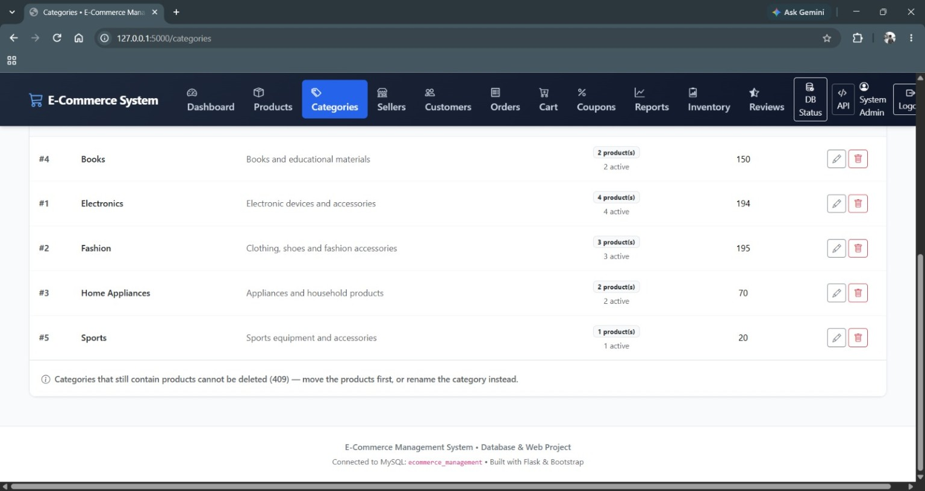
Keys, Constraints & Referential Integrity
DBMS FOUNDATION
PRIMARY KEY
FOREIGN KEY
Uniquely identifies each row.
Connects child records to parent records.
UNIQUE
CHECK
Prevents duplicate emails, codes, transaction IDs and other constrained values.
Validates status, price, stock, rating, quantity and amount ranges.
NOT NULL
FK ACTIONS
Requires mandatory fields.
CASCADE / RESTRICT / SET NULL are used according to the relationship.
Application evidence: referenced categories cannot be deleted
DBMS • E-COMMERCE MANAGEMENT SYSTEM
10

Slide 11
DDL – Database Definition
SQL OPERATIONS
The supplied database script defines the relational structure using CREATE DATABASE and CREATE TABLE statements.
DDL — ACTUAL SCHEMA EXCERPT
DDL purpose
CREATE TABLE products (
product_id INT AUTO_INCREMENT PRIMARY KEY,
seller_id INT NOT NULL,
category_id INT NOT NULL,
product_name VARCHAR(150) NOT NULL,
price DECIMAL(10,2) NOT NULL,
stock_quantity INT NOT NULL DEFAULT 0,
FOREIGN KEY (seller_id) REFERENCES sellers(seller_id),
FOREIGN KEY (category_id) REFERENCES categories(category_id),
CHECK (price >= 0),
CHECK (stock_quantity >= 0)
);
Creates the database objects and embeds integrity rules directly into the relational schema.
Project evidence
13 tables are created in the supplied SQL schema, including generated subtotal in Order Items.
DBMS • E-COMMERCE MANAGEMENT SYSTEM
11

Slide 12
DML – Data Manipulation Language
SQL OPERATIONS
INSERT
UPDATE
DELETE
Adds records such as customers, products, orders, order items, payments and shipping.
Changes existing values such as stock, order status, payment status or profile data.
Removes records when business rules and FK relationships allow it.
DML — ACTUAL APPLICATION CODE
Where it appears
DML — ACTUAL APPLICATION CODE
INSERT INTO orders (customer_id, coupon_id, total_amount,
order_status, shipping_address)
VALUES (%s, %s, %s, 'PLACED', %s);
UPDATE products SET price = %s, stock_quantity = %s
WHERE product_id = %s;
DELETE FROM products WHERE product_id = %s;
CRUD screens manage products, categories, sellers, customers, coupons, orders and reviews. Checkout creates order-related records in one transaction.
DBMS • E-COMMERCE MANAGEMENT SYSTEM
12

Slide 13
DQL – Data Query Language
SQL OPERATIONS
SELECT
WHERE
ORDER BY
GROUP BY
Retrieve records from one or more tables.
Filter rows using conditions.
Sort results.
Group records for analysis.
DQL — ACTUAL REPORT QUERY
Project retrieval examples
DQL — ACTUAL APPLICATION QUERIES
SELECT product_id, product_name
FROM products
WHERE category_id = %s;
SELECT product_id, COUNT(*) AS review_count
FROM reviews
GROUP BY product_id;
SELECT product_id, product_name, category_name,
quantity_sold, revenue
FROM product_sales ORDER BY revenue DESC;
Product sales ranking • customer orders • order/payment ledger • inventory • dashboard totals • review records
DBMS • E-COMMERCE MANAGEMENT SYSTEM
13

Slide 14
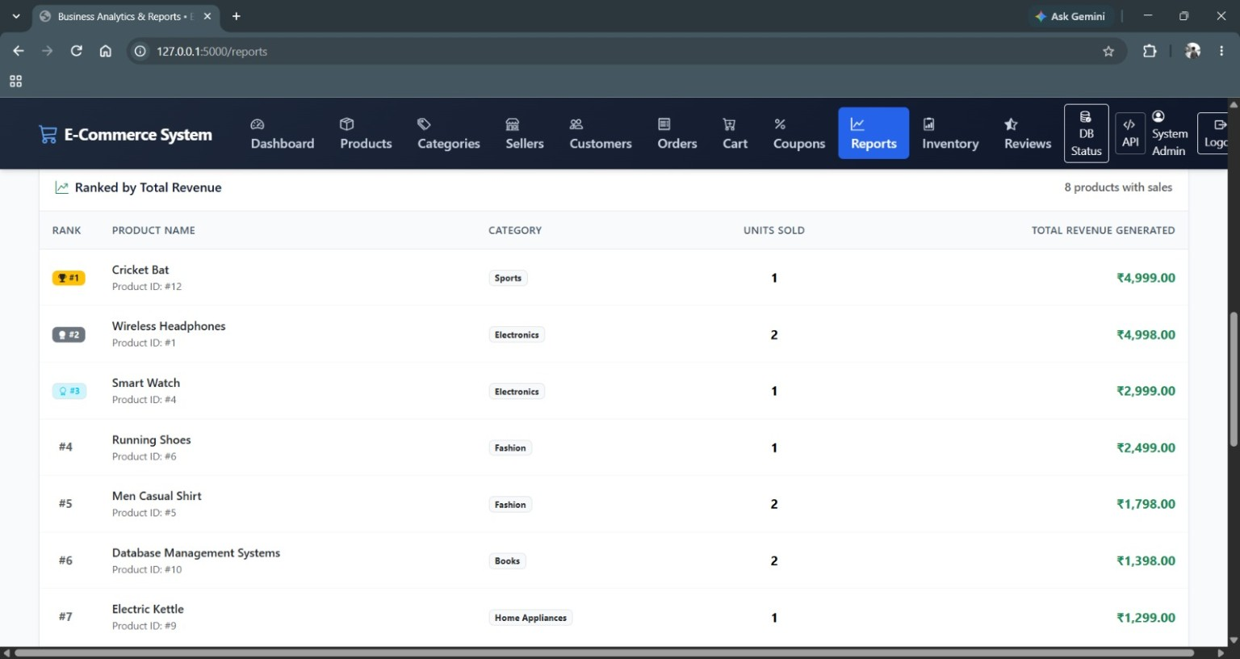
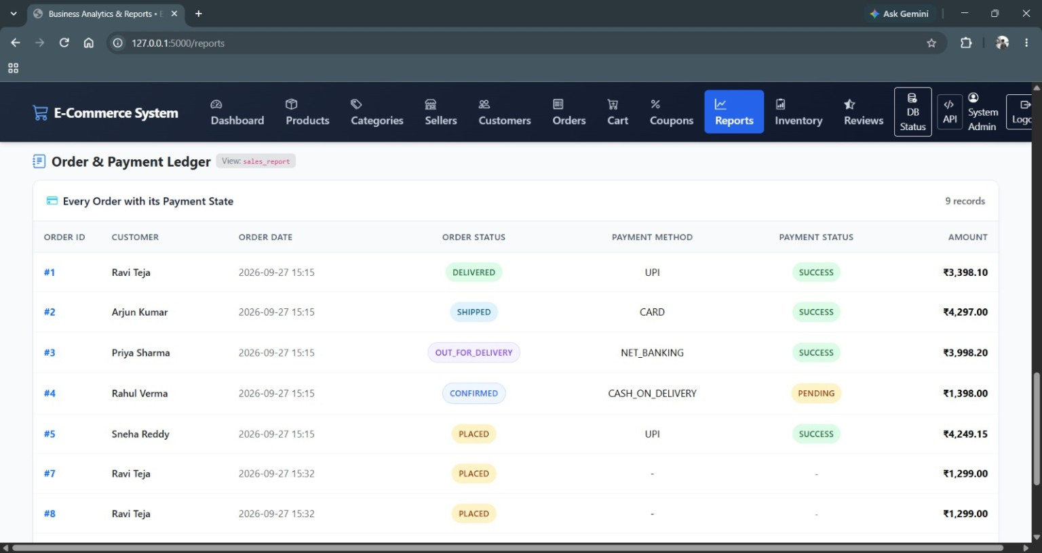
Joins & Views
SQL OPERATIONS
INNER JOIN
LEFT JOIN
RIGHT JOIN
Returns matching rows between related tables.
Keeps all rows from the left table and matching rows from the right.
Keeps all rows from the right table and matching rows from the left.
VIEW USAGE — ACTUAL APPLICATION EVIDENCE
product_sales
sales_report
SOURCE VERIFICATION
Consumed by app.py for product-wise sales / revenue ranking.
Consumed by app.py for the order & payment ledger.
The supplied project SQL does not contain CREATE VIEW definitions. app.py consumes the pre-existing MySQL views product_sales and sales_report.
Product revenue ranking — evidence of product_sales usage
Order & payment ledger — evidence of sales_report usage
DBMS • E-COMMERCE MANAGEMENT SYSTEM
14

Slide 15
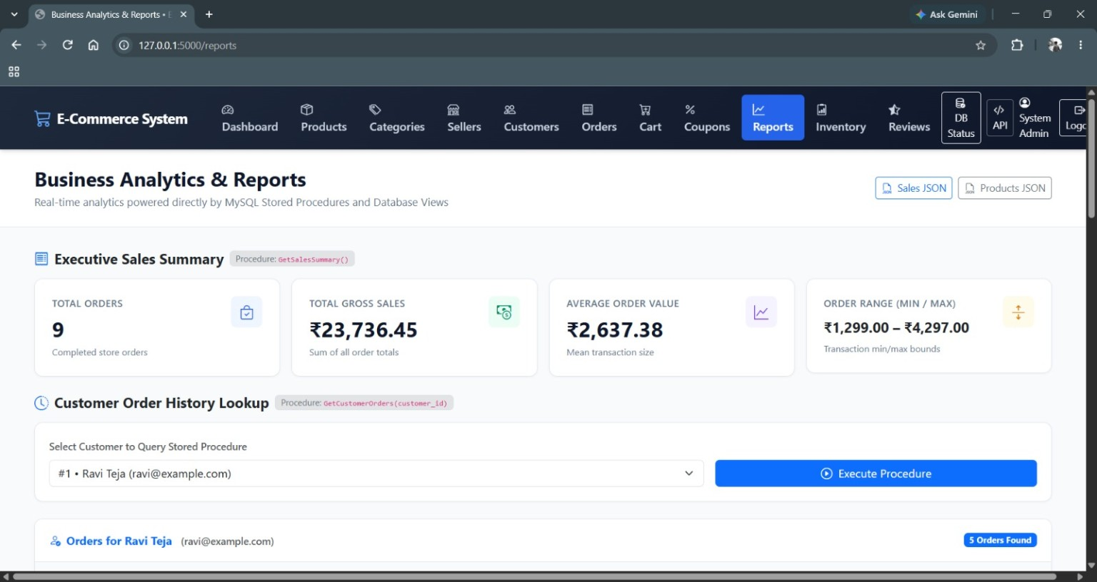
Stored Procedures – Database Reporting
DATABASE PROGRAMMABILITY
GetSalesSummary()
GetCustomerOrders(customer_id)
GetProductsByCategory(category)
Returns aggregated sales information used by the Reports page.
Retrieves order history for the selected customer.
Used by the product API when filtering by category.
ACTUAL APPLICATION CALLS
ACTUAL APPLICATION CALLS
cur.callproc("GetSalesSummary")
cur.callproc("GetCustomerOrders",
(selected_customer_id,))
cur.callproc("GetProductsByCategory",
(category,))
SOURCE VERIFICATION
The supplied project source contains application calls to these pre-existing MySQL procedures, but no CREATE PROCEDURE definitions. Definitions are therefore not fabricated here.
Actual Reports page showing stored-procedure execution
DBMS • E-COMMERCE MANAGEMENT SYSTEM
15

Slide 16
ACID Properties & Transaction Control
TRANSACTIONS
Atomicity
Consistency
All related checkout writes commit together or roll back.
PK/FK/CHECK rules remain valid after the transaction.
Isolation
Durability
SELECT ... FOR UPDATE locks the product row before a stock update.
Committed changes remain stored.
ACTUAL TRANSACTION HELPER
Checkout transaction
ACTUAL TRANSACTION + LOCKING EVIDENCE
conn.autocommit = False
SELECT product_id, stock_quantity
FROM products WHERE product_id = %s FOR UPDATE;
conn.commit()
conn.rollback() # on exception
Validate → lock product rows → create order → create order items → create payment → create shipping → clear cart → COMMIT. Any exception triggers ROLLBACK.
DBMS • E-COMMERCE MANAGEMENT SYSTEM
16

Slide 17
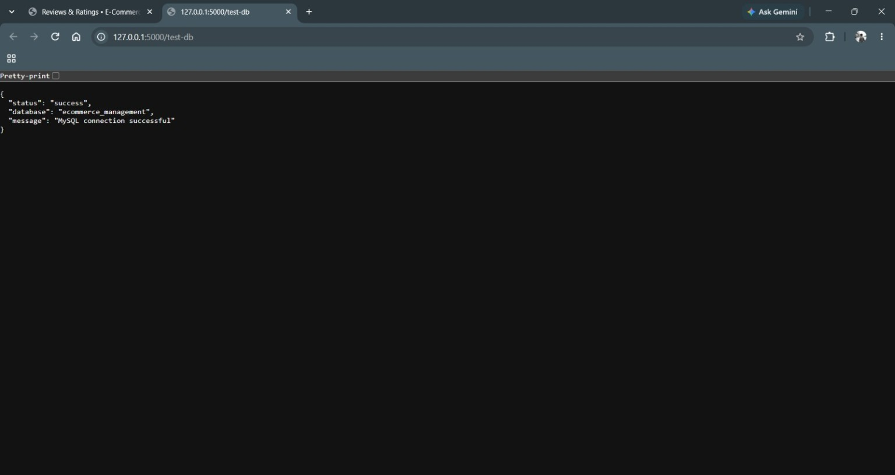
API & Database Connectivity
IMPLEMENTATION
REST API layer
The Flask application exposes JSON endpoints for products, orders, reports and the database health check.
API ENDPOINTS IN THE APPLICATION
GET /api/products
GET /api/orders/<order_id>
GET /api/reports/sales-summary
GET /api/reports/product-sales
GET /api/reports/customer-orders
GET /test-db
Actual DB health-check output
Database
ecommerce_management
MySQL connection successful
DBMS • E-COMMERCE MANAGEMENT SYSTEM
17

Slide 18
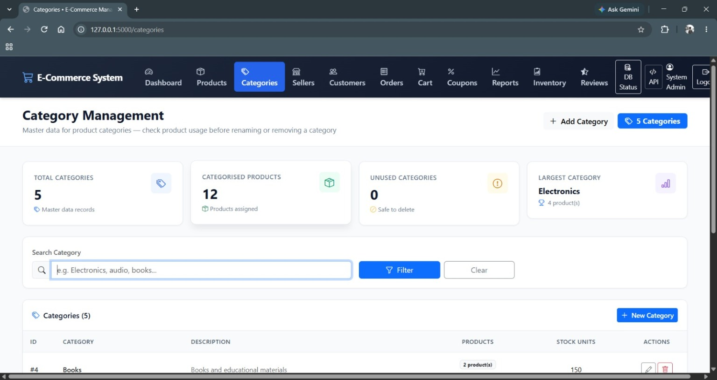
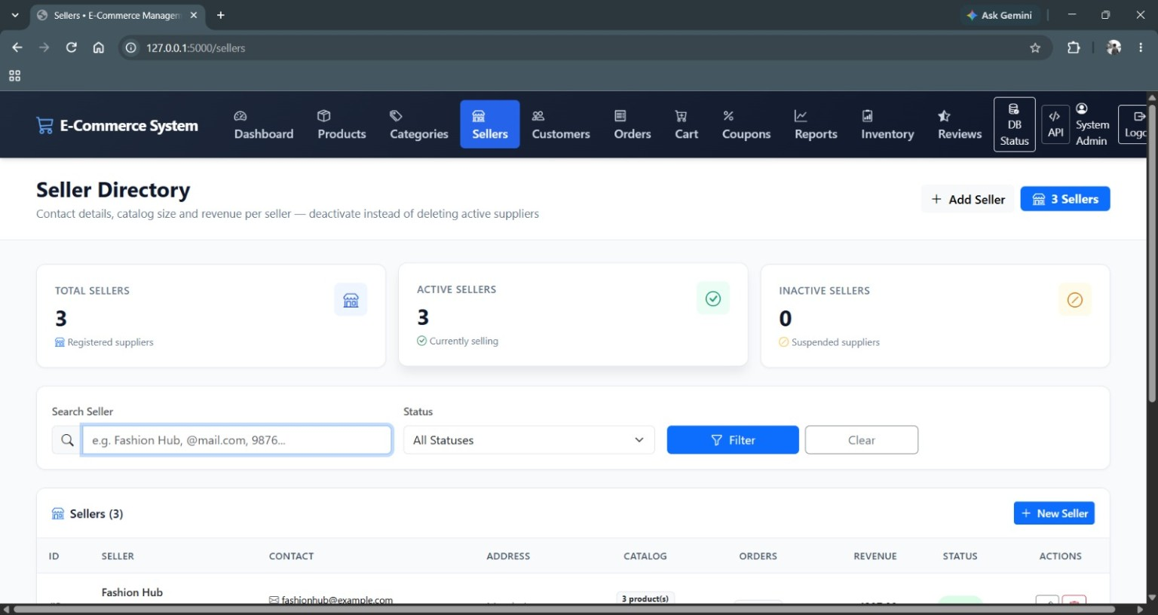
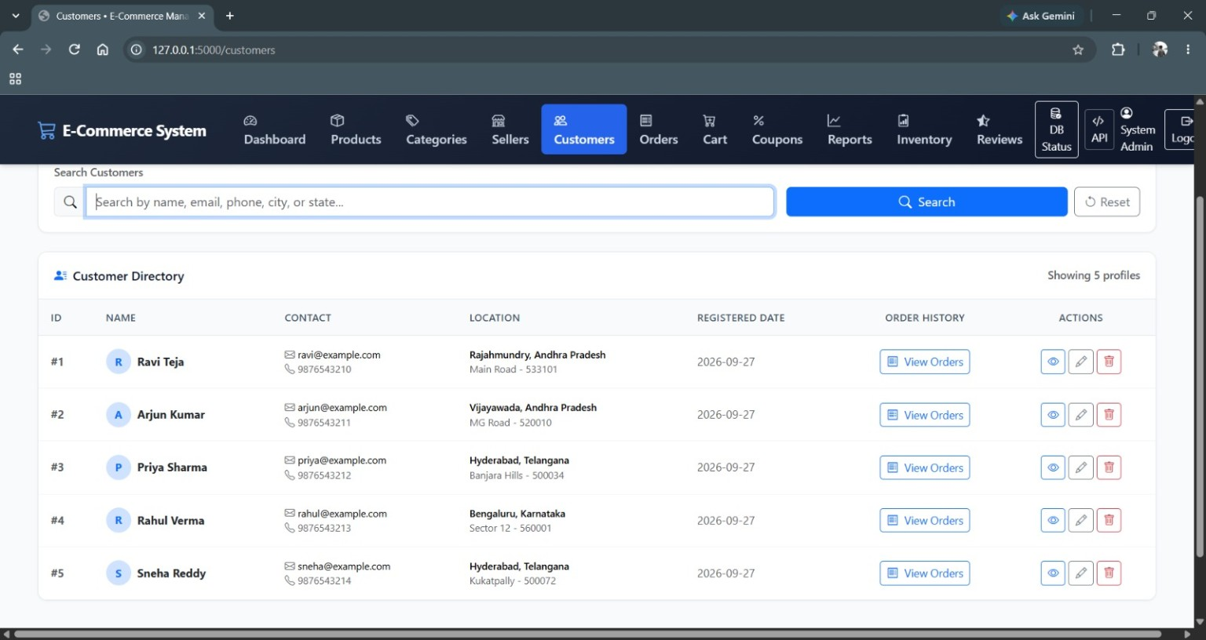
Implementation Evidence – Master Data
ACTUAL OUTPUT
Categories
Sellers
Customers
Administrator Login
DBMS • E-COMMERCE MANAGEMENT SYSTEM
18

Slide 19
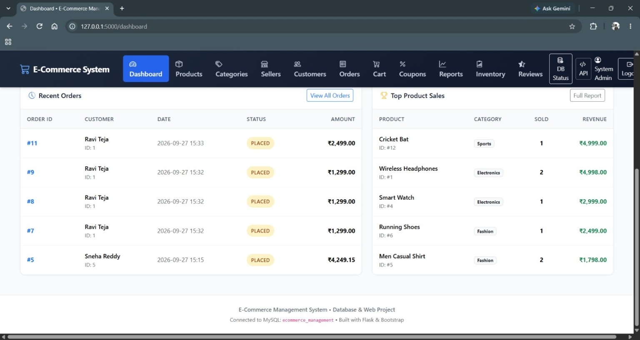
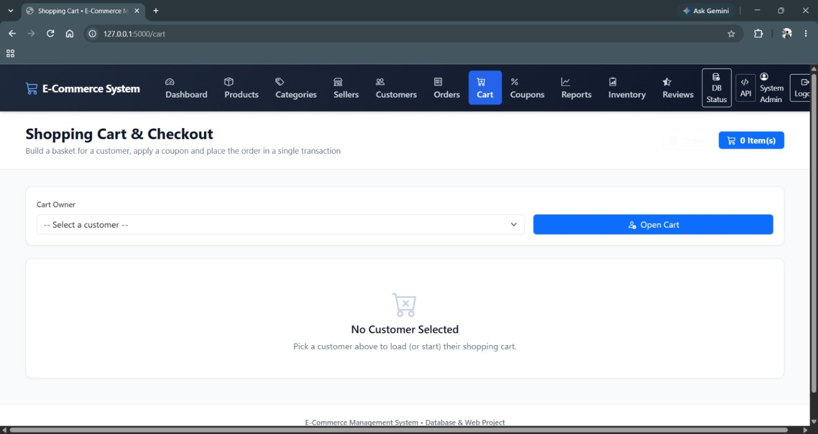
Implementation Evidence – Order & Cart Flow
ACTUAL OUTPUT
Orders
Shopping Cart
DBMS connection
Orders reference customers; order items reference products; payments and shipping reference orders. The UI exposes these connected records.
DBMS • E-COMMERCE MANAGEMENT SYSTEM
19

Slide 20
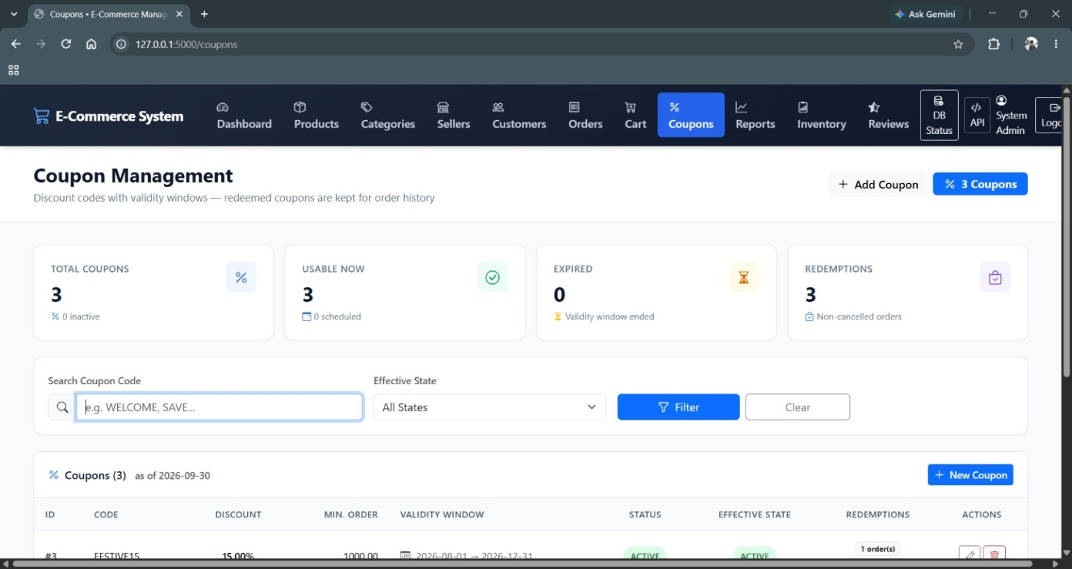
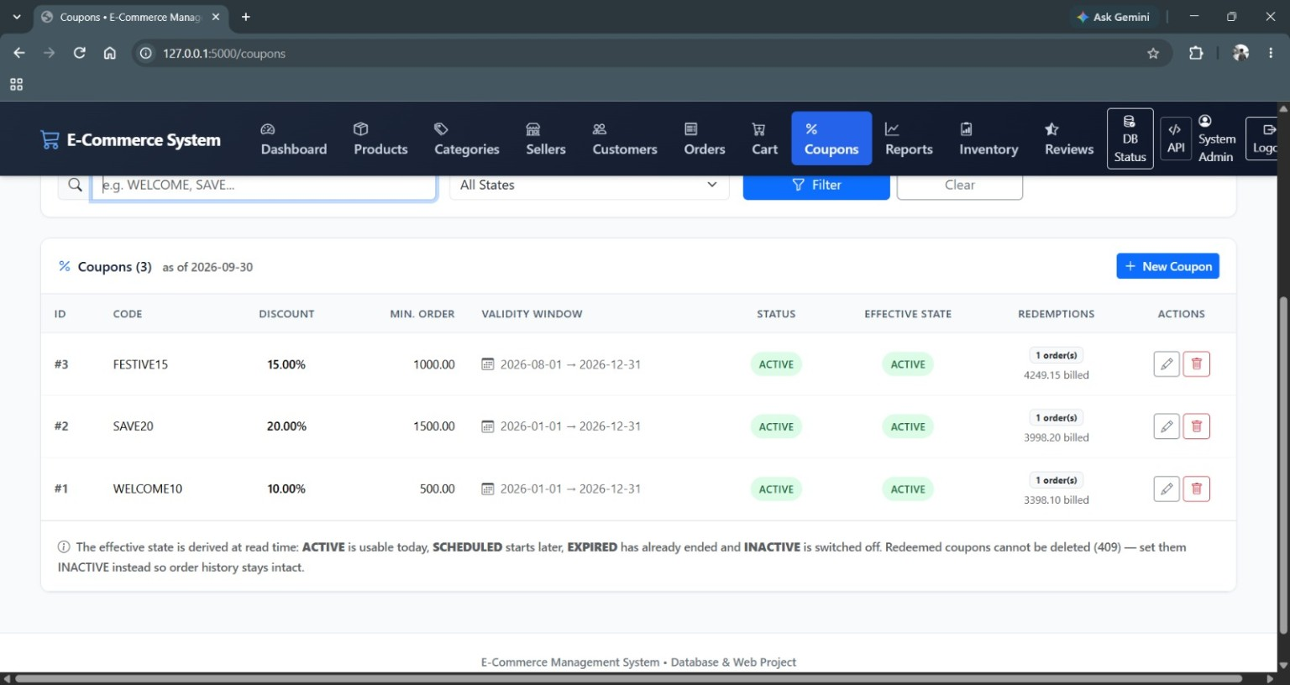
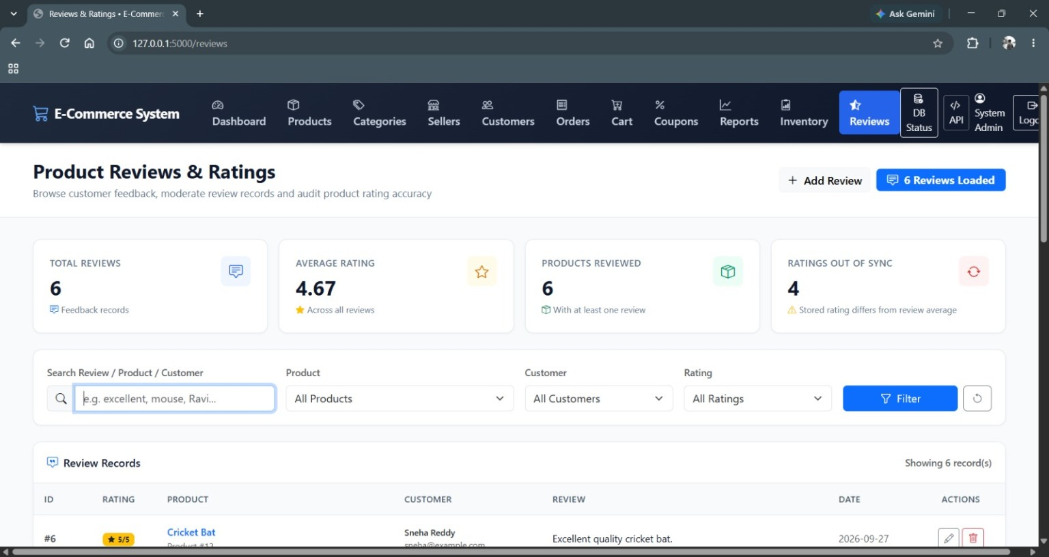
Implementation Evidence – Coupons & Reviews
ACTUAL OUTPUT
Coupon Management
Coupon records & redemptions
Integrity behaviour
Redeemed coupons cannot be deleted; the application keeps order history intact.
Reviews & Ratings
DBMS • E-COMMERCE MANAGEMENT SYSTEM
20

Slide 21
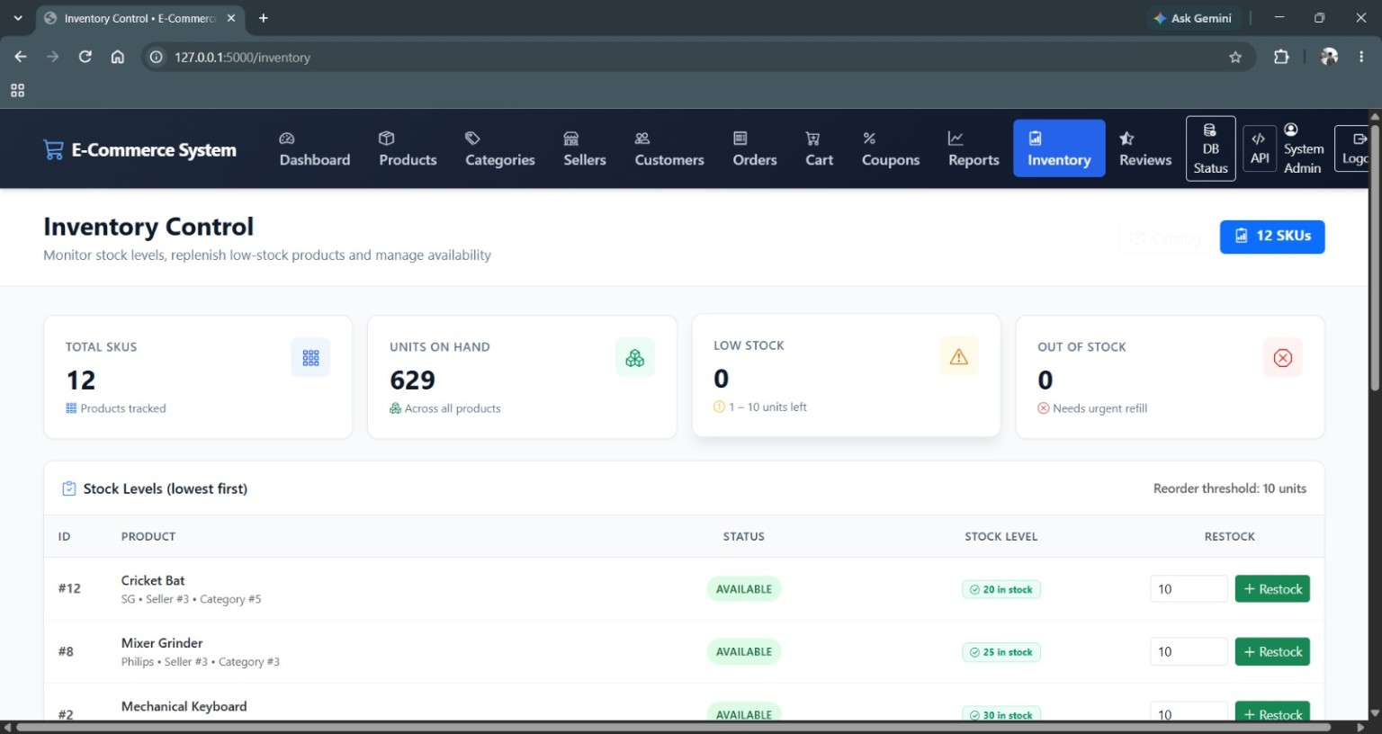
Implementation Evidence – Reports & Inventory
ACTUAL OUTPUT
Business Analytics & Reports
Inventory Control
Product Revenue Ranking
Order & Payment Ledger
DBMS • E-COMMERCE MANAGEMENT SYSTEM
21

Slide 22
Implementation Evidence – Dashboard & System State
ACTUAL OUTPUT
Visible project snapshot
12 products
5 customers
9 orders
₹23,736.45 total sales
629 units on hand
5 categories
Why it matters
Dashboard values are retrieved from the database and summarise operational records rather than being static presentation data.
Actual project dashboard
DBMS • E-COMMERCE MANAGEMENT SYSTEM
22

Slide 23
Implementation Verification
RESULTS
✓ Database connectivity
✓ Stored procedures
/test-db reports a successful MySQL connection.
Reports page executes sales summary and customer order procedures.
✓ Views
✓ Integrity
Application queries product_sales and sales_report for reporting.
Schema defines PK, FK, NOT NULL, UNIQUE and CHECK constraints; selected integrity behaviour is validated in the application.
✓ Transactions
✓ Working modules
Write operations use explicit COMMIT / ROLLBACK handling.
Products, categories, sellers, customers, orders, cart, coupons, inventory, reviews and reports are evidenced.
Result
The project demonstrates a working DBMS-backed application with relational design, SQL retrieval, reporting-object consumption, and transaction handling.
DBMS • E-COMMERCE MANAGEMENT SYSTEM
23

Slide 24
Future Scope
NEXT DEVELOPMENT OPPORTUNITIES
01
AI recommendations
02
Advanced analytics
Personalised product suggestions using customer behaviour.
More detailed dashboards and customer insights.
03
Inventory prediction
04
Payment integration
Forecast demand and improve stock planning.
Support additional secure payment methods.
05
Cloud scalability
06
Mobile experience
Support larger workloads and distributed deployment.
Extend the system to responsive/mobile applications.
Scope note
These are future enhancements; the current project focuses on the implemented relational DBMS and web application.
DBMS • E-COMMERCE MANAGEMENT SYSTEM
24

Slide 25
Conclusion
PROJECT OUTCOME
DATABASE
SQL
TRANSACTIONS
13 relational tables model the e-commerce domain with keys, constraints and relationships.
DDL, DML, DQL, joins, existing views and stored procedures support database operations and reporting.
Explicit COMMIT / ROLLBACK handling protects multi-step checkout updates.
FINAL TAKEAWAY
• The database is the foundation of the e-commerce workflow.
• SQL connects stored relational records to operational screens and reports.
• Integrity constraints and transaction control help keep related data reliable.
• The implementation screenshots provide direct evidence of the working system.
DBMS theory → relational design → SQL → application workflow → verified output
DBMS • E-COMMERCE MANAGEMENT SYSTEM
25

Slide 26
References & Source Basis
DOCUMENTATION
01
E-Commerce Management System source project
database/sample_data.sql, app.py, templates and project tests.
02
DBMS Batch-15 reference presentation
Used for the original cover, terminology and DBMS topic structure.
03
Project output screenshots
Dashboard, master data, orders, cart, coupons, reports, inventory, reviews and DB status.
04
Recent C++ / DAE presentation style
Used as visual guidance for project-story flow, concise cards and implementation evidence.
DBMS • E-COMMERCE MANAGEMENT SYSTEM
26

Slide 27
Thank You
QUESTIONS & SUGGESTIONS
DBMS – E-COMMERCE MANAGEMENT SYSTEM
Database Design • SQL • Integrity • Transactions
Presented by
N. Hari Kumar Ravi Teja • S. Vijay Bhaskar Sai • R.V.S.S.G. Abhishek • M. Bala Venkat
Questions & Suggestions?
DBMS • E-COMMERCE MANAGEMENT SYSTEM
27

