Slide 1

Diabetes Risk Prediction System
Using Patient Health Parameters and Machine Learning Techniques to enable early detection, personalized risk assessment, and data-driven clinical decision support.
MACHINE LEARNING · HEALTHCARE AI · PREVENTIVE MEDICINE

Slide 2

A Global Health Crisis Demands Smarter Solutions
Diabetes is one of the fastest-growing chronic diseases worldwide. Early detection is critical — yet millions remain undiagnosed until serious complications develop. Traditional methods are slow, costly, and reactive.
537M
Adults with Diabetes
Global prevalence in 2023 (IDF Atlas)
1 in 2
Undiagnosed Cases
Unaware of their condition
$966B
Annual Healthcare Cost
Global economic burden
2045
Projected 783M Cases
Estimated global prevalence

Slide 3


The Limits of Traditional Diagnosis
Why Current Methods Fall Short
Late Detection: Symptoms often appear only after organ damage has occurred
High Cost: Lab tests and clinical visits create financial and access barriers
Reactive Approach: Treatment begins after diagnosis, not before risk emerges
Limited Scalability: Manual processes cannot serve large at-risk populations
An intelligent, ML-driven system can identify risk before symptoms appear — shifting healthcare from reactive to preventive.

Slide 4




ML-Powered Risk Prediction: The Core Approach
Our system applies supervised classification algorithms to patient health data, generating a probabilistic diabetes risk score — enabling early, non-invasive screening at scale.
Glucose & Insulin
BMI & Blood Pressure
Fasting glucose and insulin levels are primary metabolic indicators of diabetes risk.
Obesity and hypertension are strongly correlated with Type 2 diabetes onset.
Age & Family History
Lifestyle Factors
Genetic predisposition and age significantly elevate individual risk profiles.
Diet, physical activity, and smoking status refine prediction accuracy.

Slide 5









End-to-End System Workflow
The prediction pipeline transforms raw patient inputs into actionable clinical risk assessments through a structured, nine-stage ML workflow.
Data Collection
Preprocessing
Feature Selection
Patient health parameters captured via forms or EHR
Cleaning, normalization, and missing value handling
Identifying the most predictive health variables
Model Training
Validation
Prediction
Supervised learning on labeled historical patient data
Cross-validation and performance benchmarking
Diabetes risk score generated for new patients
Risk Assessment
Report Generation
Visualization
Classification into Low, Medium, or High risk
Automated clinical summary with findings
Interactive dashboards for clinicians and patients

Slide 6
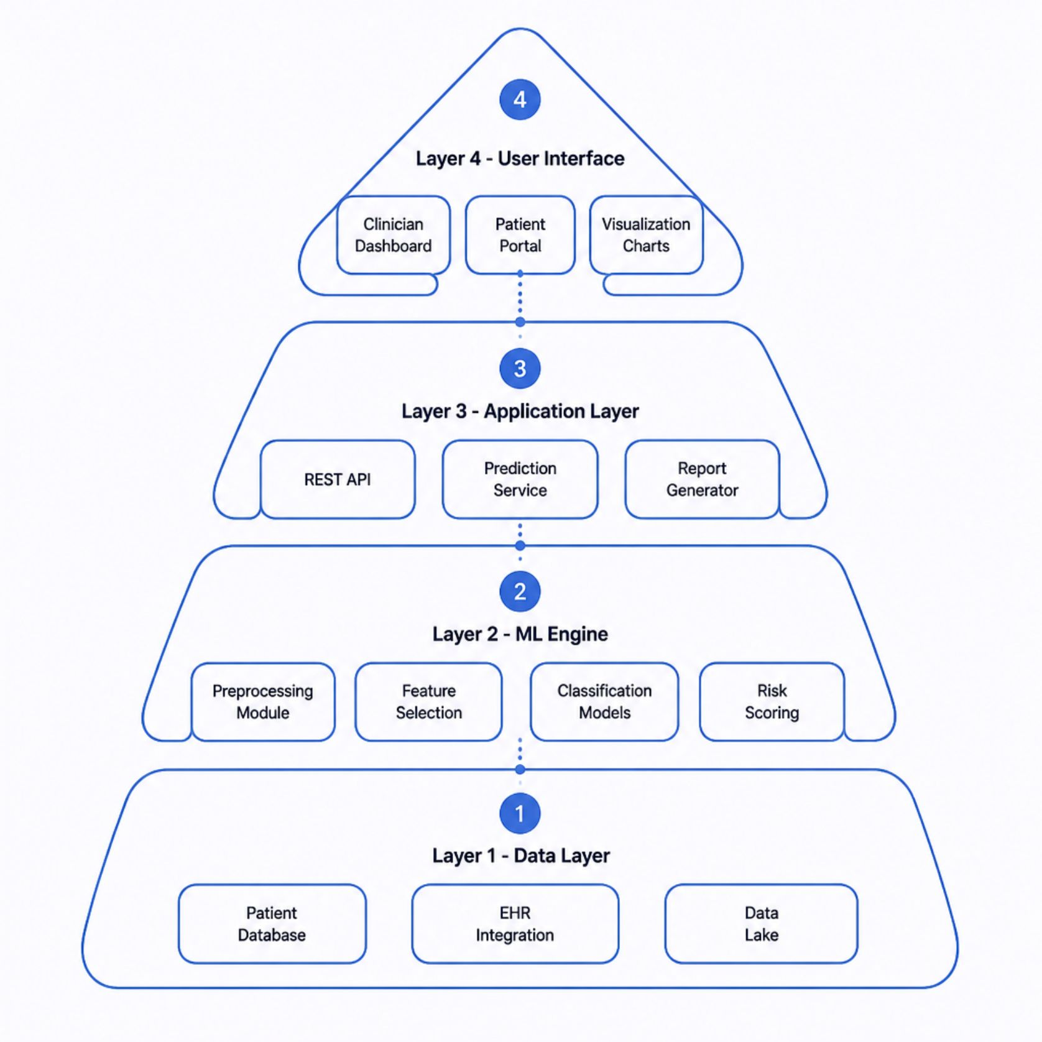
System Architecture & Technology Stack
Technology Stack
Backend: Python, Flask / FastAPI, Django
ML Libraries: Scikit-learn, XGBoost, TensorFlow, Keras
Database: PostgreSQL, MySQL, MongoDB
Frontend: React.js, D3.js, Plotly Dash
Deployment: Docker, Kubernetes, AWS / Azure
Security: OAuth2, HIPAA-compliant encryption, RBAC

Slide 7
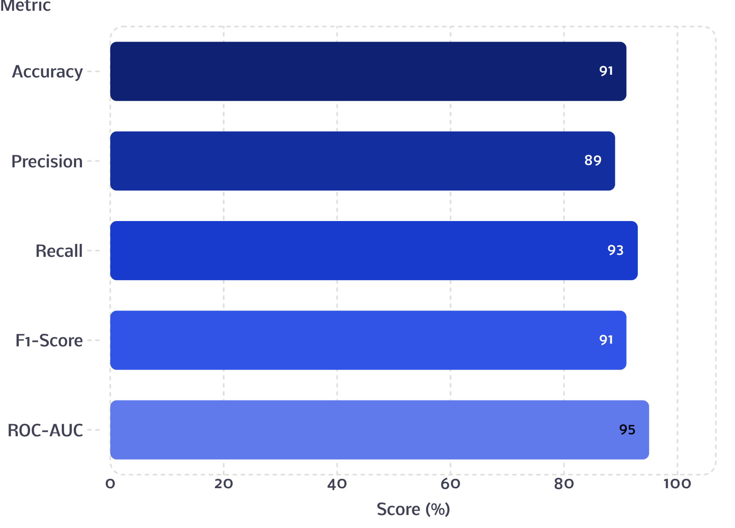

Model Performance & Evaluation Metrics
What These Metrics Mean
Accuracy (91%): Overall correctness of predictions
Precision (89%): Reliability of positive risk flags
Recall (93%): Ability to detect true at-risk patients
F1-Score (91%): Balanced measure of precision and recall
ROC-AUC (95%): Strong discriminative power between classes
High Recall is prioritized to minimize false negatives — missing an at-risk patient is the costliest error.

Slide 8
Key System Features
🔮 Risk Prediction
📊 Health Analysis
ML-driven probability scores for diabetes onset based on multi-parameter health data
Comprehensive patient profiling across metabolic, demographic, and lifestyle dimensions
⚡ Automated Assessment
📋 Clinical Reports
Instant Low / Medium / High risk classification with no manual interpretation needed
Structured, shareable PDF reports with findings, risk factors, and recommendations
🖥️ Visualization Dashboard
🩺 Decision Support
Interactive charts and trend views for clinicians and patient self-monitoring
Actionable insights to guide healthcare professionals in diagnosis and care planning

Slide 9




Real-World Applications
The system is designed for deployment across the full spectrum of healthcare delivery — from frontline clinics to national preventive health programs.
Hospitals & Clinics
Telemedicine Platforms
Research Institutions
Preventive Programs
Integrate into admission workflows for proactive screening of high-risk patients.
Support population health studies and epidemiological diabetes research at scale.
Deploy in community health initiatives to identify at-risk individuals early.
Enable remote risk assessment and follow-up care without in-person visits.

Slide 10

Scalability, Security & The Road Ahead
Future Enhancement Roadmap
Why This System Matters
01
This ML-powered platform transforms diabetes care — shifting from late, reactive diagnosis to early, proactive, data-driven prevention.
Wearable Integration
Scalable to serve millions of patients globally
HIPAA-compliant, role-based security architecture
Cloud-ready for high availability and resilience
Empowers clinicians with intelligent decision support
Real-time glucose and vitals from smartwatches and IoT health devices
02
EHR Interoperability
Seamless connection with Epic, Cerner, and HL7/FHIR-compliant systems
Early detection saves lives. Intelligent prediction makes it possible at scale.
03
Explainable AI (XAI)
Transparent, interpretable predictions clinicians can trust and act upon
04
Personalized Recommendations
Tailored lifestyle and treatment guidance based on individual risk profiles

