Slide 1
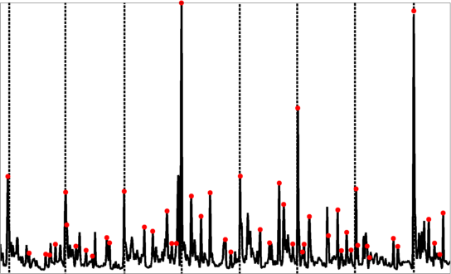

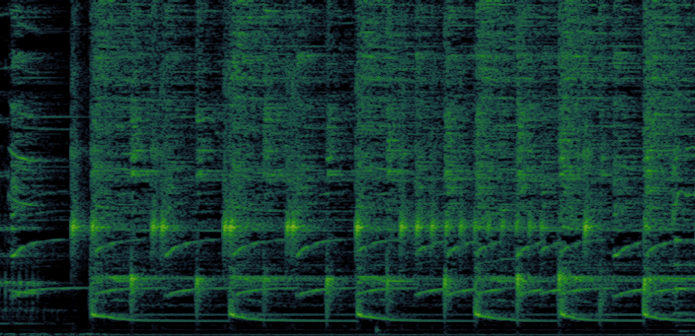

Meter
Audio
Rhythm analysis
Patterns
Structure

