Slide 1
Layer Details of mCertiKOS

Slide 2
http://mcertikos.parseapp.com

Slide 3
Memory Management

Slide 4
1: MBoot Layer
MBoot Layer
(MM, init,CR3, PFInfo, pe, ikern, ihost, ipt)
pf_get/ret
mm_get
bootloader
setcr3
pe/ikern/ihost_set
Abstract State (abs)
MM: physical memory information table
init: (logical) whether boot-loader has been called or not
CR3: abstract CR3 register (start address of page table)
pe: abstract CR0 register (paging is enabled or not)
ikern: whether it is in the kernel mode or not
ihost: whether it is in the host mode or not
ipt: (logical) whether it is using the kernel’s page table

Slide 5
1: MBoot Layer
MBoot Layer
(MM, init,CR3, PFInfo, pe, ikern, ihost, ipt)
pf_get/ret
mm_get
bootloader
setcr3
pe/ikern/ihost_set
Primitives
mm_get: read the MMsetcr3: set the start address of the page table
pe/ikern/ihost_set: set the corresponding abs
bootloader: boot-loader of mCertiKOS
Initialization function is marked by green

Slide 6
2: MATIntro Layer
MATIntro Layer
(MM, init, CR3, PFInfo, iflags, AT, nps)
pf_get/ret
at_get/set
nps_get/set
bootloader
setcr3
iflags_set
Introduce the page allocation table
Abstract State
iflags: (pe, ikern, ihost, ipt)
AT: page allocation table
nps: number of physical pages
Primitive
iflags_set: a set of primitives that set the value of iflags
at_get/set: getter and setter for AT
nps_get/set: getter and setter for nps

Slide 7
3: MATOp Layer – 4: MAT Layer
MAT Layer
(init, CR3, PFInfo, iflags, AT, nps)
pf_get/ret
pfree
palloc
meminit
setcr3
iflags_set
MATOp Layer
(MM, init, CR3, PFInfo, iflags, AT, nps)
pf_get/ret
at_get/set
nps_get
meminit
setcr3
iflags_set
Initialize the allocation table and provide primitives to manipulate the allocation table
Abstract State
minfo and nps are hidden
Primitive
meminit: initialize AT and nps from minfo
palloc: allocate a page in High Memory
pfree: free a page

Slide 8
5: MPTIntro Layer
MPTIntro Layer
(init, iflags, AT, PT, ptp)
palloc/free
get/set/rmv_PTE
setPDE
meminit
setPT
iflags_set
Introduce the two-level page table pool
Abstract State
PT: the current page table index
ptp: page table pool (64 page tables)
Primitive
setPDE: setter for the first level page table entry
get/set/rmv_PTE: getter and setter for the second level page table entry

Slide 9
6: MPTOp Layer – 8: MPTKern Layer
MPTKern Layer
(init, iflags, AT, PT, ptp)
palloc/free
PT_insrt/read/rmv
PTInitKern
setPT
iflags_set
MPTComm Layer
(init, iflags, AT, PT, ptp)
palloc/free
PT_insrt/read/rmv
PTInitComm
setPT
iflags_set
MPTOp Layer
(init, iflags, AT, PT, ptp)
palloc/free
PT_insrt/read/rmv
setPDE
meminit
setPT
iflags_set
Initialize the page table (pt) pool
Primitive
PT_inst/read/rmv: insert/read/remove a map to/from a pt
PTinitComm: initialize the Low Memory part of all the pts
PTinitKern: initialize the High Memory part of the kernel’s pt (with the index 0)

Slide 10
9: MPTInit Layer
MPTInit Layer
(iflags, AT, PT, ptp)
palloc/free
PT_insrt/read/rmv
PT_init
setPT
iflags_set
Enable the paging mechanism
Primitive
PT_init:
Initialize the kernel’s pt (call PTInitKern)
Set the start address of kernel’s pt to CR3 (call set_CR3)
Enable paging (call pe_set)

Slide 11
10: MPTBit Layer – 11: MPTNew Layer
MPTNew Layer
(iflags, AT, PT, ptp, pbit)
palloc/free
PT_resv/read
PT_new/free
pmapinit
setPT
iflags_set
MPTBit Layer
(iflags, AT, PT, ptp, pbit)
palloc/free
PT_insrt/read/rmv
get/set_bit
PT_init
setPT
iflags_set
Introduce the bit map for page table pool
Abstract State
pbit: bit map for ptp
Primitive
get/set_bit: getter and setter for the bit map
PT_new/free: allocate/free a pt from ptp
PT_resv: allocate a page and insert a map into pt
pmap_init: enable paging and reserve the 0-th bit in pbit

Slide 12
Process Management

Slide 13
12: PKCtx Layer – 13: PKCtxNew Layer
PKCtxNew Layer
(iflags, AT, PT, ptp, pbit, kctxp)
pmapinit
kctx_switch
kctx_new
PT_free
mm.prim
PKCtx Layer
(iflags, AT, PT, ptp, pbit, kctxp)
pmapinit
kctx_switch
PT_new/free
mm.prim
Introduce the kernel context pool
Abstract State
kctxp: kernel context pool (using ptp as bit map)
Primitive
kctx_switch: kernel context switch (written in assembly)
kctx_new: allocate a pt and kernel context (kctx) from ptp
mm.prim: primitives provided by memory management

Slide 14
14: PTCBintro Layer – 15: PTCBInit Layer
PTCBInit Layer
( mm.abs, kctxp, Ltcbp)
tcbinit
Ltcb_get/set
kctx_switch/new/free
mm.prim
PTCBIntro Layer
( mm.abs, kctxp, Ltcbp)
pmapinit
Ltcb_get/set/init
kctx_switch/new
PT_free
mm.prim
Introduce and initialize the thread control blocks (tcb) pool
Abstract State
Ltcbp: low-level tcb pool (using ptp as bit map)
mm.abs: abs provided by memory management
Primitive
Ltcb_get/set/init: getter and setter for Ltcbp
kctx_free: free a pt, kctx and tcb from ptp
tcbinit: enable paging and initialize ptp and Ltcbp

Slide 15
16: PTDQintro Layer – 17: PTDQInit Layer
PTDQInit Layer
(mm.abs, kctxp, Ltcbp, Ltqp)
tdqinit
Ltcb_get/set
Len/de/rm_queue
kctx_switch/new/free
mm.prim
PTDQIntro Layer
(mm.abs, kctxp, Ltcbp, Ltqp)
tdqinit
Ltcb_get/set
Ltdq_get/set
kctx_switch/new/free
mm.prim
Introduce and initialize the thread queue (td) pool
Abstract State
Ltqp: low-level td pool (using ptp as bit map)
Primitive
Ltdq_get/set: getter and setter for Ltdqp
Len/de/rm_queue: enqueue, dequeue and remove a thread from the low-level thread queue
tdqinit: enable paging and initialize ptp, Ltcbp and Ltdp

Slide 16
18: PAbQueue Layer
PAbQueue Layer
(mm.abs, kctxp, Htcbp, Htqp)
htdqinit
Htcb_get/set
Hen/de/rm_queue
kctx_switch/new/free
mm.prim
Introduce the high-level (abstract) tcb and td
Abstract State
Htcbp: high-level tcb (defined as Coq inductive type) pool
Htqp: high-level td (defined as Coq list) pool
Primitive
Htcb_get/set: getter and setter for Htcb
Hen/de/rm_queue: enqueue, dequeue and remove a thread from the high-level thread queue
htdqinit: enable paging and initialize ptp, Htcbp and Htdp

Slide 17
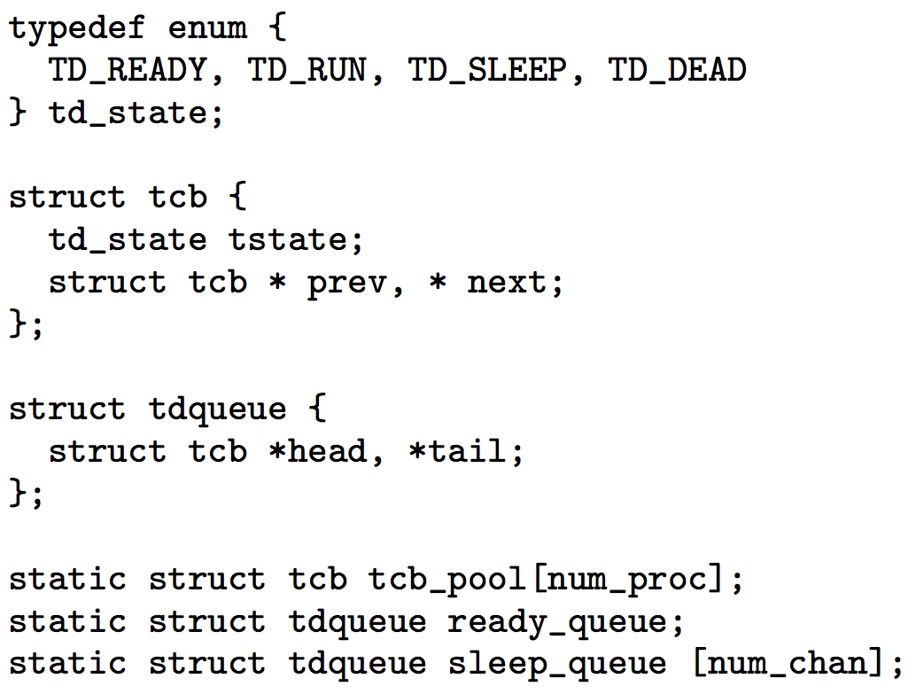
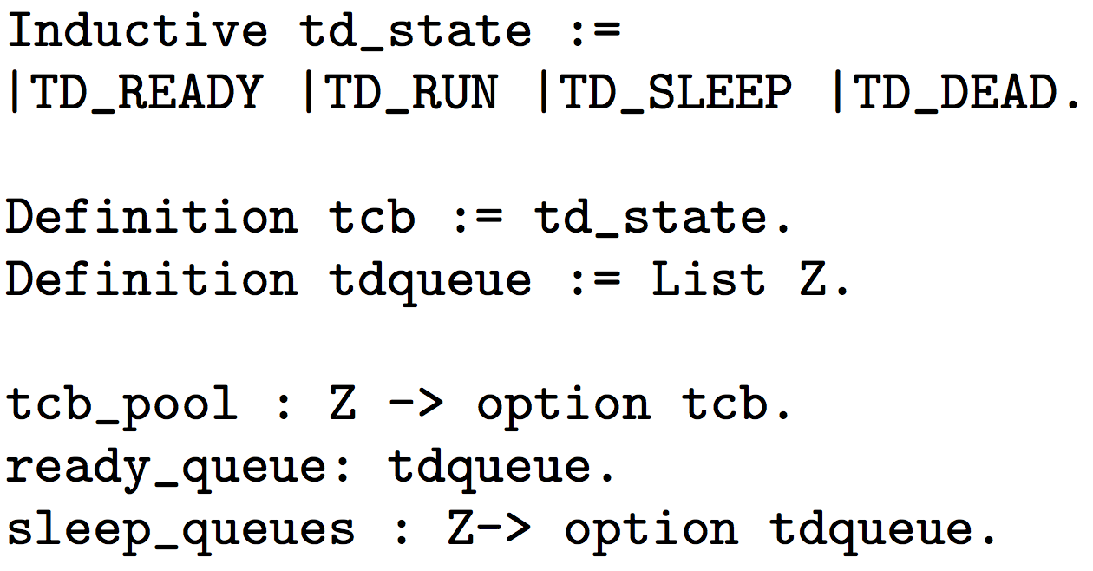
18: PAbQueue Layer
PAbQueue Layer
(mm.abs, kctxp, Htcbp, Htqp)
htdqinit
Htcb_get/set
Hen/de/rm_queue
kctx_switch/new/free
mm.prim
Low-level tcb and td defined in C
High-level tcb and td defined in Coq

Slide 18
19: PCID Layer
PCID Layer
(mm.abs, kctxp, Htcbp, Htqp, cid)
htdqinit
cid_get/set
Htcb_
get/set
Hen/de/
rm_queue
kctx_switch/new/free
mm.prim
Introduce the current thread id
Abstract State
cid: current thread id
Primitive
cid_get/set: getter and setter for cid

Slide 19
20: PSched Layer - 21: PThread Layer
PThread Layer
(mm.abs, kctxp, Htcbp, Htqp, cid)
schedinit
cid_get
thread_sleep/yield/spawn/kill/wakeup
mm.prim
PSched Layer
(mm.abs, kctxp, Htcbp, Htqp, cid)
schedinit
cid_get
Htcb_set
thread_sched/kill
/spawn/wakeup
mm.prim
Introduce the primitives for thread management
Primitive
thread_sched: thread scheduler (non-preemptive)
thread_spawn/kill: spawn/kill a thread. Including allocate/free the corresponding pt and tcb, and modify the Htdp
thread_wakeup: wakeup a sleeping thread
thread_sleep: sleep for a resource (such as a channel)
thread_yield: yield to the first ready thread
schedinit: enable paging, initialize ptp, Ltcbp, Ltdp, and cid

Slide 20
22: PIPCIntro Layer
PIPCIntro Layer
(mm.abs, kctxp, Htcbp, Htqp, cid, chanp)
schedinit
get/set_chan
thread.prim
mm.prim
Introduce the inter process communication channel pool
Abstract State
chanp: channel pool for inter process communication
Primitive
get/set_chan: getter and setter for chanp
thread.prim: primitives provided by thread management

Slide 21
23: PIPC Layer
PIPC Layer
(mm.abs, kctxp, Htcbp, Htqp, cid, chanp)
procinit
send/recv/check_chan
mm/thread.prim
Intitialize the inter process communication channel pool
Primitive
send_chan: send the message to a channel
check_chan: check whether its channel is full or not
recv_chan: receive the message from its own channel, and wakeup the first thread sleeping on the channel
procinit: enable paging and initialize ptp, Ltcbp, Ltdp, cid and chanp

Slide 22
24: PUCtx Layer – 25: PProc Layer
PProc Layer
(mm.abs, proc.abs)
get/set_uctx
procinit
send/recv/check_chan
proc_create/start/ exit
mm/thread.prim
PUCtx Layer
(mm.abs, thread.abs, uctxp)
get/set/save/restore_uctx
procinit
send/recv/check_chan
mm/thread.prim
Introduce the user process context (uctx) pool
Abstract State
uctxp: user process context pool (using ptp as bit map)
thread/proc.abs: abs provided by thread/proc management
Primitive
get/set/save/restore_uctx: getter and setter for uctxp
proc_create: create a user process and initialize the uctx
proc_start/exit: start/exit a user process

Slide 23
Virtual Machine Module

Slide 24
26: VNPTIntro Layer – 27: VNPTInit Layer
VNPTInit Layer
(mm.abd, proc.abs,npt)
nptinit
NPT_insrt
mm/proc.prim
VNPTIntro Layer
(mm.abd, proc.abs, npt)
procinit
set_NPDE
set_NPTE
mm/proc.prim
Introduce and initialize the (guest) nested page table
Abstract State
npt: nested page table (for guest mode)
Primitive
set_NPDE: setter for the first-level npt entry
set_NPTE: setter for the second-level npt entry
nptinit: initialize the process management (PM) and the npt
proc.prim: primitives provided by PM

Slide 25
28: VSVMSwitch Layer
VSVMSwitch Layer
(mm.abs,proc.abs, npt, hctx)
nptinit
NPT_insrt
restore/save_hctx
mm/proc.prim
Introduce and context for host mode
Abstract State
hctx: host context
Primitive
restore/save_hctx: restore and save the host context

Slide 26
29: VVMCBIntro Layer – 30: VMCBInit Layer
VVMCBInit Layer
(mm/proc.abs, npt, hctx, vmcb)
vmcbinit
vmcb_read/write
NPT_insrt
restore/save_hctx
mm/proc.prim
VVMCBIntro Layer
(mm/proc.abs, npt, hctx, vmcb)
nptinit
vmcb_read/write
NPT_insrt
restore/save_hctx
mm/proc.prim
Introduce and initialize the virtual machine control block
Abstract State
vmcb: virtual machine control block
Primitive
vmcb_read/write: getter and setter for vmcb
vmcbinit: initialize the PM, npt and vmcb

Slide 27
31: VSVMIntro Layer
VSVMIntro Layer
(mm/proc.abs, npt, hctx, vmst)
vmcbinit
vm_st_read/write
NPT_insrt
restore/save_hctx
mm/proc.prim
Introduce the virtual machine state
Abstract State
vmst: virtual machine state, including vmcb and other registers (EBX, ECX, EDX, ESI, EDI, EBP)
Primitive
vm_st_read/write: getter and setter for vmst

Slide 28
32: VMCBOp Layer – 34: VSVMSave Layer
VSVMSave Layer
(mm/proc.abs, npt, hctx, vmst)
vmcbinit
svm_check/exit/sync
/inject/set/get (16)
vm_run/exit
NPT_insrt
mm/proc.prim
VSVM Layer
(mm/proc.abs, npt, hctx, vmst)
vmcbinit
svm_check/exit/sync
/inject/set/get (16)
vm_run
restore_hctx
NPT_insrt
mm/proc.prim
VMCBOp Layer
(mm/proc.abs, npt, hctx, vmst)
vmcbinit
vmcb_check/clear/inject/set/get (13)
restore/save_hctx
NPT_insrt
mm/proc.prim
Introduce and initialize the virtual machine control block
Primitive
vm_run: run a virtual machine, save/restore the hctx/vmstvmcb_check/clear/inject/set/get (13): 13 primitives to read and modify the vmcb
svm_check/exit/sync/inject/set/get (16): 16 primitives to read and modify the vmst

Slide 29
Trap Handler Module

Slide 30
35: TTrapArg Layer – 36: TTrap Layer
TTrap Layer
(mm/proc/virt.abs)
get_arg/set_ret
vmcbinit
vm_run/exit
sys_check/exit/sync/inject/set/chan (17)
mm/proc.prim
TTrapArg Layer
(mm/proc/virt.abs)
get_arg/set_ret
vmcbinit
vm_run/exit
svm_check/exit/sync/inject/set/get (16)
virt/mm/proc.prim
Wrap the trap handler body with the argument getter and return value setter
Abstract State
virt.abs: abs provided by Virtual Machine Module
Primitive
get_arg/set_ret: getter and return value setter
sys_check/exit/sync/inject/set/chan (17): 17 system calls
virt.prim: primitives provided by Virtual Machine Module

Slide 31
37: TSysCall Layer
TSysCall Layer
(pe, ikern, ihost, ipt, AT, PT, ptp, pbit, kctxp, Htcbp, Htqp, cid, chanp, uctxp, npt, hctx, vmst)
thread_wakeup/kill/sleep/yield
pt_read
get/set_uctx
palloc/free
cid_get
sys_chan_send/recv/wait/check
sys_yield
sys_get_exit_reason
sys_get_eip
sys_check_shadow/pending_event
sys_proc_create
sys_set_seg
sys_inject
sys_get_exit_io_width/port/rep/str/write/eip
sys_set_intcept_int
sys_npt_instr
vmcbinit
pagefault_handler
sys_reg_get/set
sys_sync
sys_run
vm_exit
Top Layer: system calls and internal primitives of mCertiKOS
Primitive
sys_run: system call to run a virtual machine
pagefault_handler: get the linear address that page fault happens from CR2 register, allocate a page and insert a pt map, and re-execute the instruction causes page fault

