Slide 1

Flight delay Analysis
Big Data analysis-3 (dashboard)
Rongjia jing
file:///Users/xixibaobao/Desktop/study/Semester%201/Big%20Data/Analysis-3/Analysis-3.html

Slide 2
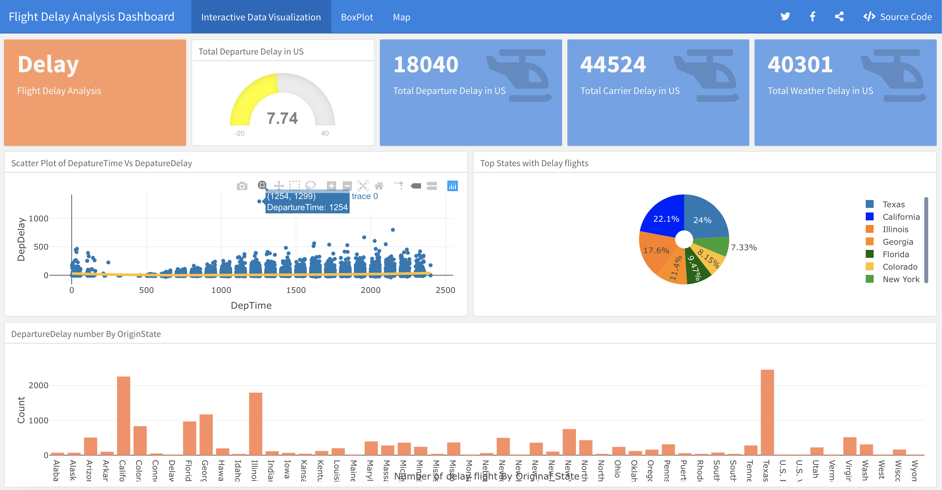

Slide 3
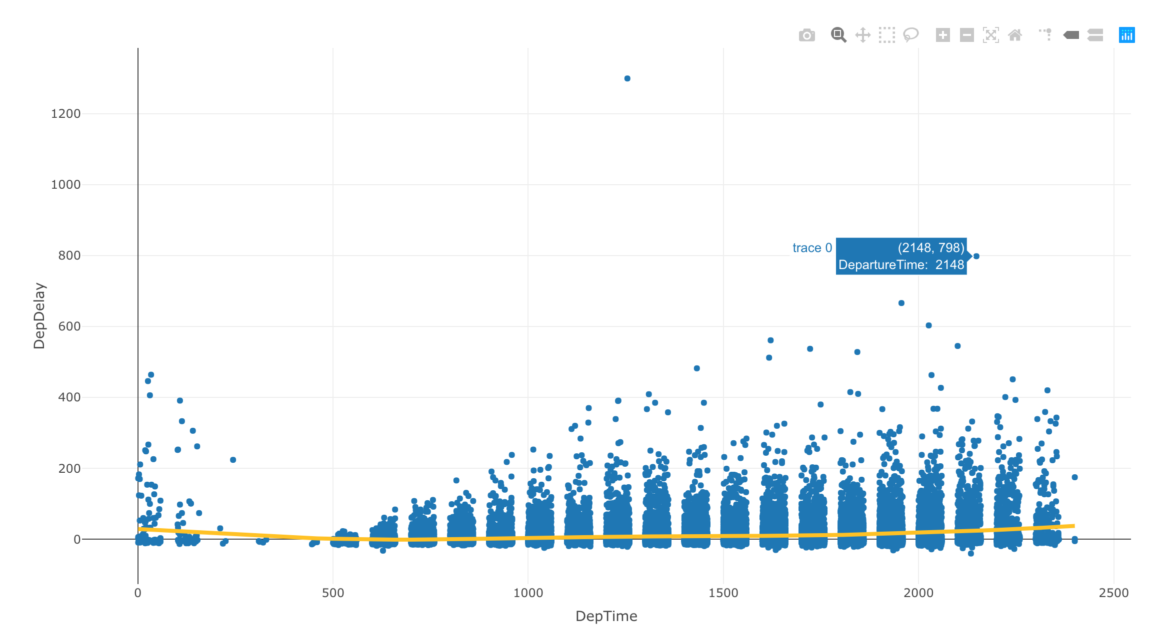
Scatter Plot
Relation of Departure time and departure delay time.
The delay start at 5 a.m. and become worst in the late afternoon (17-19:00).

Slide 4
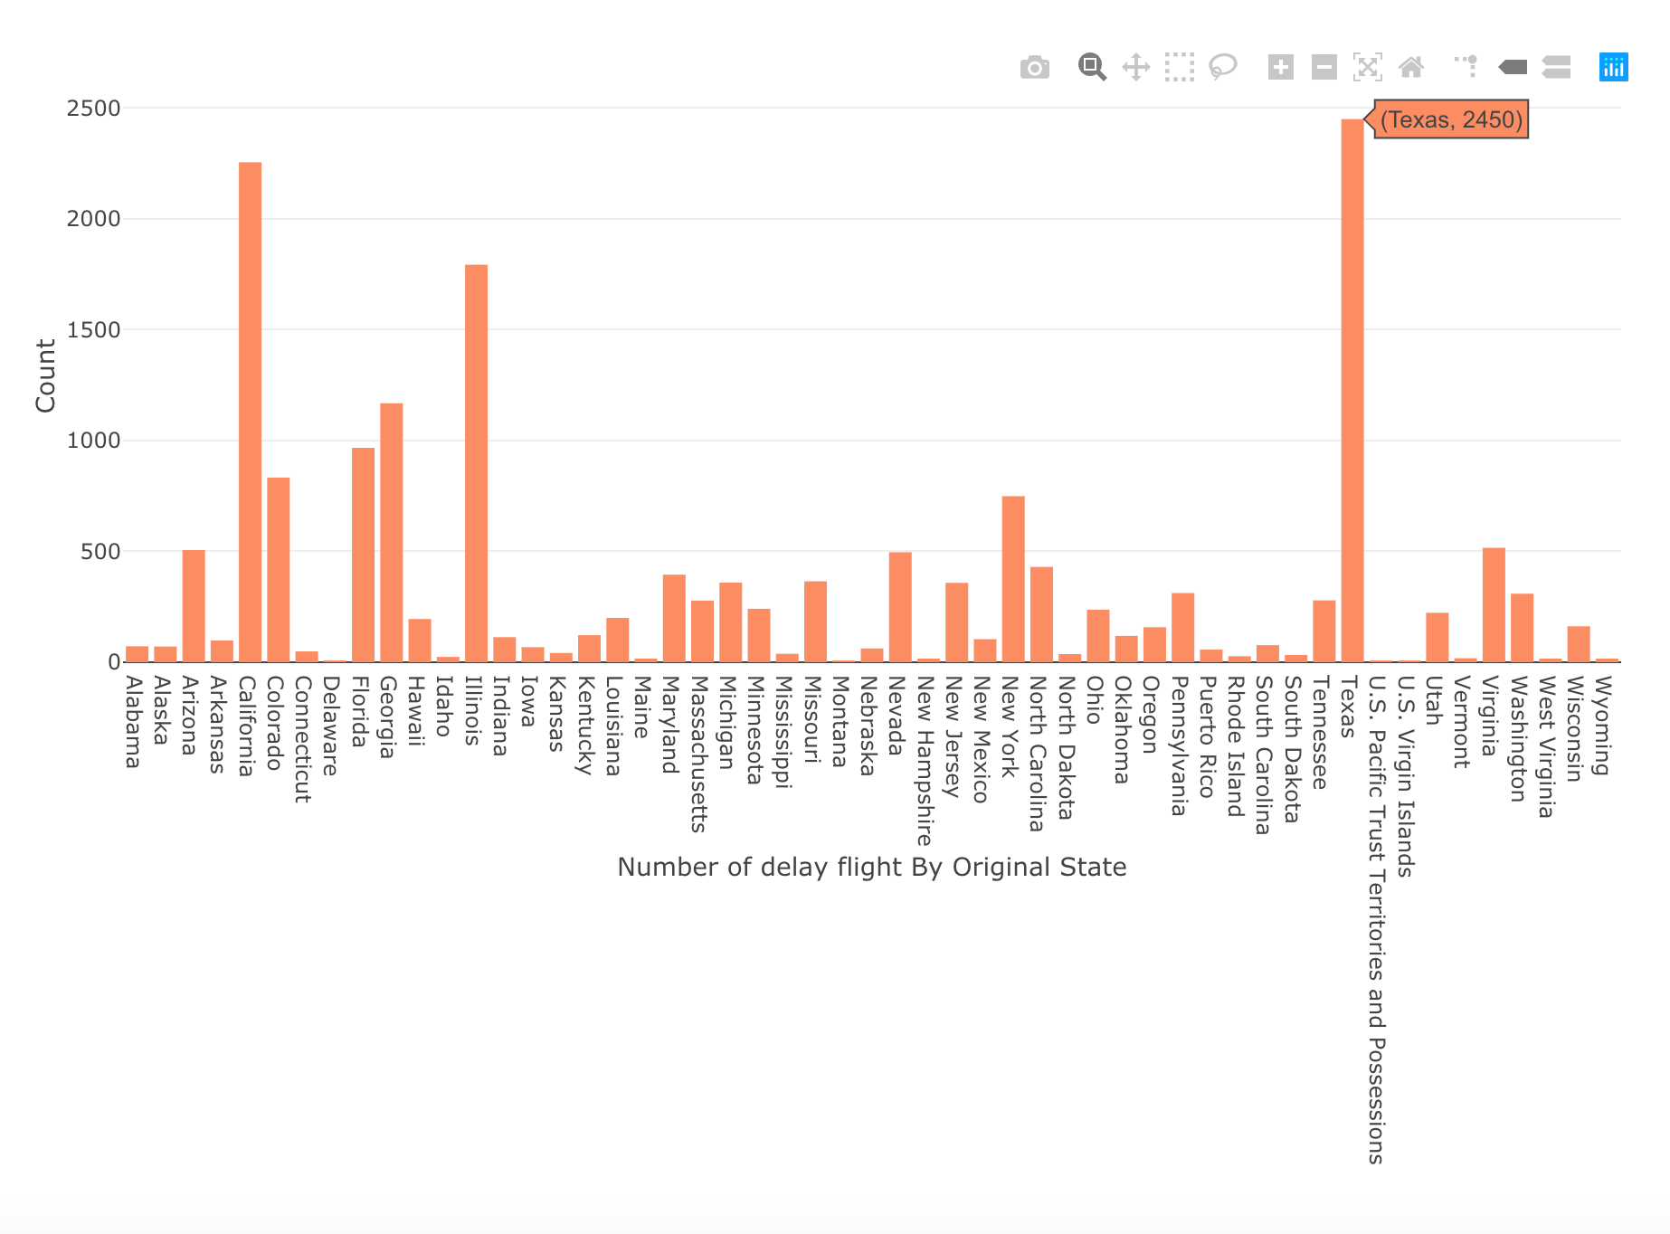
Bar Chart
According to the bar chart, we can see the exact number of departure delay vivdly.
Texas has 1204 times of longtime departure delays, and Illinois has 1062, California has 961 times.

Slide 5
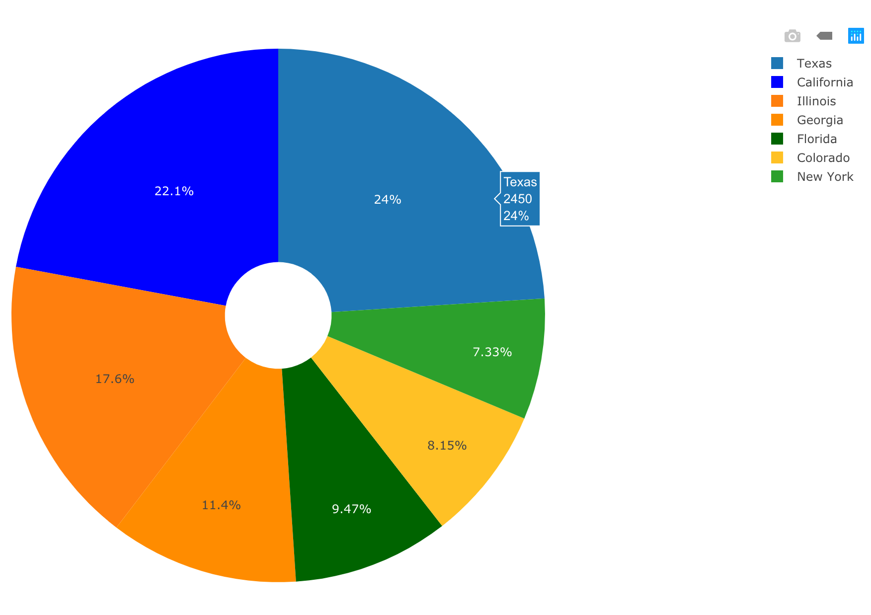
Pie Chart
Then, a pie chart is drawn to show how do these states’ departure delay times occupy the whole 18040 times.
We can see 3 quarters of departure delay is occupied by top 4 states: Texas, California, Illinois and Georgia.

Slide 6
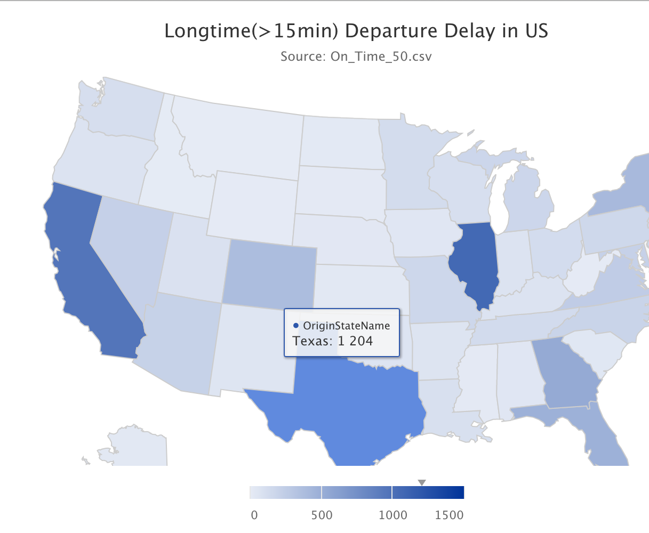
Map
According to the map, we can get to know the difference of longtime departure delay issue among US Geographically.
Texas has 1204 times of longtime departure delays, and Illinois has 1062, California has 961 times.

Slide 7
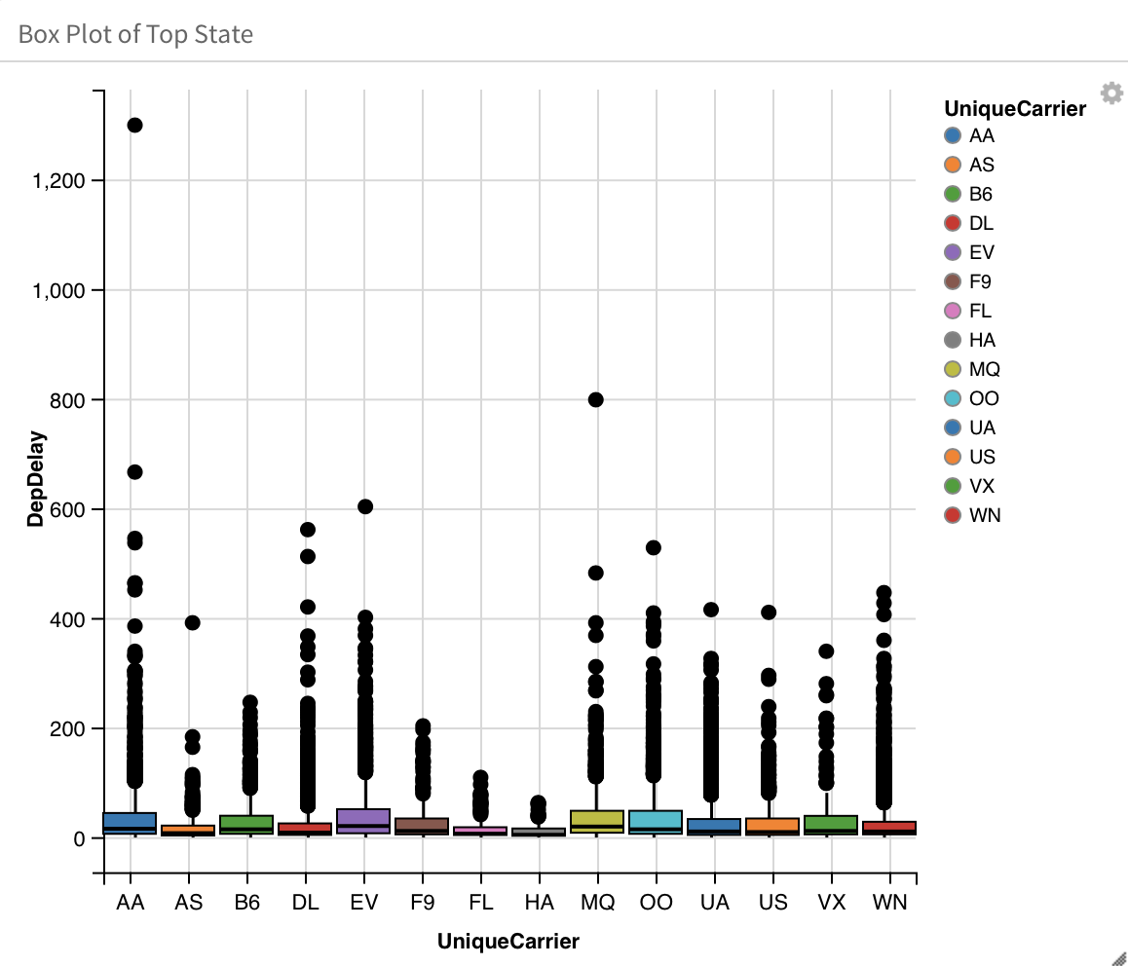
Box Plot
In the boxplot, we can see the dispersion degree of departure delay time among different carriers.
Apart from AS, FL, HA which have a small number of delay time, others has big difference in delay time and may not be a good choice.

