Slide 1

Customer leaving of telephone operator
Analyzing big data 1
Analyst: Rong jia Jing

Slide 2
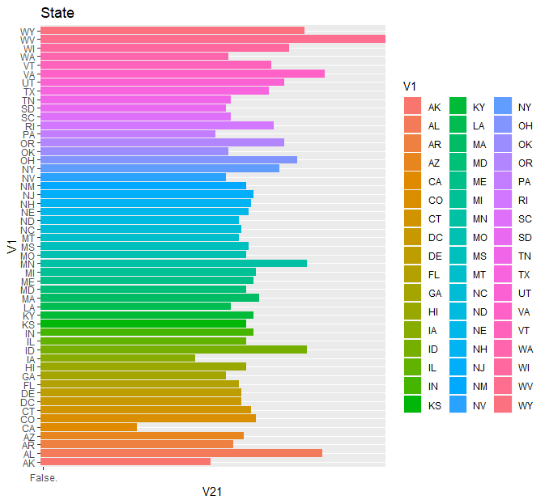
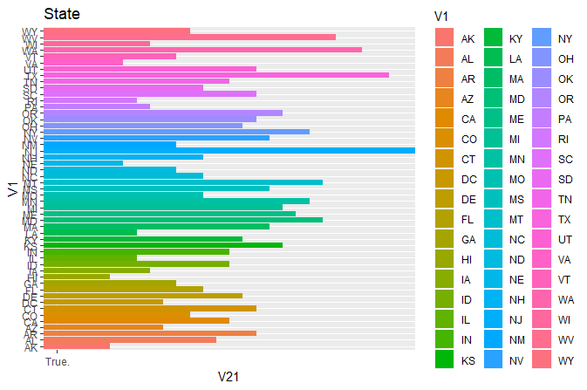
Location characteristic in two groups
States with biggest number of customers leave are NJ(28),TX(26),WA(24) and WV(22).
States with biggest number of not leaving customers is WV(136), and VA(112), AL(111).
Notes:
First, I group the data by variable 21,and look into the location characteristic in two groups.

Slide 3
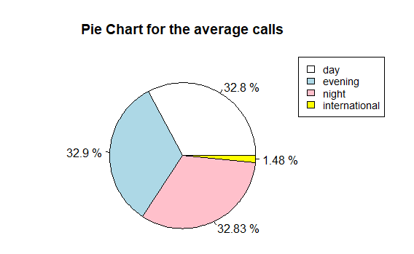

Number of calls in two groups
As is shown in the two pie charts, there is no obvious difference between two groups of customers in number of average calls.
Group of Customers who didn’t leave
Group of Customers who leave
Notes:
Then, I look into the difference between two groups in calling numbers. And the customers who leave and not leave seems has the same percentage of calling numbers in four business.

Slide 4
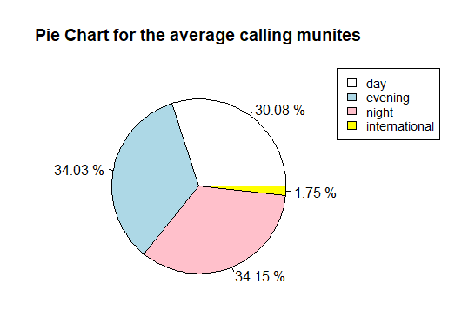
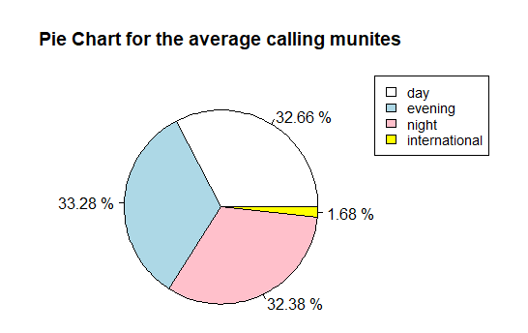
time of calls in two groups
There is no obvious difference between the percentage of customer groups in average time of calls. But customers who leave have slight longer time of calls in four businesses.
 | True | False
Day | 208 | 175
Evening | 212 | 199
night | 206 | 200
international | 11 | 10
Group of Customers who didn’t leave
Group of Customers who leave
Average calling minutes of two groups

Slide 5
Charge of calls in two groups
In four different business field, customers who leave are charged obviously higher telephone fee than those who did not leave.
 | Daytime |  | Evening |  | Night |  | International
 | TRUE | FALSE | TRUE | FALSE | TRUE | FALSE | TRUE | FALSE
Average charge | 35.3 | 29.9 | 18 | 16.9 | 9.27 | 8.98 | 2.89 | 2.75
SD of charge | 11.7 | 8.44 | 4.38 | 4.26 | 2.24 | 2.28 | 0.75 | 0.74
Max charge | 59.8 | 53.6 | 30.9 | 30.8 | 17.2 | 17.8 | 5.4 | 5.32
Median charge | 36.7 | 30.3 | 17.9 | 17 | 9.28 | 8.96 | 2.86 | 2.78
Charge of calls in Four different business

Slide 6
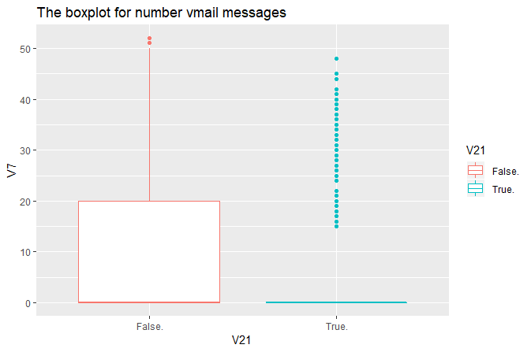
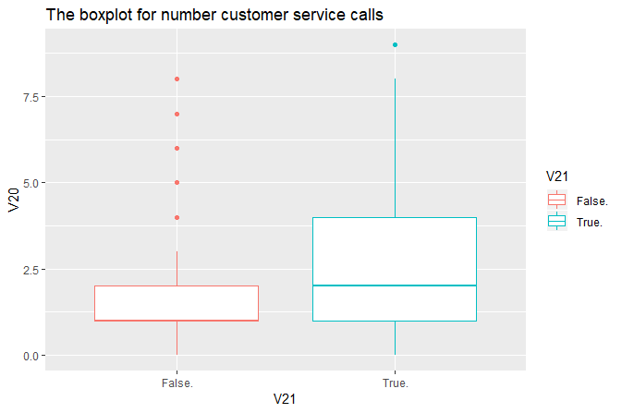
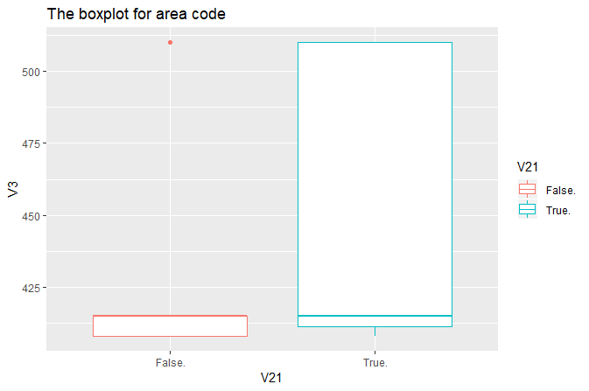
Other variables
Customers who leave have higher number of vmail messages and higher numbers of service calls.
Meanwhile, the customers who didn’t leave is gathered in areas with small area code.

Slide 7
Conclusion
There are several reasons for customers’ leaving.
The biggest reason is the telephone fee that operator charges. Customers who leave have higher telephone fee, and thus disappointing them.
There are also some clues to show the relationship between area and customers’ leaving, it seems that customers in WV, VA and, AL have higher consumer loyalty.
Other variables have no obvious relationship with the problems but we can look further with other advanced tools.

