Slide 1

Email AutoLabeler
Automatically Label Emails
Without User-Defined Criteria
Rong Li
rl.rongli@gmail.com

Slide 2



Unorganized Inbox: Disaster! Manually Labeling: Troublesome!
Notes:
Motivation
In July 2017, Google announced that Gmail had passed 1.2 billion active users.
Each user receives tens or hundreds emails every day.
Unorganized, difficult to find the emails you want.
Gmail filter only can label emails by letting user clearly define the fields “From, To, Subject, Has the words, Doesn’t have, Size’ .
Hand labeling emails is troublesome or even infeasible.

Slide 3
Current Filter Failed! Email AutoLaber Succeed!
Two sample emails in Label: Finance
Different
senders
From: Joseph Deffner
To: Louise Kitchen
From: David Gorte
To: Louise Kitchen

Slide 4
Current Filter Failed! Email AutoLaber Succeed!
Two sample emails in Label: Finance
Different
senders
From: Joseph Deffner
To: Louise Kitchen
Subject: Funds Flow Targets
From: David Gorte
To: Louise Kitchen
Subject: Updated NEPCO Data
Different subjects

Slide 5
Current Filter Failed! Email AutoLaber Succeed!
Two sample emails in Label: Finance
Different
senders
From: Joseph Deffner
To: Louise Kitchen
Subject: Funds Flow Targets
It should be priced more like prm activity than pure debt if it is to attract a capital charge.
From: David Gorte
To: Louise Kitchen
Subject: Updated NEPCO Data
I have included expected project profitability in the comments section of the attached.
Different subjects
No common
topic words

Slide 6
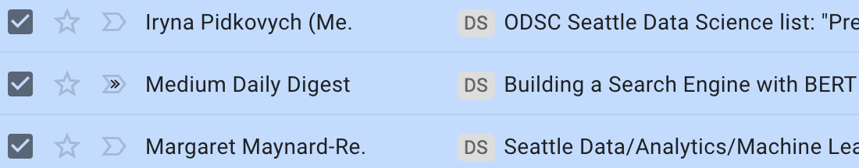
Email AutoLabeler: Time and Effort Saver
Create label ‘DS’ and apply to old emails
Email AutoLabeler

Slide 7
Email AutoLabeler: Time and Effort Saver
New email arrives
Create label ‘DS’ and apply to old emails
Email AutoLabeler

Slide 8

Email AutoLabeler: Time and Effort Saver
New email arrives
Create label ‘DS’ and apply to old emails
Email AutoLabeler
New email labeled

Slide 9




Email AutoLabeler Pipeline
Data Input
Data Cleaning and Feature Engineering
Model
Parse Email Contents
Email
Message
Subject, Related Parties (From, To, CC, Bcc), Body

Slide 10
Email AutoLabeler Pipeline
Data Input
Data Cleaning and Feature Engineering
Model
Parse Email Contents
Preprocess
(Tokenization, Stop words removal, Lemmatization, Stemming)
Email
Message
Subject, Related Parties (From, To, CC, Bcc), Body
Processed word list

Slide 11
Email AutoLabeler Pipeline
Data Input
Data Cleaning and Feature Engineering
Model
Parse Email Contents
Preprocess
(Tokenization, Stop words removal, Lemmatization, Stemming)
Feature Extraction
(TF-IDFvectorizer, SelectKBest)
Email
Message
Subject, Related Parties (From, To, CC, Bcc), Body
Processed word list
Number vectors

Slide 12
Email AutoLabeler Pipeline
Data Input
Data Cleaning and Feature Engineering
Model
Parse Email Contents
Preprocess
(Tokenization, Stop words removal, Lemmatization, Stemming)
Feature Extraction
(TF-IDFvectorizer, SelectKBest)
Classification
Multilayer perceptron (MLP)
Email
Message
Subject, Related Parties (From, To, CC, Bcc), Body
Processed word list
Number vectors
Labeled email

Slide 13
Customized Classification Model for Each User
Enron email dataset: 500,000+ from 150 employees
Name # of Emails
Steven 14505
Vincent 4481
Louise 4033
Darren 3786

Slide 14

Customized Classification Model for Each User
Louise’s emails: 4000+
Labels # of Emails
esvl 715
mrha/ooc 309
hr 306
east_power 257
Enron email dataset: 500,000+ from 150 employees
Name # of Emails
Steven 14505
Vincent 4481
Louise 4033
Darren 3786

Slide 15
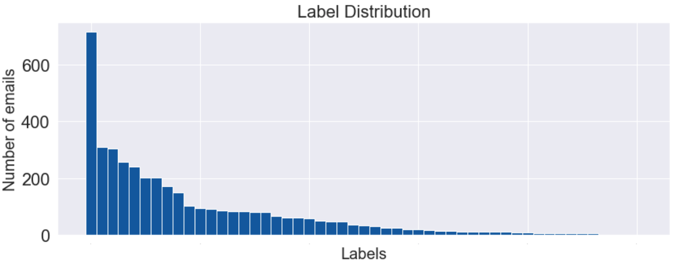
Imbalanced Label Distribution: Stratified Split and Random Under Sampling

Slide 16
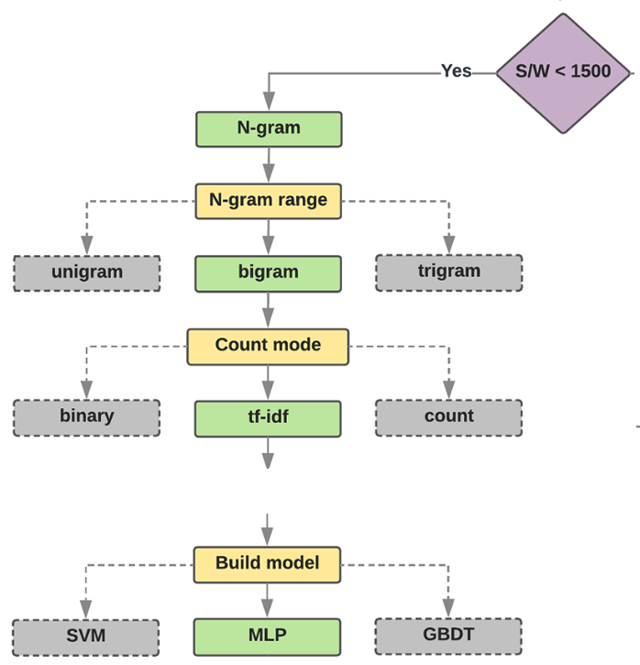
Long Emails Small Sample Size: Multi-Layer Perceptrons with Bag of Words
https://developers.google.com/machine-learning/guides/text-classification/step-2-5

Slide 17
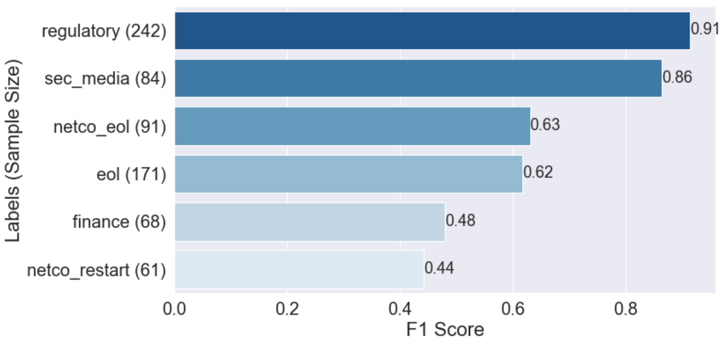
It Works Even for Medium Size of Folders
Macro F1 Score: 0.67

Slide 18
Similar Topics Make Classification Harder
Macro F1 Score: 0.67

Slide 19
Small Sample Size May be a Problem
Macro F1 Score: 0.67

Slide 20
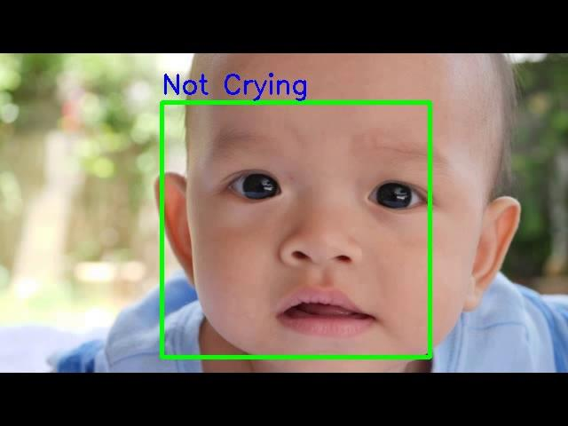
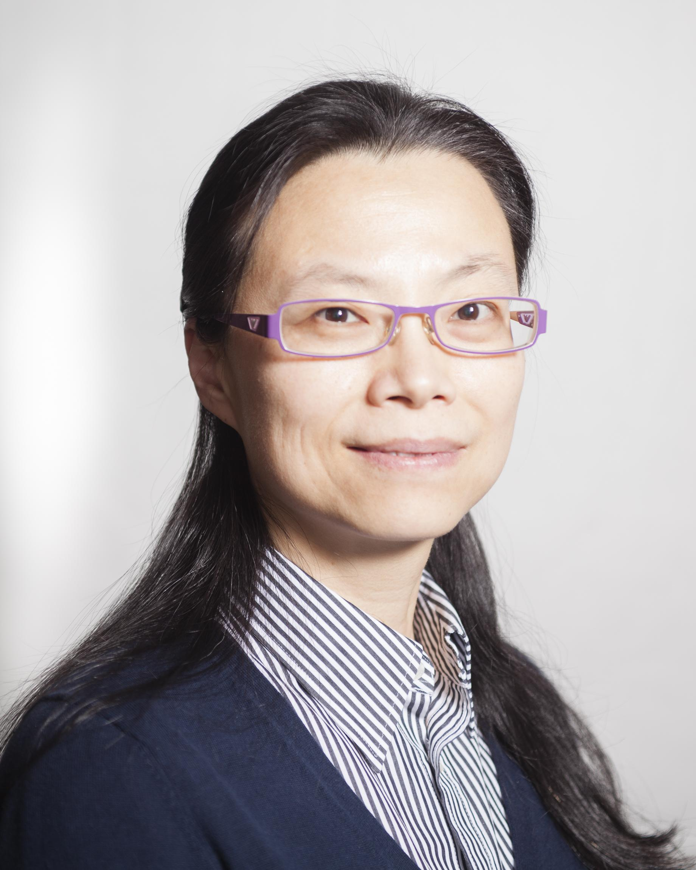
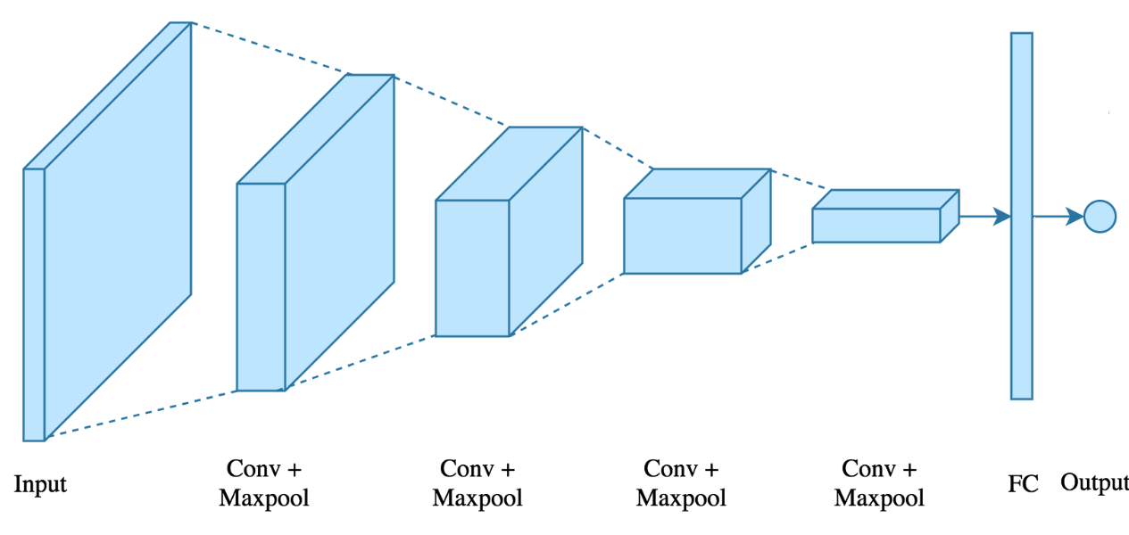




Rong Li
Ph.D in Electrical and Computer
Engineering
Data Scientist Intern at D4DT
rl.rongli@gmail.com

Slide 21
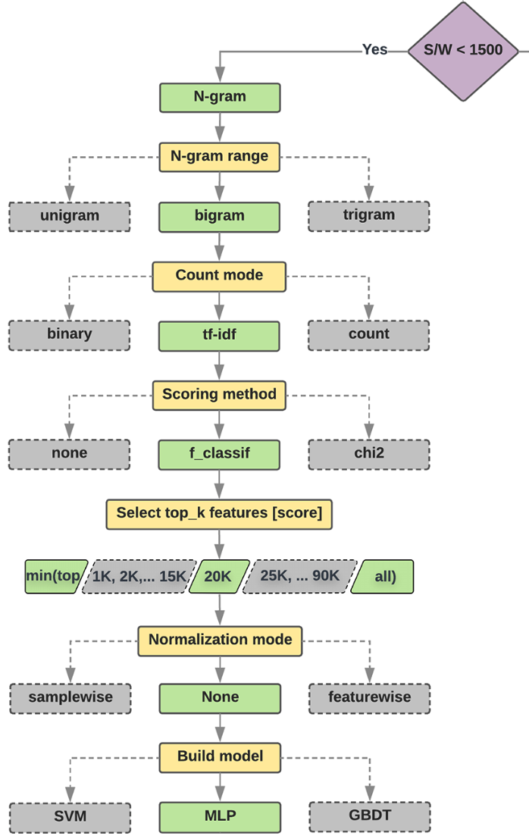
Long Emails Small Sample Size: Multi-Layer Perceptrons with Bag of Words
Step 2.5: Choose a Model | ML Universal Guides

Slide 22
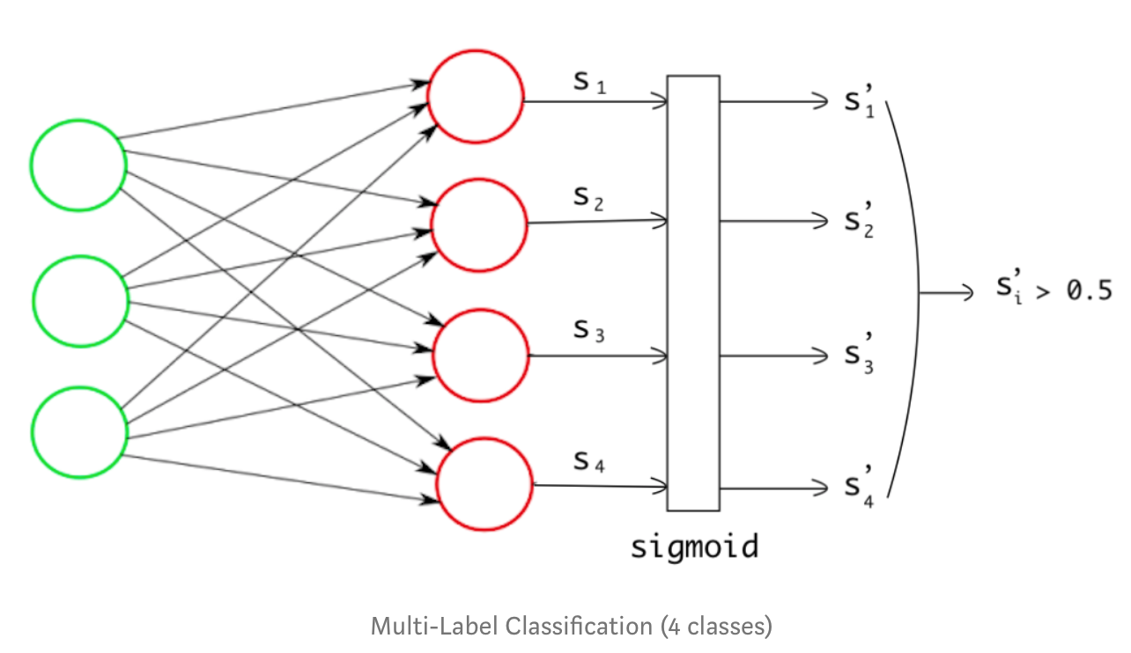
Multi-Label Classification: MLP One versus Rest

