Slide 1
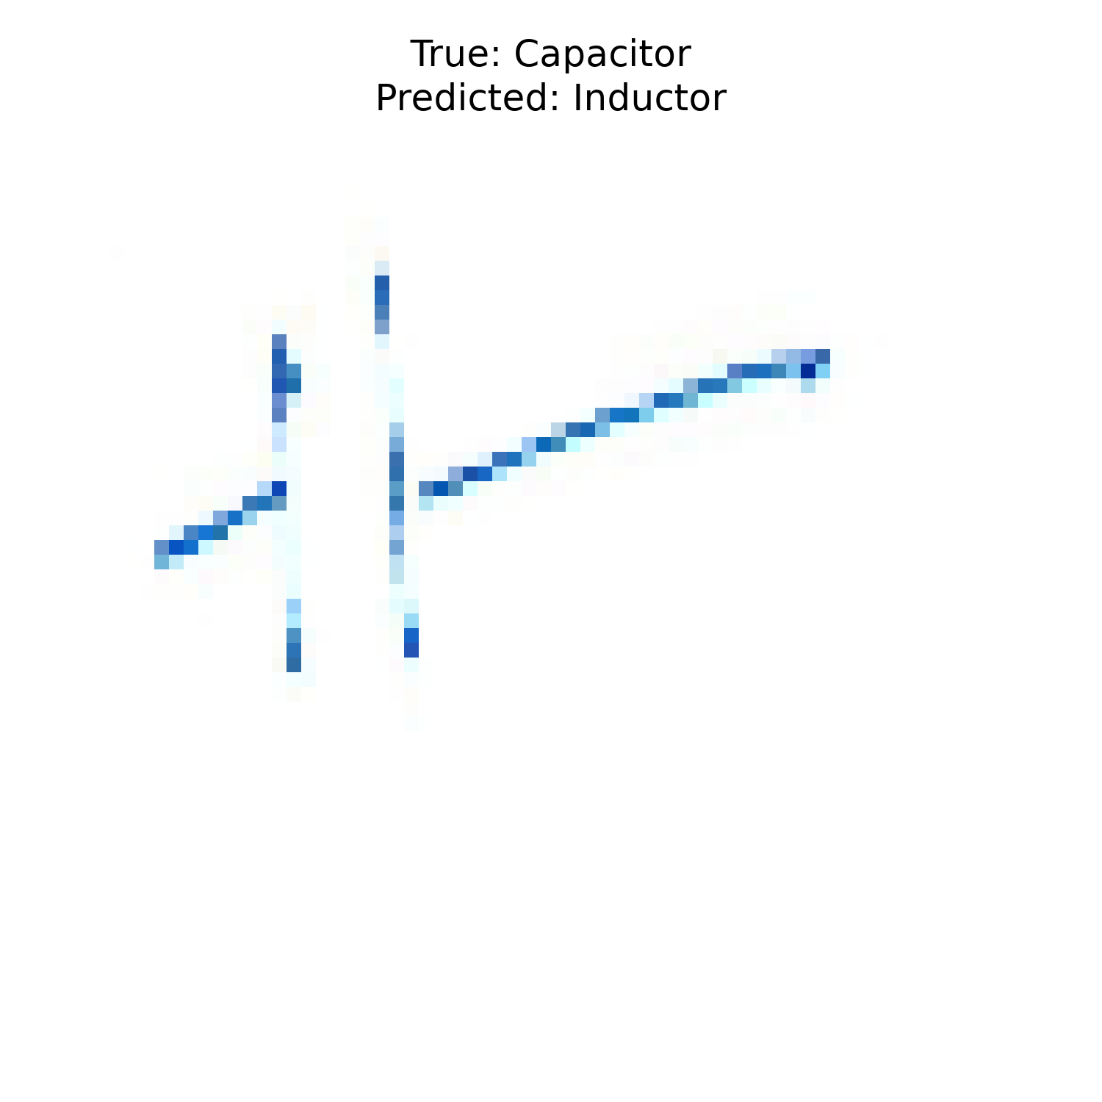
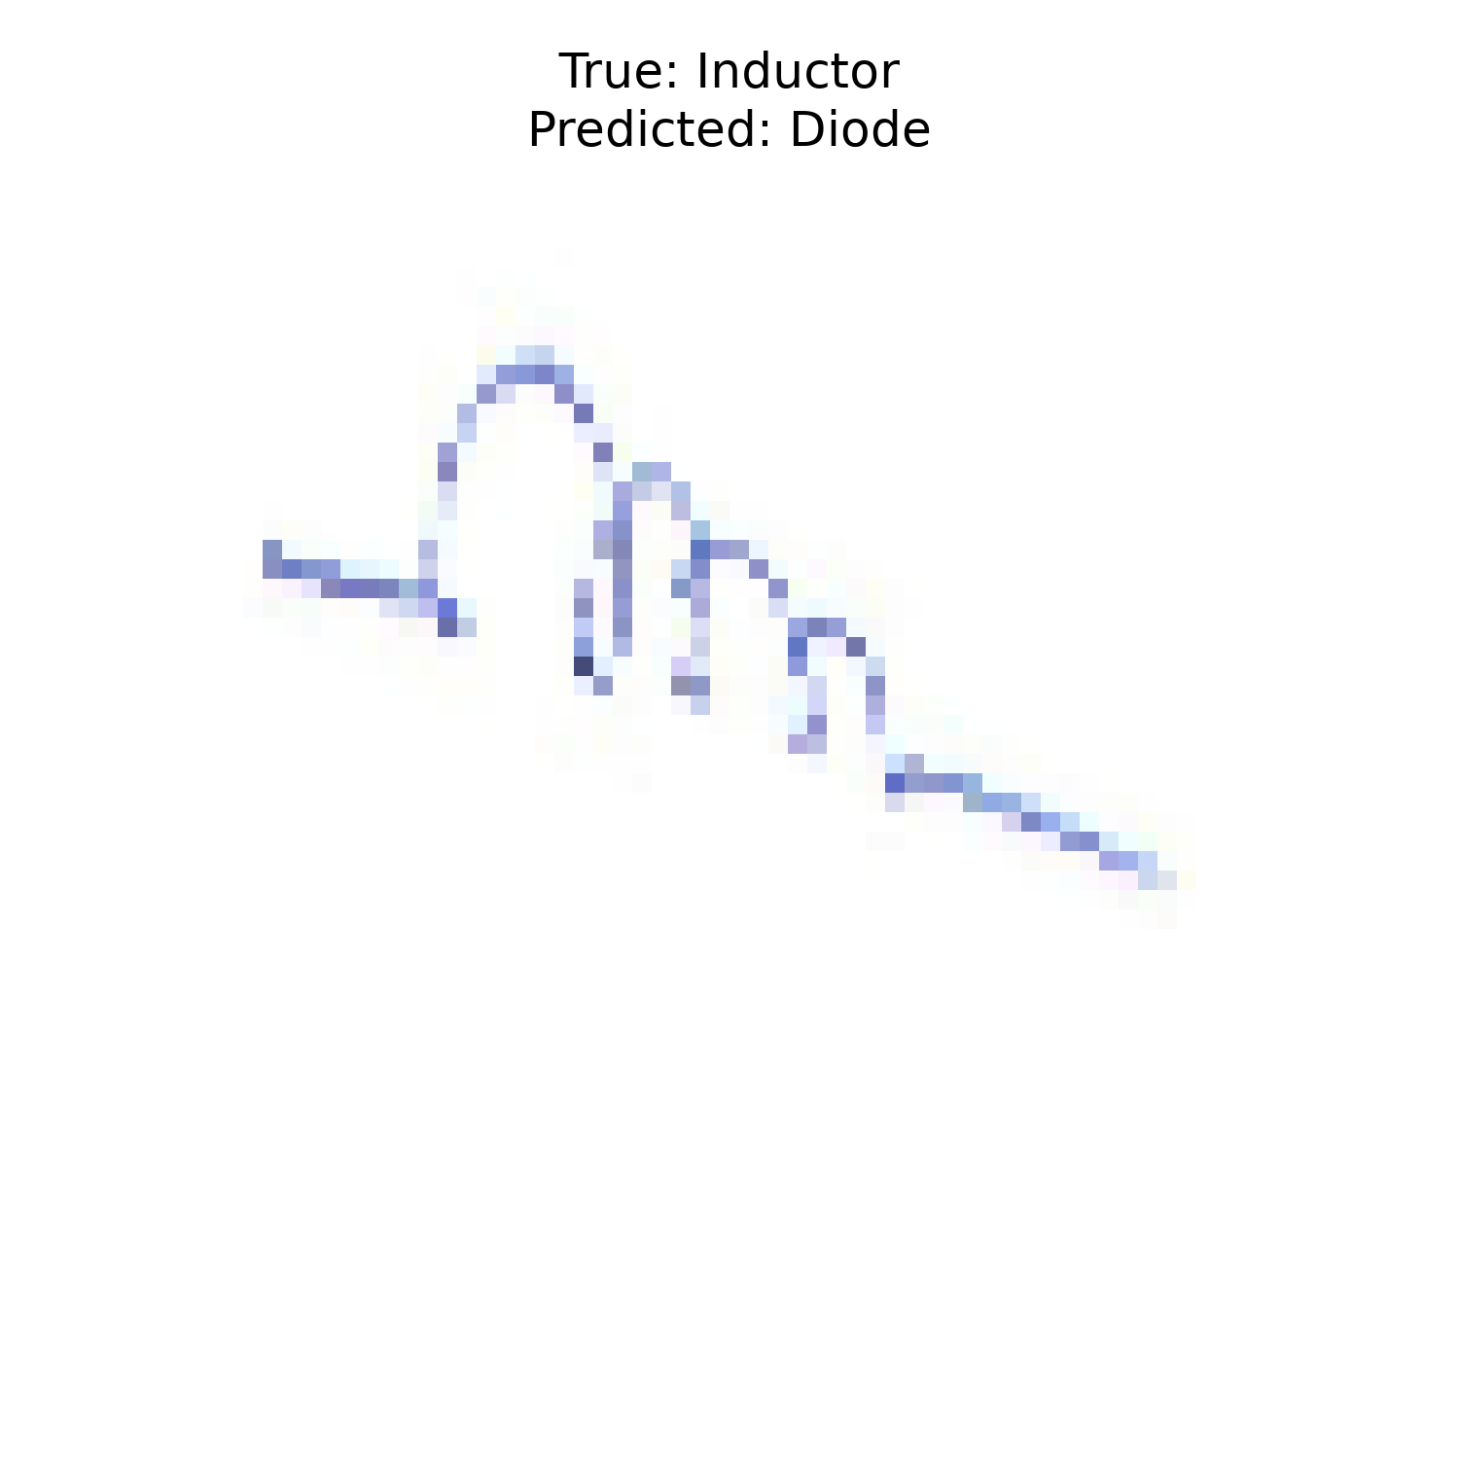

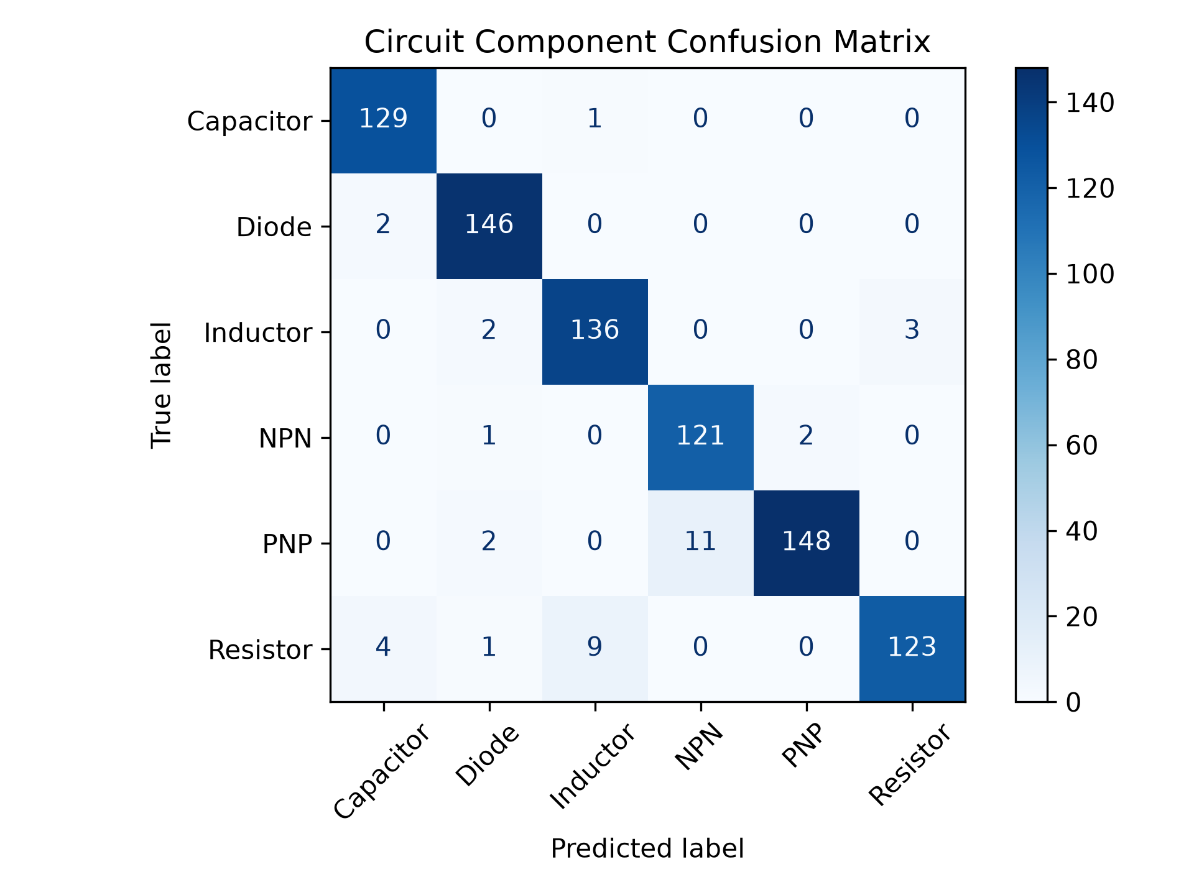
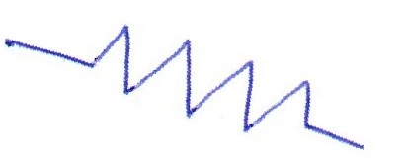
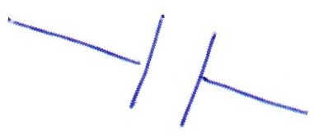
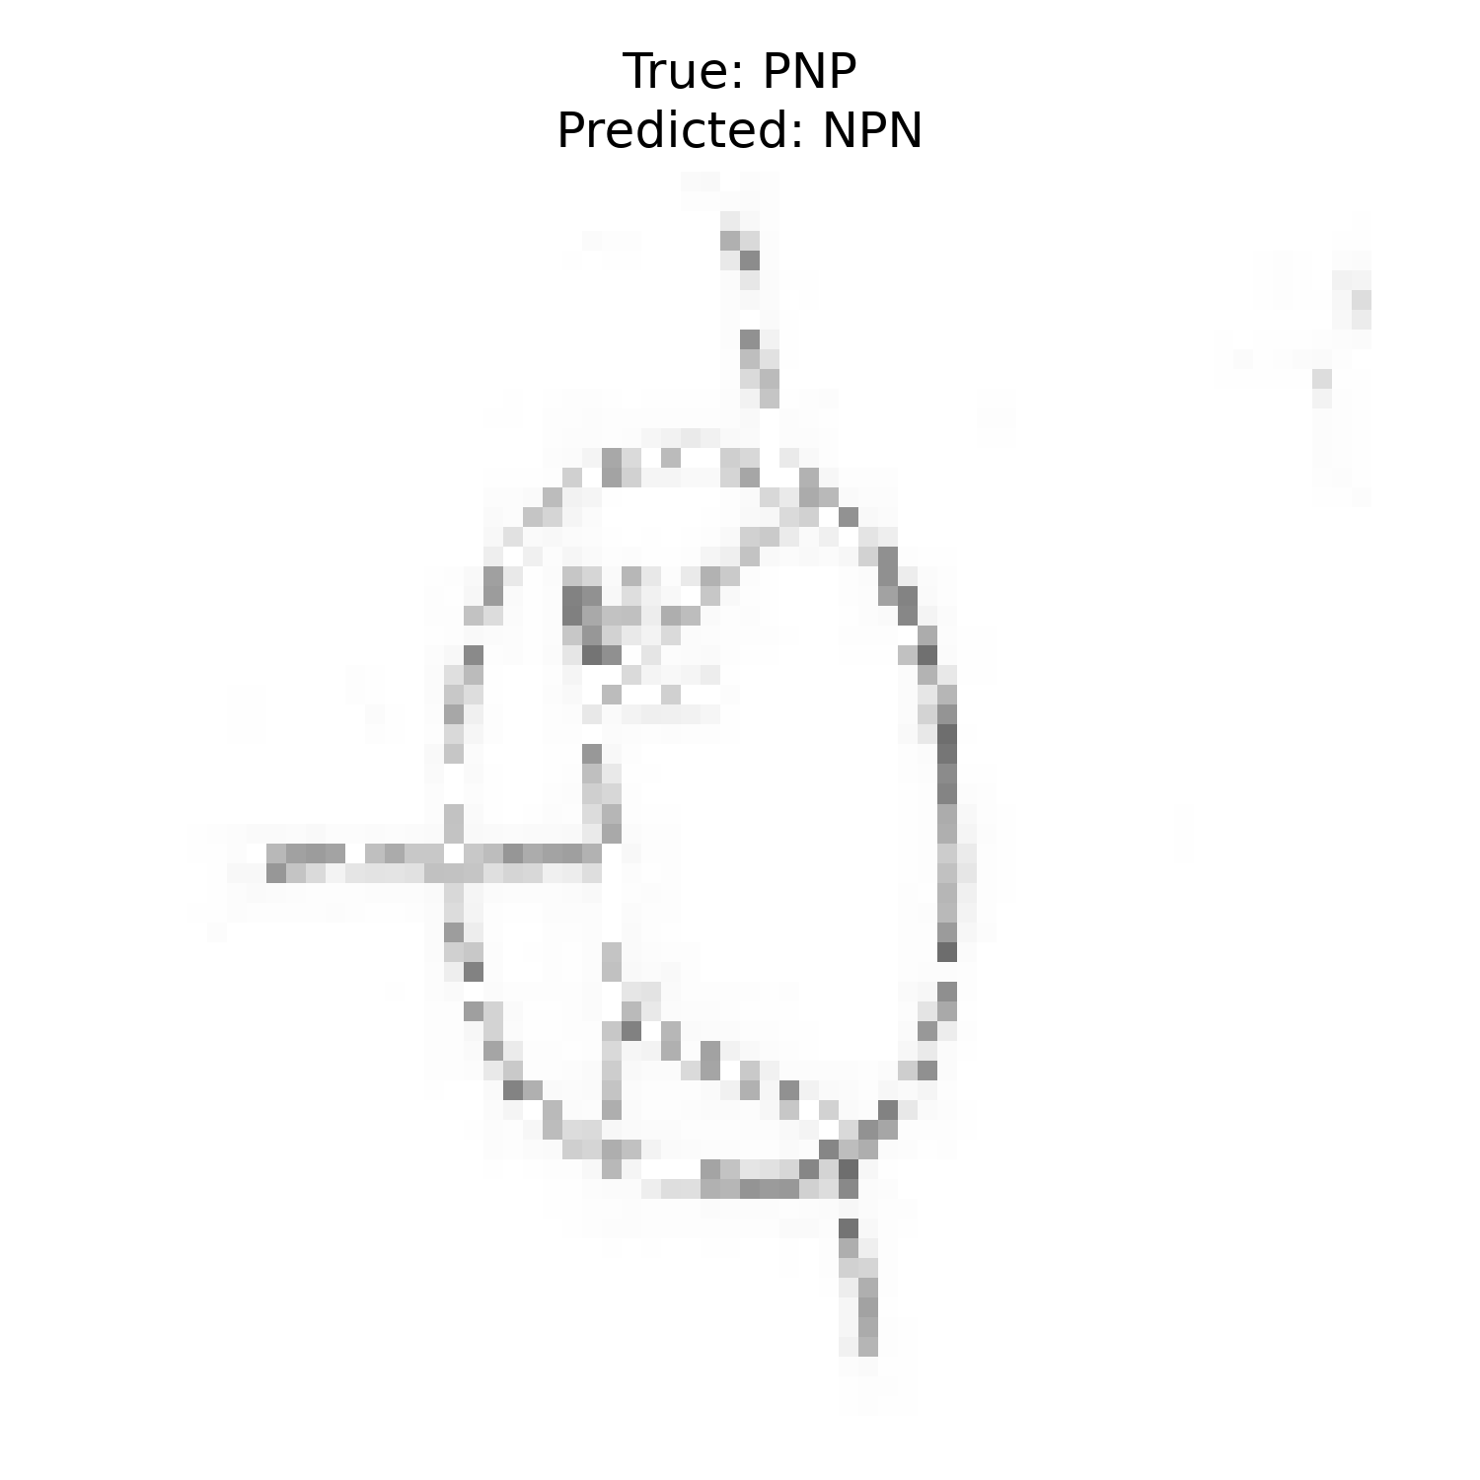
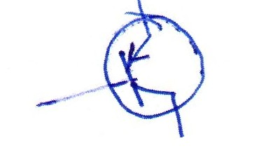
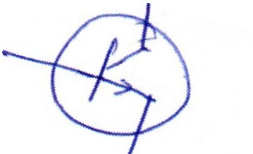
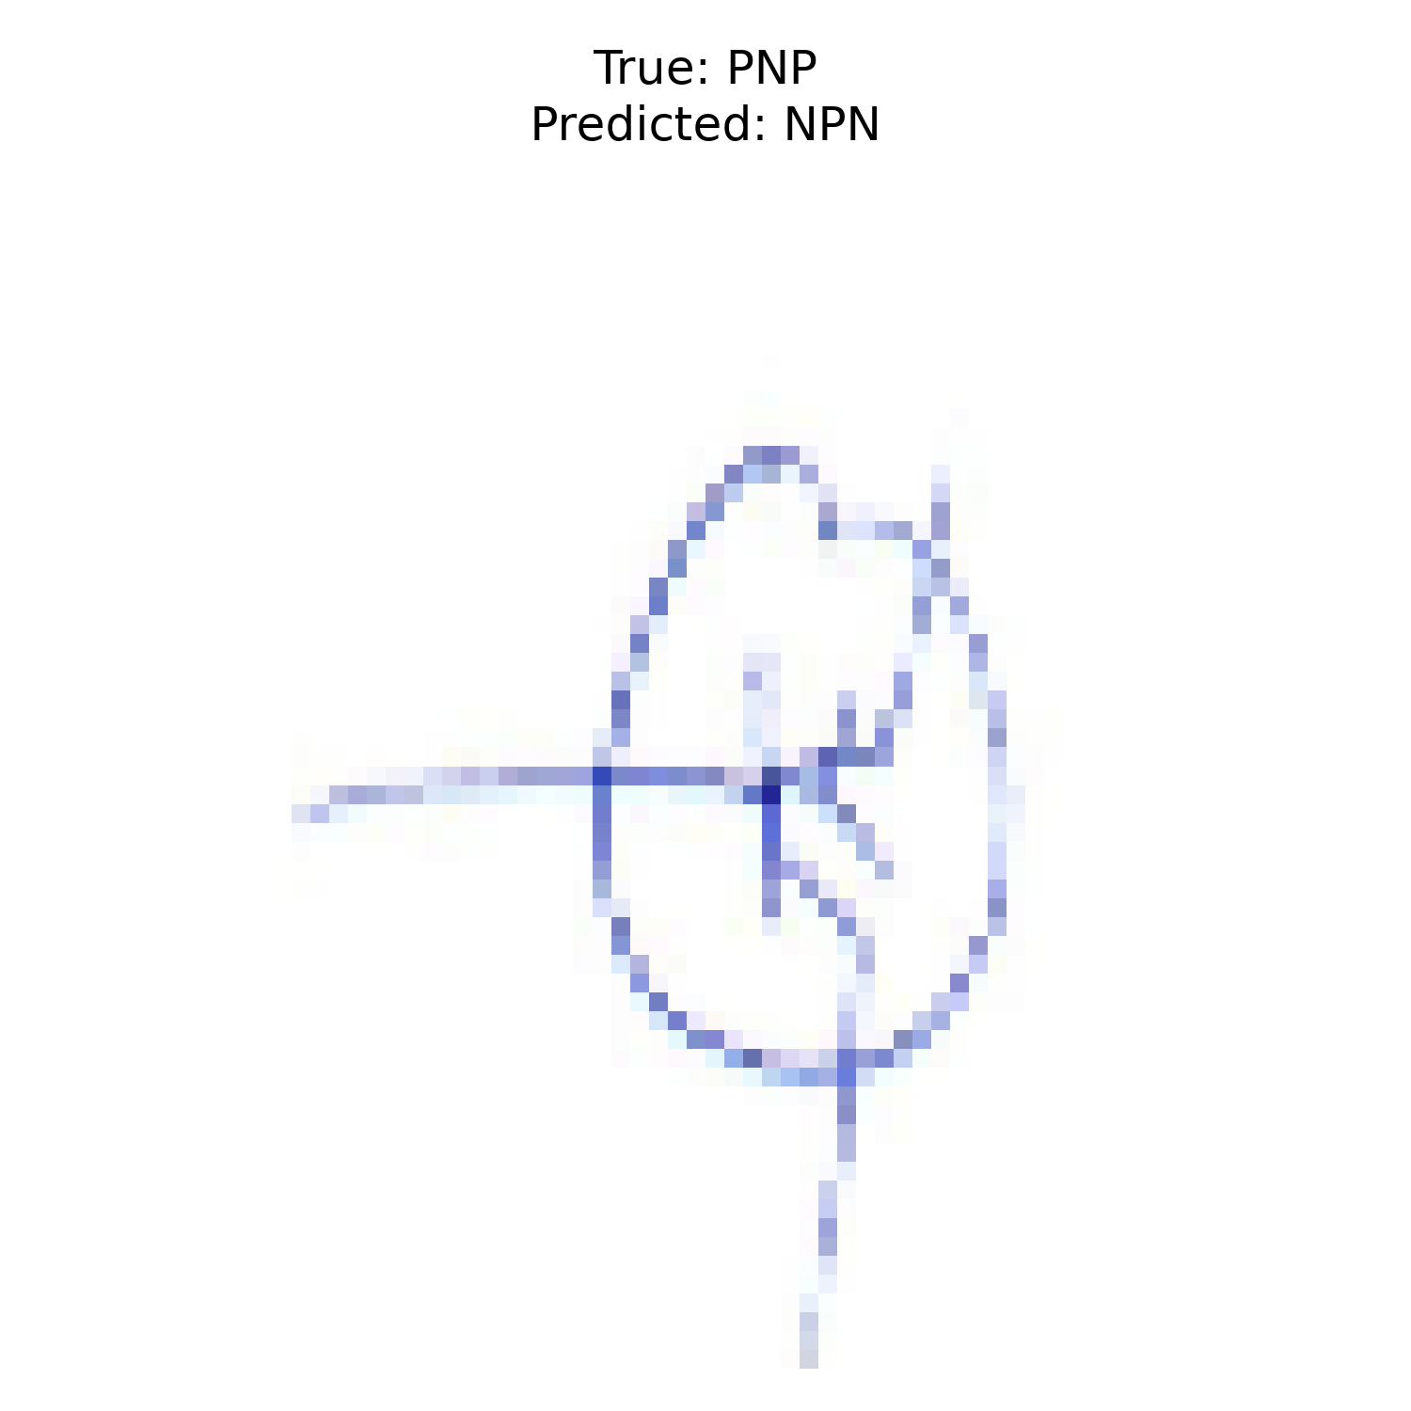
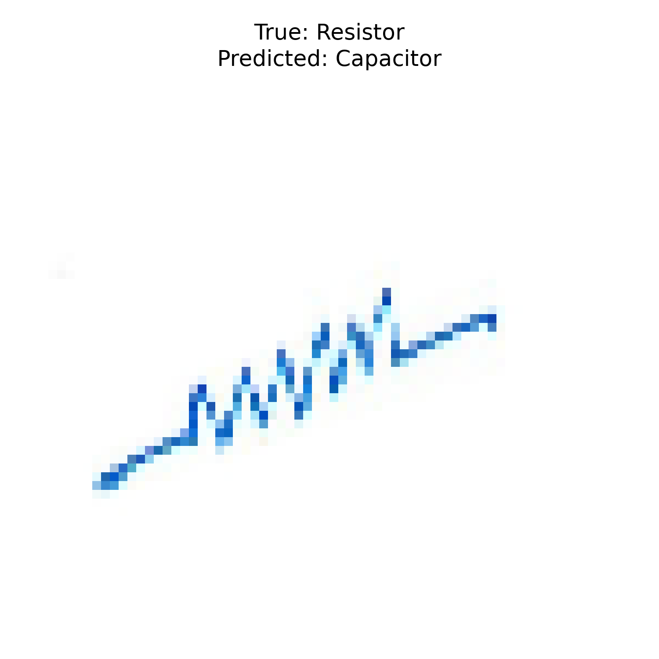
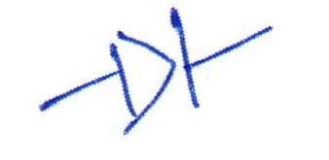
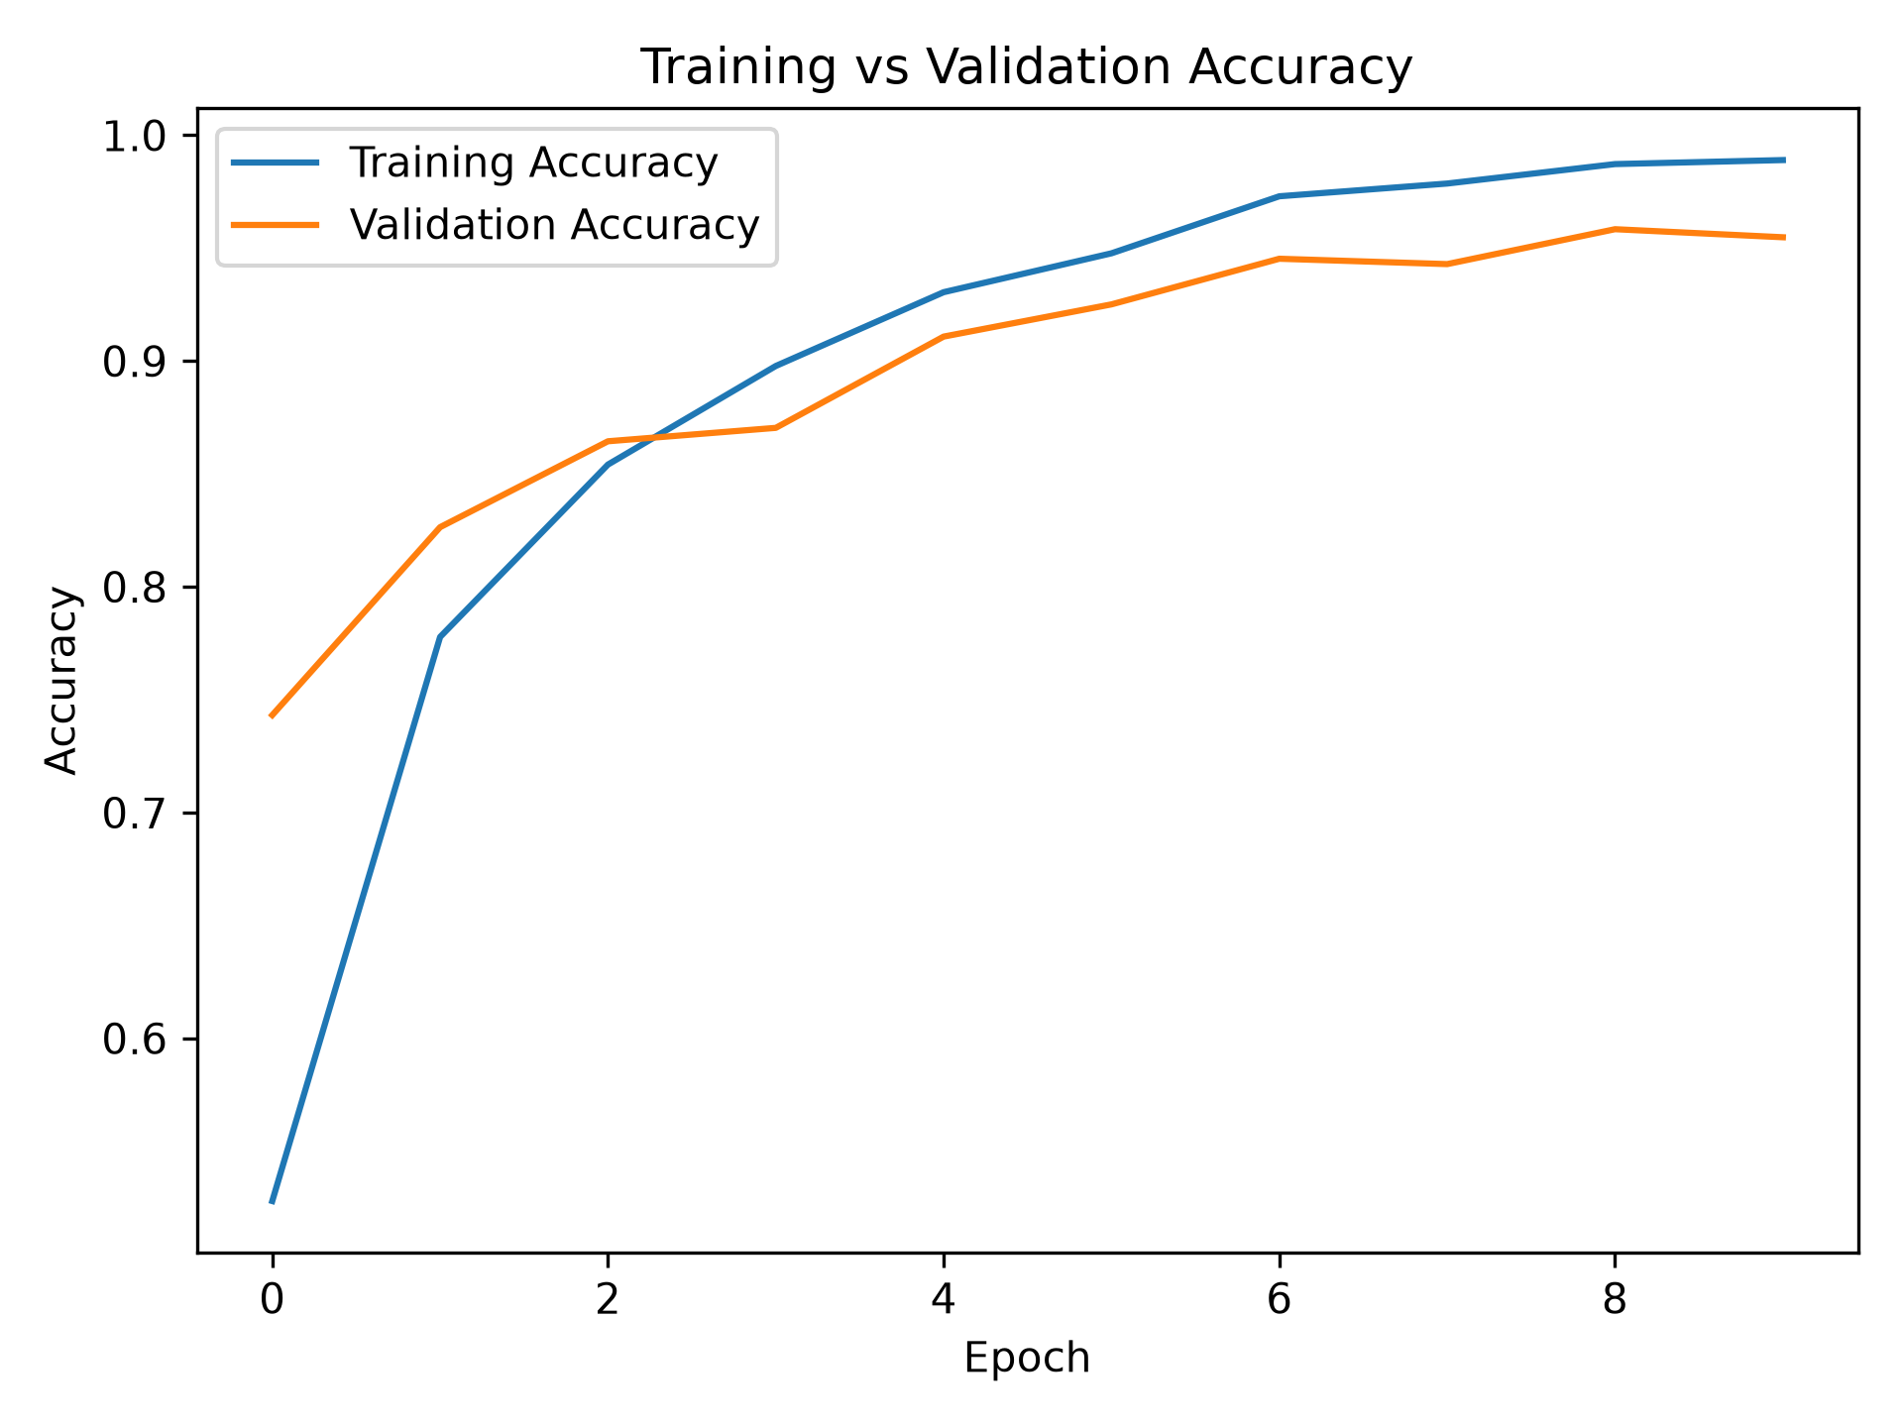
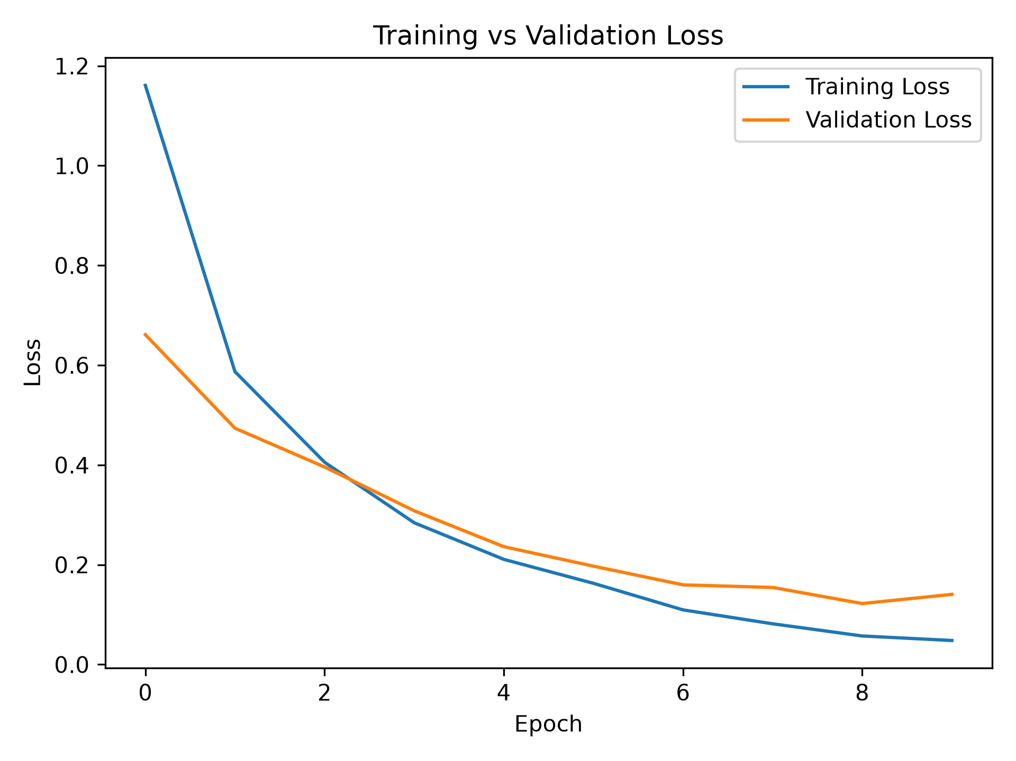
MNIST for Analog Circuits: Component Symbol Recognition
By: Rong Shen Ng
Experiment setup
Baseline model + evaluation
Failure analysis
Goal: learn the full pipeline for the “circuit alphabet”: crop symbols, train a baseline, then inspect model mistakes.
Model: small CNN, 64×64 grayscale input, 3 convolution blocks, ReLU, max-pooling, dropout, final softmax. Loss: cross-entropy.
Test accuracy:
Confusion matrix
Resistor
Capacitor
Inductor
R
C
L
D
N
P
R
✓
C
✓
L
✓
Diode
PNP Transistor
NPN Transistor
True label
D
✓
Dataset
N
✓
JUHCCR-v1a from Kaggle
Test folder: File 04, 07, 11, 13, 14, 16
P
✓
Notebook link: https://www.kaggle.com/datasets/ayush02102001/circuit-component-analysis?resource=download
GitHub link:
https://github.com/rongshen0515/Training-Model-for-Circuits-
What was hard?
Hand-drawn symbols vary a lot in stroke thickness, rotation, and cleanliness. MOSFET orientation and local details are especially important.
What improved performance?
Basic cleanup + augmentation: small rotations, shifts, scaling, noise, and line-thickness changes. Stratified split avoids hiding class imbalance.

