Slide 1
[How Things Work]: Linux – Containers
@khenidak

Slide 2
Where we are. Where we are going. https://aka.ms/k8s/howthingswork https://github.com/khenidak/on-linux
you are here
On hiatus next iteration. Rethinking last mile
Processes + IPC
FS + Block Dev
I/O
Networking 1
Networking 2
Containers
virtualization
Boot + Extending Kernel
Security Roundup
Feb 25th, 2022
Notes:
We have optimized a bit of our future topics. We want to remain within 10 or 9 sessions. We will further optimize as we learn about how the delivery mechanism

Slide 3
Language Matters..
Linux Kernel does not have the construct Container in any of its api/abi/syscalls. What it has is a set of capabilities and features that help in limiting what application can do, can see, or can use when it runs. Those existed way before “containers” to help with higher density deployments. IOW Today we are talking about how applications are contained.
What we call A Container today is self described and contained application packages – i.e., OCI standard packages - that are hosted by some endpoint (registry e.g., ACR) downloaded to local machine and started by a container runtime which uses the above capabilities and features.
Container runtimes provide a configurable composition of said features and capability to expand what is possible. Such as running two containers in a shared sandbox (e.g., shared network), additional local/remote volume capability via indirection, snapshotting etc.

Slide 4
What have we learned so far?
init
Kernel starts this
Parent Proc
Kernel starts an init proc (PID:1) which can start other process using clone(2) + execve(2) replacing current executable by a different elf file. A proc always points to an executable and command line args.
The proc uses the current user unless sticky bits are set. Proc acquires and inherits capabilities which allows it to perform various functions.
Proc has an inherited root (the root of mount tree). The root is used to find shared objects that may be referenced via the elf (via LD_LIBRARY_PATH). The mount tree itself is where various pseudo file systems offered by the kernel and blkdev(s) can be mounted at any leaf. Additionally, it has a pwd pointing to where the executable started. Proc also uses the networking stack via various syscalls.
Any proc is allowed to use *all* system resources unless stated differently by rlimits/ulimits.
Kernel
mount root
Child Proc
Pseudo fs
Has a root
uses
/
Has a pwd
mount
blkdev
/home
/home/kal/
Bind mount
Network Stack

Slide 5
Let us remember something..
Applications and tools that are interested in interacting anything offered by the kernel have one of three ways (two really):
Execute a syscall against the kernel interface
Execute an ioctl (which is also syscall) against a device file.
Read from or write to one or more files offered by kernel pseudo file systems such as procfs or sysfs. Or read/write one of the many aux config files such as /etc/hosts or /etc/hostname.
IOW root env and mount tree are windows to the guts and gore of kernel.
Putting capabilities together:
Namespaces and chroot limit what a process can see.
CGroups limits resource process can use.
Linux Capabilities limit what a process can do.

Slide 6
Chroot and Namespaces
Limit what them procs can see

Slide 7
To Change a Root
Proc1 started with the default root of the system, it can see the entire tree
Proc2 will start with a different root:
$ export NEWROOT=“/tmp/some”
$ mkdir $NEWROOT
$ mkdir -p $NEWROOT/{bin,lib,lib64}
Note: You can do the same for things like java runtime, .net core runtime, etc..
$ for f in $(ldd /bin/bash | grep -o '/lib.*\.[0-9]');do cp -v --parent $f $NEWROOT/ ; done
$ cp /bin/bash $NEWROOT/bin
$ chroot $NEWROOT/ bash
At this point you are running bash in a different root. The pseudo file systems are not mounted in the new chroot env. But you can mount them (before going into the chroot env)
Note: you don’t need all of them, below is for completeness (e.g., when building an OS image).
$ mkdir -pv $NEWROOT/{dev,proc,sys,run}
$ mkdir -pv $NEWROOT/{dev,proc,sys,run}
$ mknod -m 600 $NEWROOT/dev/console c 5 1
$ mknod -m 666 $NEWROOT/dev/null c 1 3
$ mount -v --bind /dev $NEWROOT/dev
$ mount -vt devpts devpts $NEWROOT/dev/pts -o gid=5,mode=620
$ mount -vt proc proc $NEWROOT/proc mount -vt sysfs sysfs $NEWROOT/sys
$ mount -vt tmpfs tmpfs $NEWROOT/run
$ if [ -h $NEWROOT/dev/shm ]; then mkdir -pv $NEWROOT/$(readlink $NEWROOT/dev/shm) fi
/
Proc 1
/home
/home/kal/
Proc 2

Slide 8
But I don’t want my proc to see everything on my box..
chroot environment changes the root of a process but does not limit a proc can see nor it can change it.
Namespace(s) is a kernel capability that existed since v2.4 (2002) the basic idea is to limit and change what procs can see by namespace-ing them into compartments, the following exist in modern kernel versions:
Mount namespace: processes in different namespaces can see a different mount tree (and accordingly must change root).
UTS namespace: changes the results of uname(2) syscall (note the dependency on mount namespace).
PID namespace: namespace-ed processes can not enumerate processes outside their pid namespace.
Net namespace: a differently configured networking stack.
IPC namespace: processes can not IPC to processes in a different IPC namespace.
User namespace: different view of system users. Typically, via mapping namespace ID range to root namespace username ID range.
Time namespace: different settings for CLOCK_MONOTONIC and CLOCK_BOOTTIME.
(some ns are not included such as cgroups ns)
Note:
Proc A can be a sister for Proc X in mount-namespace mns1 but a sister for Proc Y in network namespace nns1.
Each namespace type has its own behavior according to what it compartmentalizes.
But as a rule of thumb a proc running as root* or has CAP_SYS_ADMIN** (more on this later) can breakout of its namespace.
Moving Procs to different namespaces via setns(2) which requires CAP_SYS_ADMIN or some magic (check rootless container runtimes such as rootless kit for more.).
Some Namespaces types fold when all processes in it exit when using clone(2).

Slide 9
Example: UTS NS
Why:
Processes using local hostname for networking interactions and logs.
The behavior:
Kernel reads hostname from /etc/hostname*. Setting hostname is done via
hostnamectl(1) which is a systemd* tool and uses a file system socket
hostname(1) which calls sethostname(2) and optionally sets it in a file such as /etc/hostname.
The how to(shell):
$ ushare --fork --mount --uts /bin/bash
$ hostname anubis
$ hostname
anubis

Slide 10
On Mount NS
Why:
Applications that are packaged with its deps usually use a shared path e.g., /bin /sbin by changing the mount tree and root applications “think” they are running alone on the host with no dep conflicts
Configurations are typically files. By changing mount namespace, you can have a different configuration for your Proc as an example /etc/hosts
Behavior
The new mount namespace already contain mounted file systems mainly /sys /dev /run /boot – The reason behind that is mount propagation. When file system are mounted there is an optional propagation flag that sets:
Shared: mounts propagate from/to child mount namespaces
Slave: mounts propagate one way from parent to child namespace.
Shared and Slave: parent of parents. Where one parent can notify its children of mount changes but top parents does not get these notifications
Private: does not send/receive mount notifications.
Unbindable: private and can not be bound
In practice the are mount namespaces are structured as peer groups in a tree like structure and mount events are shared. Having multi level mount namespaces is a debugging nightmare. Container runtimes usually remount filesystems privately in container mount namespace. All those PVs/Volumes that container runtime offers are mounted privately in container mount namespace.
How (shell):
Create a new root e.g., mkdir /opt/fakeroot container runtime usually then expand the image at that new fake root. You can now chroot into the new mount ns.
Go into new mount namespace unshare –Umr (new user ns, new mont ns, and map effective uid/gid into new namespace).

Slide 11
On PID NS
Why:
Having access on other process means that you can enumerate them and “control them” via signals and – if IPC NS is same – you can access shared memory objects (we talked about this in our 1st session).
Behavior:
Linux assigns a pid (starting from 1->size_t). That counter starts from 1 for each new pid namespace.
How(shell):
start a new pid namespace by ushare -fp (fork the unshare process and start new pid namespace). The forked process is the new init process for pid ns
Note: Tools like ps are not exactly namespace aware and since /proc is the same when you run ps -aux in the new pid namespace you see everything. This is why pid namespace is usually combined with starting both mount namespace and pid namespace or via a simple short cut as unshare -Urfp -mount-proc

Slide 12
On Network NS
Why:
Having a different network stack allows containers to run with its own network control/data plane. Example: port sharing, different IP, different dns server (via mount namespace). It also enables you to hook different bpf programs specific to containers (instead of root that performs a lookup on every packet).
Behavior:
A new network namespace starts with empty network stack (not even lo interface). You are required to configure it all. Container runtime offload this entire process to CNI not just because of the complixities but also because it requires coordination w/ external entities such as breaking down the ip-space, configuring network routes etc.
How(shell):
use ushare -fn /bin/bash to fork into a new net ns or ip netns add <name>
Configure the new net ns via ip command via
Ip link set <dev-name> netns <name>
Ip netns exec <command>
But how do we route traffic into and out of new netns?
Bridges either linux own or some arbitrary implementation. Usually coupled with veth pairs
Switches such as ovs
Custom encap/decap/routing rules.
(review networking sessions ☺)

Slide 13
cgroups
Limit what them procs can use

Slide 14
Resource Governance – Control Groups
In order to enable resource governance, you need resource, controller, and accounting. And that is pretty much how Linux does it
Each resource* is owned by a controller and that controller performs the accounting on the resource:
blkio: rate limiting io against blkdevs.
cpu: time slices* # and sizes assigned to procs.
cpuacct: report-only against cpu usage.
cpuset: procs access on cpu cores.
Memory: limit how much memory a proc can use.
devices: access/denial on various system devices.
freezer: procs that are member of this group are “suspended”.
net_cls: interfaces with linux TC to enable rate limiting network traffic usage.
net_prio: similar to cls but operates on traffic priority.
(perf_events, ns, hugetlb, rdma are omitted).
The basic principle, is the entire structure is represented by a file system (cgroups fs). Each controller is mounted on the tree and uses two things
A set configuration of files (each control uses a different format specific to it).
Adding a proc to cgroup is by writing it into one of the many places into that tree.
Note:
Reaching ulimit of mem will trigger alloc failures (malloc() == NULL), reaching limit in cgroups will trigger oomkiller*. Whichever less will trigger first.
This is not a resource reservation system. You reserve by limiting resources for everything else*.
Controller’s Resources are tied to a control group, all pids in a group share said resources.
YMMV if your program runtime ignores proc current cgroup you will be in major trouble (ask java folks).

Slide 15
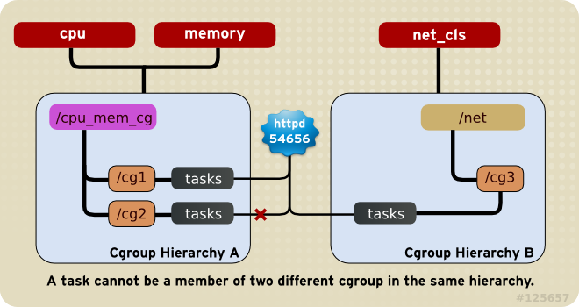
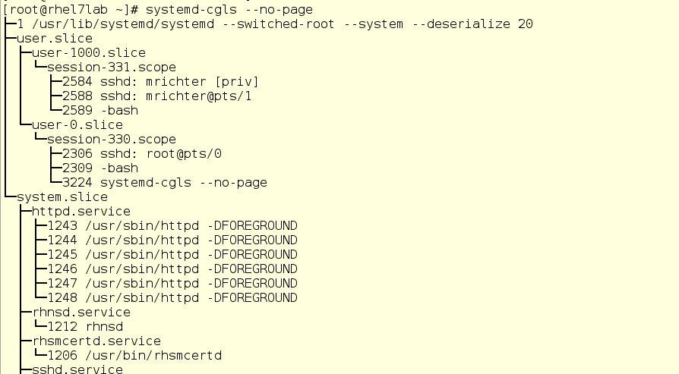
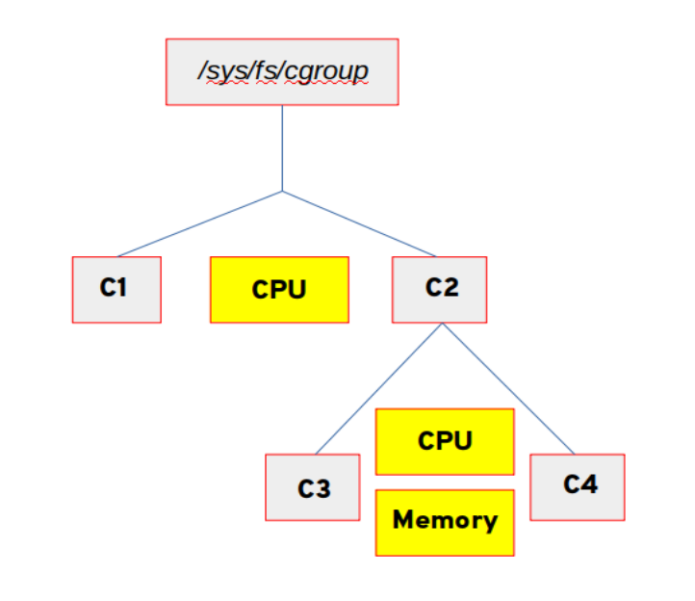
Single Tree, Multi Tree V1/V2 and systemd
Originally (v1 cgroups) we had controllers and trees. We can structure it anyway we like including multi root (e.g., “normal”, ”critical” apps) then further break down as needed. The only catch was controllers can not be mounted in more than one root. Oh and you could have assigned different threads of same proc to different cgroups (just because!)
Then enter V2 (sometimes referred to as unified tree) a where there is only one rooted tree. But v2 didn’t have all the controllers* and controllers can only be used as v1 or v2.
Then systemd which has it is own opinionated approach mounts controller in a very specific way to match slice config. The rational is to manage all system resources for all apps including user interactive session apps. The basic principle is you create slices/cgroup as systemd units (called slices) then you can ref them from regular units using Slice=<name> pragma. This also enable quick copy across machines. Hence the cgroups driver=system||cgroupsfs flag that most container runtimes supports
V1 hierarchies
Systemd slices
v2
Images are sourced from redhat docs

Slide 16
Putting it to work
Mounting Controllers:
Use mount –t cgroup –o <controller/subsystenm name> <path>
Example: mount –t memory /cgroup/mem
Use lssubsys to list all available subsystems
Unmounting controllers:
umount <path> example umount /cgroup/mem
Creating a new cgroup:
mkdir /cgroup/mem/g1
Setting limits on cgroups (controller dependent configs)
echo 0-1 /cgroup/cpu_and_mem/g1/cpuset.cpus
Adding a process to a cgroup
echo <pid> /cgroup/cpu_and_mem/g1/tasks
Note:
The above uses cgroupfs. There are tools such as cg{get, set, classify} that wraps around it and provide a better interface. However, the understanding the underlying system is a must read https://github.com/torvalds/linux/tree/master/Documentation/admin-guide/cgroup-v{1,2}
The above depends on how cgroups were structured and weather systemd cgroups integration is ued or not.

Slide 17
Linux Capabilities
Limit what them procs can do

Slide 18
In the beginning..
Linux had two types of users, root and non-root. Where root can do perform anything on the host.
Executables were given rights according who is running the executable or the executable itself via sticky bits.
That means: If you want to allow user or an executable to perform a privileged operation you are left with give user root permission or set sticky bit for root on the executable itself.
Enter Linux Capabilities
A Capabilities is either a privilege operation or a group of them.
They are asserted various places inside the kernel with a simple logic assertion effective_uid == root || has_cap(abc)
They are set using two ways
Runtime to executable.
Executable via extended attributes*
There are ~40 cap (https://man7.org/linux/man-pages/man7/capabilities.7.html) in Linux and more is being added with each feature add. Use capsh command to list them.
A common use case is CAP_NET_ADMIN allowing a non root user to configure networking control plane or CAP_NET_RAW allowing a non root user to perform raw packet listening. Or meta like CAP_SETCAP.
There are five sets of capabilities. Each is represented by a bitmask assigned to thread. Only effective set is checked by kernel at the time of execution. The rest is used to drive the value of effective and for various actions such what gets copied to child process at execve(2).
Capabilities are assigned when starting the process or via getcap(2), setcap(2) (note libc have no wrapper for these syscalls)

Slide 19
Ok, what governs how a child proc gets its capabilities?
P'(ambient) = (file is privileged) ? 0 : P(ambient)
P'(permitted) = (P(inheritable) & F(inheritable)) | (F(permitted) & P(bounding)) | P'(ambient)
P'(effective) = F(effective) ? P'(permitted) : P'(ambient)
P'(inheritable) = P(inheritable) [i.e., unchanged]
P'(bounding) = P(bounding) [i.e., unchanged]
where:
P() denotes the value of a thread capability set before the execve(2)
P'() denotes the value of a thread capability set after the execve(2)
F() denotes a file capability set
Not a joke, man pages: https://man7.org/linux/man-pages/man7/capabilities.7.html

Slide 20
How does it really look like?

Slide 21
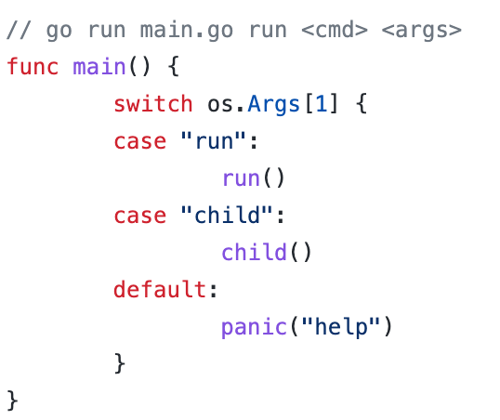
Ok – So how does it really look like?
src: https://github.com/lizrice/containers-from-scratch/blob/master/main.go

Slide 22
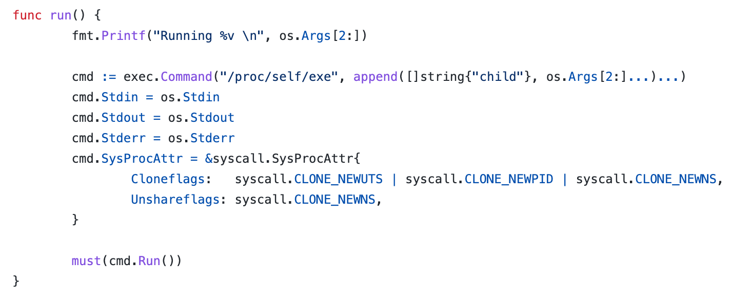
Ok – So how does it really look like?
src: https://github.com/lizrice/containers-from-scratch/blob/master/main.go

Slide 23
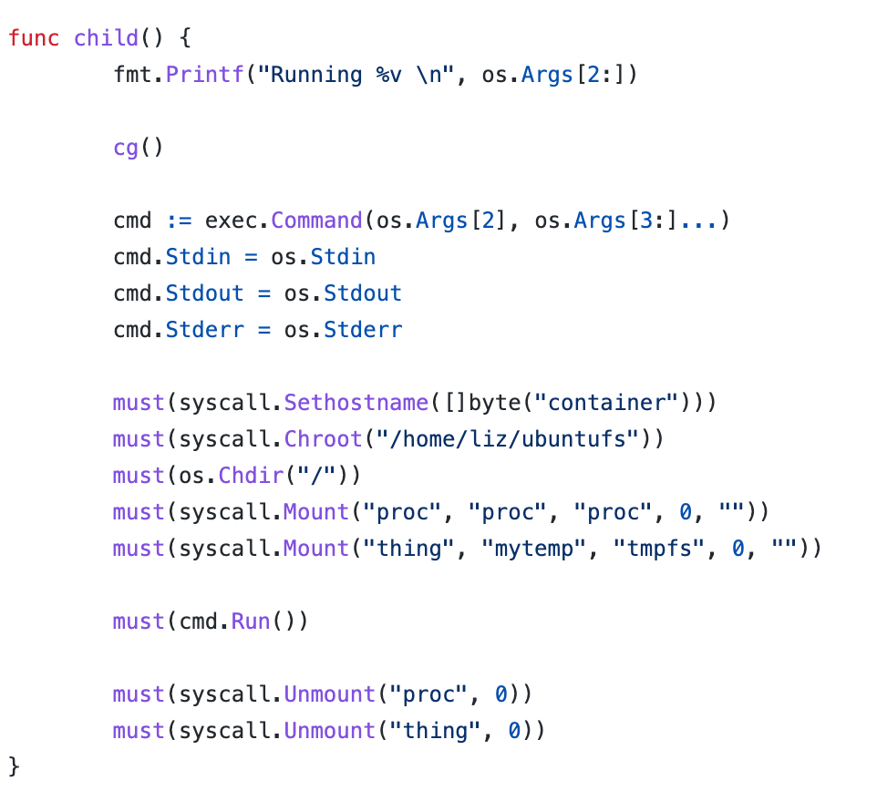
Ok – So how does it really look like?
1
2
3
4
5
src: https://github.com/lizrice/containers-from-scratch/blob/master/main.go

Slide 24
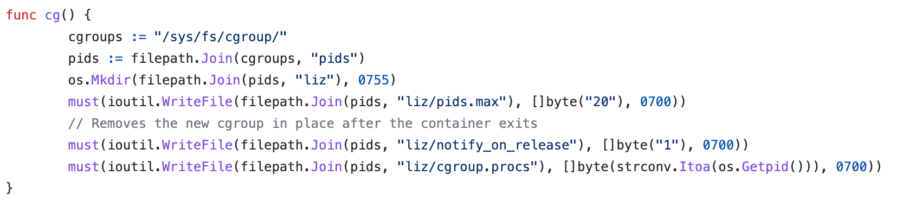
Ok – So how does it really look like?
src: https://github.com/lizrice/containers-from-scratch/blob/master/main.go

Slide 25
Ok – So how does it really look like?
2
3
4
5
src: https://github.com/lizrice/containers-from-scratch/blob/master/main.go

Slide 26
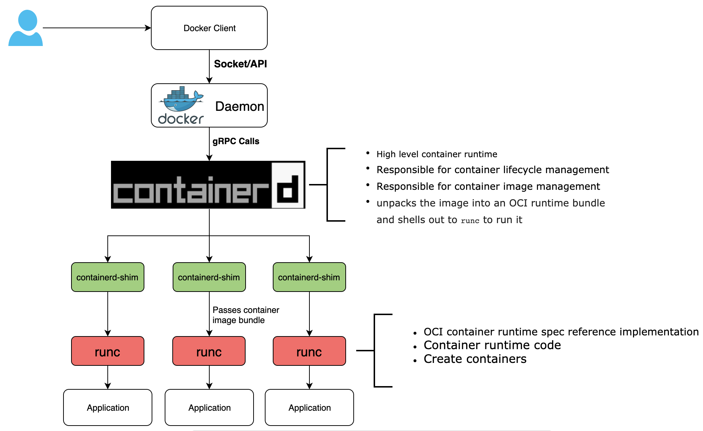
modern container runtime layers

Slide 27
Thank You!

