Slide 1
AWS Solutions Architect Associate
IAM and S3 101

Slide 2
IAM 101 – Identity Access Management
IAM allows for the management of users and their level of access to the AWS console
Allows us to set up:
Users – End users such as employees.
Groups – A collection of users. Each user in the group will inherit the permissions of the group
Roles – Allows AWS resources to take certain actions on other AWS resources
Policies – Defined by policy documents. These are written in JSON and five permission as what a user/group/role is able to do
It is essentially a global place to control shared access, permissions, and identity federation.
It is PCI DSS compliant (compliance necessary to take credit card information)

Slide 3
IAM 101
IAM is global – it doesn't apply to a region
The "root" account is the account created when you first setup your AWS account. It has complete admin access.
New users have NO permissions when first created
Always set up MFA on root account
You can create and customize password rotation policies
Without further configuration you are assign an access key id and secret access key to use via API/CLI and can't change them. You only get to see them once.

Slide 4
S3 101 – Simple Storage Solution
Provides secure, durable, and highly-scalable object storage.
Object storage basically means file storage
Files can be 0B to 5TB in size
Storage is (theoretically) unlimited
Files are stored in "buckets"
S3 operates on a universal namespace
This means bucket names must be globally unique – not just unique to your account
This allows S3 to create a web address for your bucket
When you upload a file to S3 you will receive an HTTP 200 code if the upload is successful

Slide 5
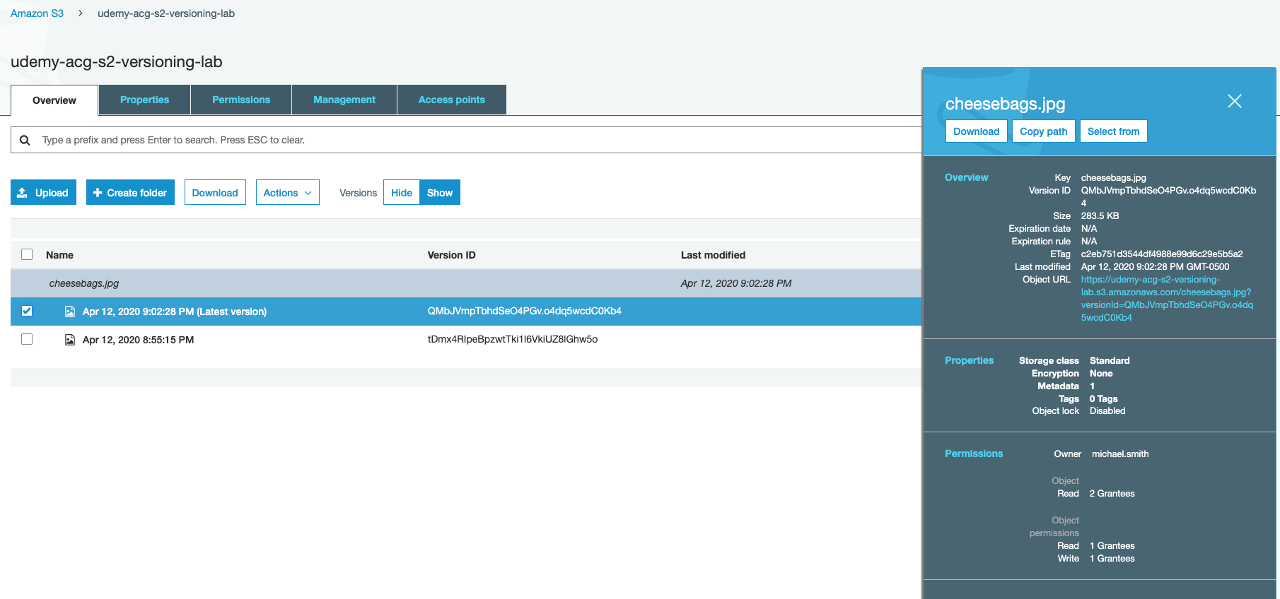
S3 Objects
An S3 object consists of the following properties:
Key: name of the object
Value: the data the object holds
Version ID
Metadata
Subresources
Access Control Lists
Torrents

Slide 6
S3 Data Consistency
Read after write consistency
This just means you can read objects immediately after writing
Eventual consistency for overwrite PUTS or DELETES (takes time to propagate)
If you upload v2 of a file and try to immediately read, you may or may not get v2. Eventually (generaly no more than a second or two) you will get the correct version of the object.

Slide 7
S3 Guarantees and Features
Lifecycle Management
Versioning
Encryption
MFA Delete
Secure your data using Access Control Lists and Bucket Policies
Tiered Storage Classes

Slide 8
S3 Tiers and Pricing
S3 Standard
99.99% availability
99.999999999% durability (11 9s)
Stored redundantly aceoss multiple devices in multiple facilities
Designed to sustain the loss of two facilities concurrently
S3 IA (Infrequently Accessed)
For data that is access less frequently, but required rapid access when needed
Lower fee than S3, but you are charged a retrieval
S3 One Zone IA
For when you want an even lower cost option
When you also don't need multiple AZ resilience
S3 Intelligent Tiering
Designed to optimize costs by automatically moving data to the most cost effective tier without performance impact or operational overhead
S3 Glacier
Secure, durable, lost cost storage class for data archives
Reliable storage at any volume
Cheaper than or competitive with on-prem solutions
Retrieval time is configurable from minutes to hours
S3 Glacier Deep Archive
Lowest cost storage class where a retrieval time of 12 hours is acceptable

Slide 9
S3 Security and Encryption
By default all new buckets are private
You can set up access control to buckets using bucket policies or access control lists
S3 buckets can be configured to create access logs which log all requests made to the S3 bucket. This can be sent to another bucket (even if it's in another account)

Slide 10
S3 Types of Encryption
Encryption in Transit
Achieved by SSL/TLS
Encryption at Rest (stored in an encrypted state)
Server Side Encryption (SSE) at Rest
S3 Managed Keys (SSE-S3)
AWS Key Management Service (SSE-KMS)
Customer Provided Keys (SSE-C)
Client Side Encryption at Rest
You encrypt client side, and upload encrypted objects to S3

Slide 11
S3 Version Control
Obviously – it stores different versions of an object
Once enabled, version control cannot be disabled. It can only be suspended
Integrates with lifecycle rules
Optional MFA delete – you would need to multi-factor authenticate to permanently delete something
Uploading a new version changes permissions on the file
The total calculated size of an S3 bucket includes all versions o a file. You can use lifecycle rules to help manage the cost associated with this.

Slide 12
S3 Lifecycle Management and Glacier
You can use lifecycle rules to automate moving your objects between different storage tiers to better manage cost.
Lifecycle rules can be used in conjunction with versioning
Can be applied to current and previous versions
Adding a prefic or tag filter to a lifecycle rule means that only the objects with that tag or prefix will be affected by the lifecycle rule.

Slide 13
IAM and S3 Lab
Goals:
IAM setup for security and best practices
Create a billing alarm with CloudWatch
Creating an S3 bucket
Modifying permissions and security of S3 buckets
Managing data lifecycles in S3

Slide 14
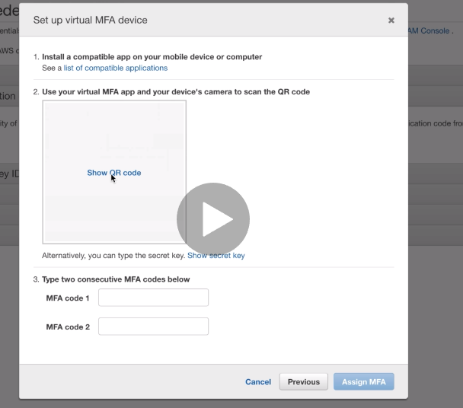
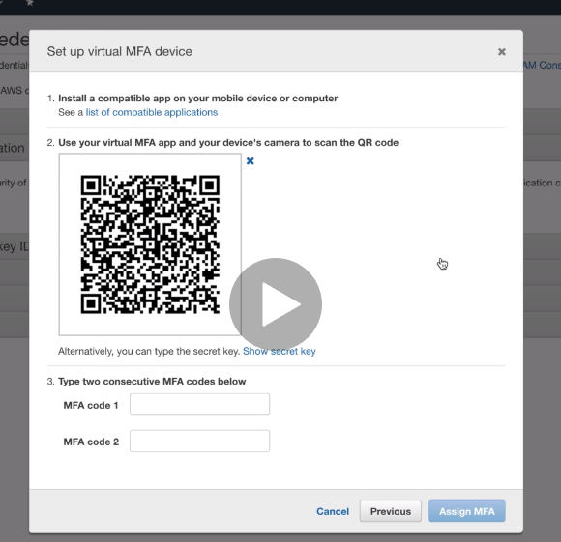
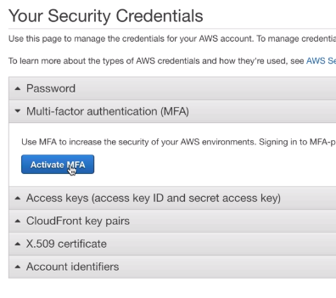
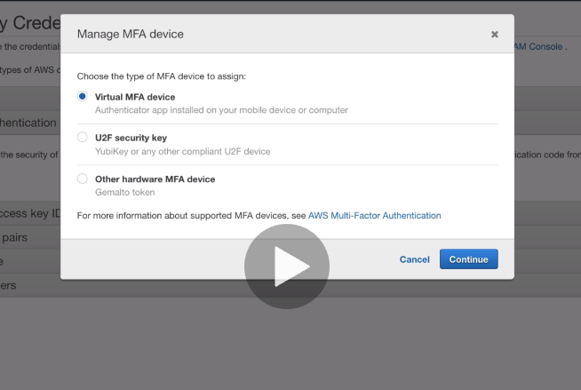
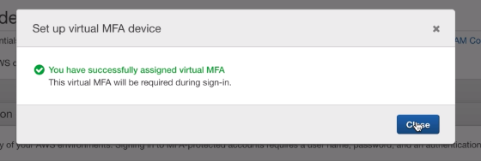
Setting up MFA

Slide 15
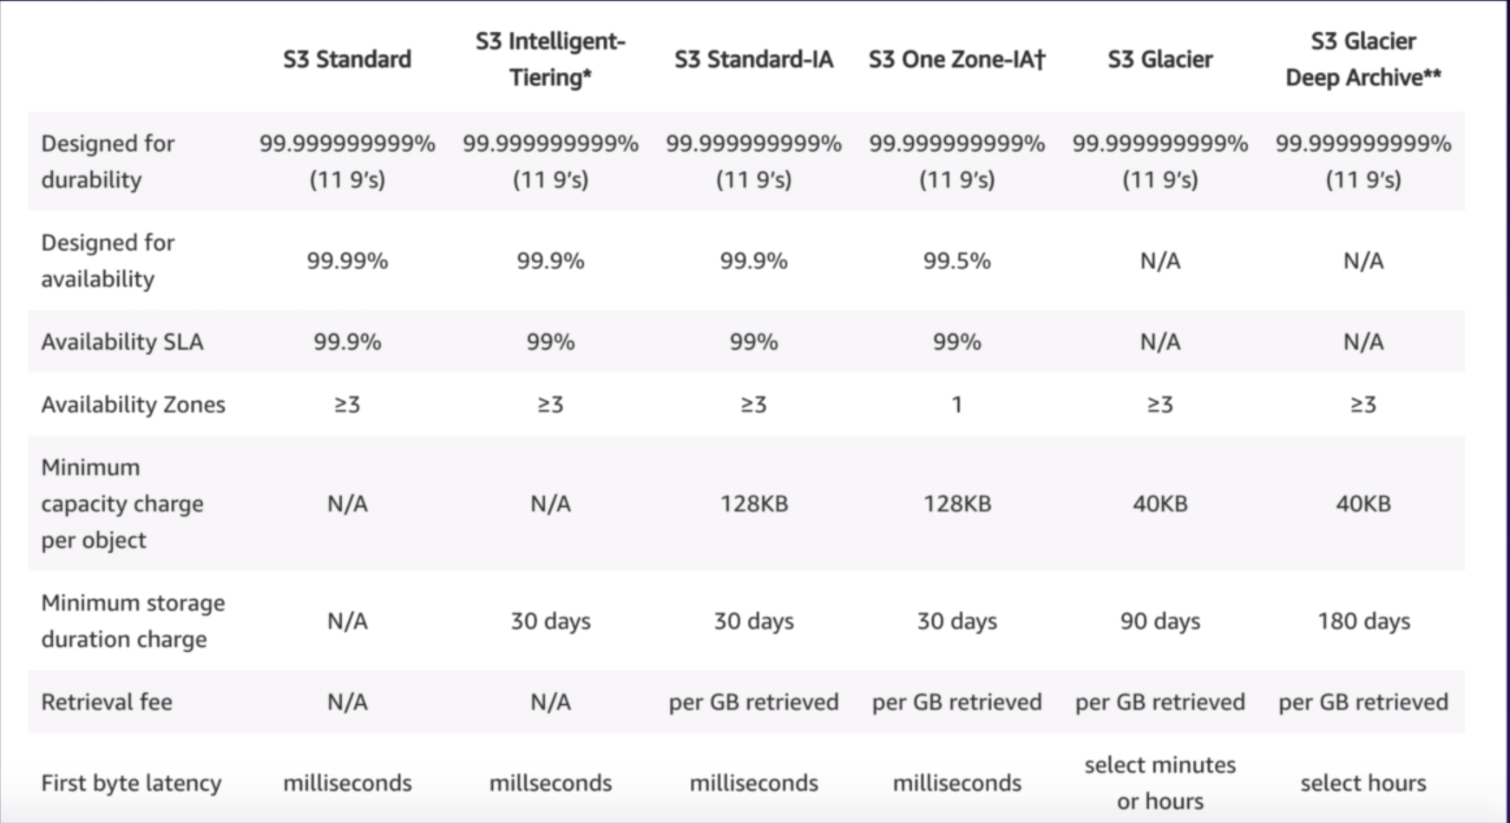
S3 Pricing

