Slide 1


Welcome to the Spektrix Patterns Group
Iterator Pattern

Slide 2
Agenda
To discuss and improve our understanding of design patterns. Initially we'll follow the 23 week guide covering the Gang of Four Design Patterns laid out by Joshua Kerievsky here - https://www.industriallogic.com/papers/learning.html
Although we'll introduce the Pattern with a code example at the start of the meeting, this is not designed to be a training session, it's intended to be a Study group to consider various questions about the pattern. In doing so we'll benefit from the wisdom of the crowd and hopefully improve our understanding.
Deep knowledge of patterns isn't required, and a diverse range of perspectives is encouraged, but it would be useful preparation if you have studied the pattern that'll be discussed before each session.
1 hour approximately
Demonstration of a problem that can be solved or avoided using the decorator pattern.
We will walk through the decision process and design process whixh leads to the Strategy Pattern emerging

Slide 3
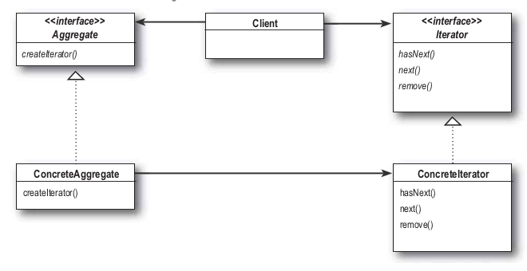
Iterator Pattern
“The Iterator Pattern provides a way to access the elements of an aggregate object sequentially without exposing its underlying representation.”
This pattern allows traversal of the elements of an aggregate without exposing the underlying implementation.

Slide 4
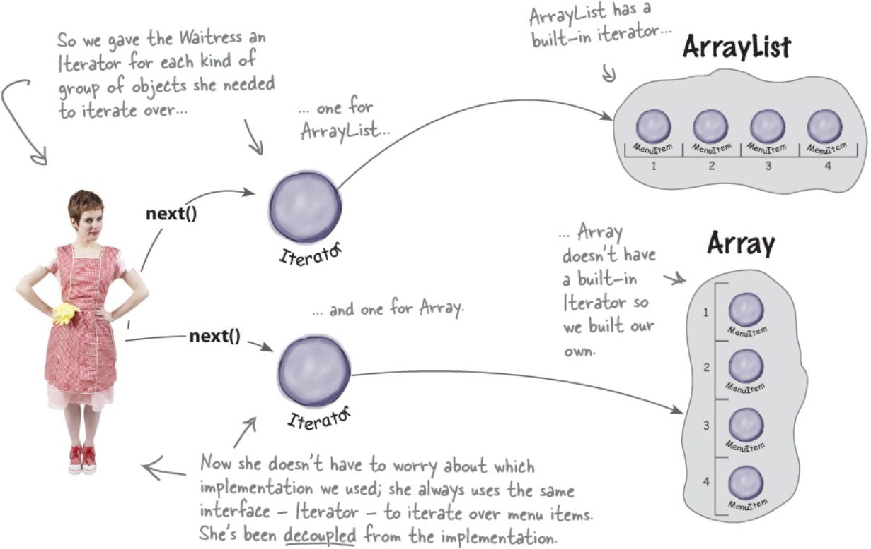
Iterator Pattern
It also places the task of traversal on the iterator object, not on the aggregate, which simplifies the aggregate interface and implementation, and places the responsibility where it should be.

Slide 5
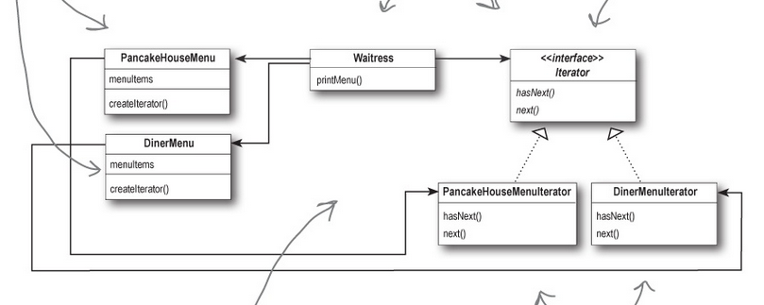
Restaurant Example
https://dev.azure.com/spektrix/spektrix/_git/patterns-study-group?path=%2FIterator&version=GBmaster

Slide 6
What if we didn’t use it?
Standard “for” loop manually iterating over aggregate
What if aggregation doesn’t have accessible length?
Not always one dimensional eg trees
Integrate iteration into collection (ie current and next in aggregation object)
Not the responsibility of that object

Slide 7
Next Session
Let’s talk about… Template Method Pattern
abstract class PatternsStudyGroup
{
protected void Run()
{
Introduction();
HandsOnCode();
ReviewAndQuestions();
}
abstract void Introduction() {}
abstract void HandsOnCode() {}
abstract void ReviewAndQuestions() {}
}

