Slide 1


Welcome to the Spektrix Patterns Group
Composite Pattern

Slide 2
Agenda
To discuss and improve our understanding of design patterns. Initially we'll follow the 23 week guide covering the Gang of Four Design Patterns laid out by Joshua Kerievsky here - https://www.industriallogic.com/papers/learning.html
Although we'll introduce the Pattern with a code example at the start of the meeting, this is not designed to be a training session, it's intended to be a Study group to consider various questions about the pattern. In doing so we'll benefit from the wisdom of the crowd and hopefully improve our understanding.
Deep knowledge of patterns isn't required, and a diverse range of perspectives is encouraged, but it would be useful preparation if you have studied the pattern that'll be discussed before each session.
1 hour approximately
Demonstration of a problem that can be solved or avoided using the decorator pattern.
We will walk through the decision process and design process whixh leads to the Strategy Pattern emerging

Slide 3
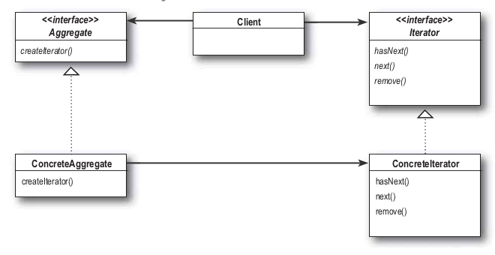
Iterator Pattern
“The Iterator Pattern provides a way to access the elements of an aggregate object sequentially without exposing its underlying representation. ”
This pattern allows traversal of the elements of an aggregate without exposing the underlying implementation.
It also places the task of traversal on the iterator object, not on the aggregate, which simplifies the aggregate interface and implementation, and places the responsibility where it should be.

Slide 4
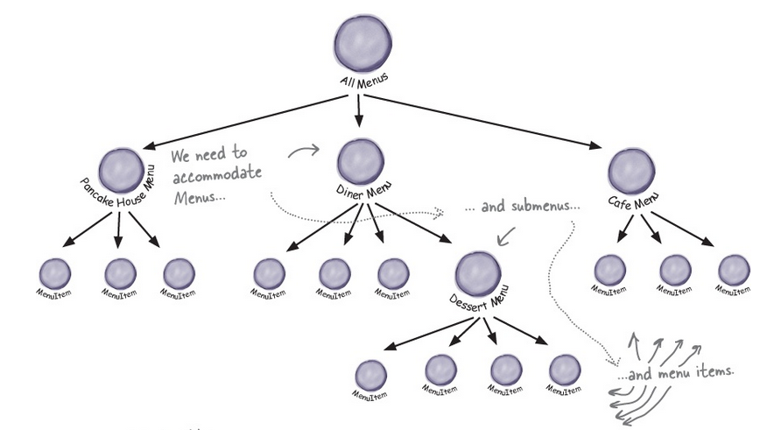
Composite Pattern
“The Composite Pattern allows you to compose objects into tree structures to represent part-whole hierarchies. Composite lets clients treat individual objects and compositions of objects uniformly.”
This pattern allows us to build structures of objects in the form of trees that contain both compositions of objects and individual objects as nodes.

Slide 5
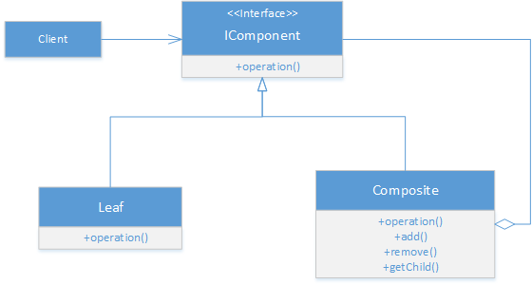
Composite Pattern
Using a composite structure, we can apply the same operations over both composites and individual objects.
In other words, in most cases we can ignore the differences between compositions of objects and individual objects.

Slide 6
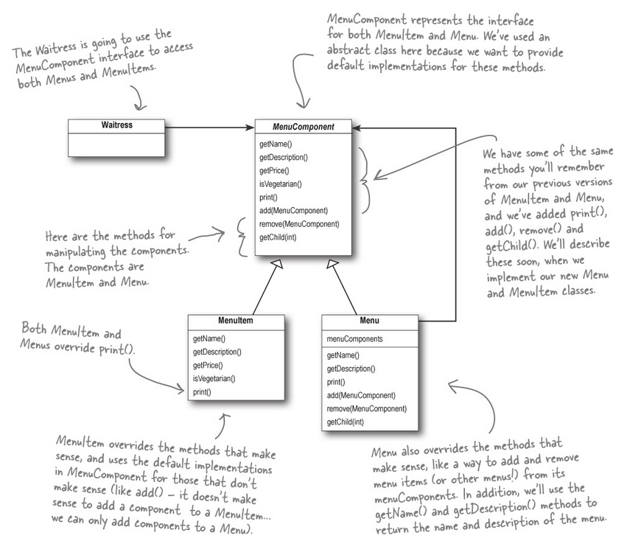
Restaurant Example
https://github.com/ronheywood/patternsgroup-decorator

Slide 7
Next Session
Let’s talk about… Iterator Pattern
Spektrix.PatternsGroup.Members.ForEach(m =>
m.Traverse(patterns)
)

