Slide 1


Welcome to the Spektrix Patterns Group
Template Method

Slide 2
Agenda
To discuss and improve our understanding of design patterns. Initially we'll follow the 23 week guide covering the Gang of Four Design Patterns laid out by Joshua Kerievsky here - https://www.industriallogic.com/papers/learning.html
Although we'll introduce the Pattern with a code example at the start of the meeting, this is not designed to be a training session, it's intended to be a Study group to consider various questions about the pattern. In doing so we'll benefit from the wisdom of the crowd and hopefully improve our understanding.
Deep knowledge of patterns isn't required, and a diverse range of perspectives is encouraged, but it would be useful preparation if you have studied the pattern that'll be discussed before each session.
1 hour approximately
Demonstration of a problem that can be solved or avoided using the decorator pattern.
We will walk through the decision process and design process whixh leads to the Strategy Pattern emerging

Slide 3
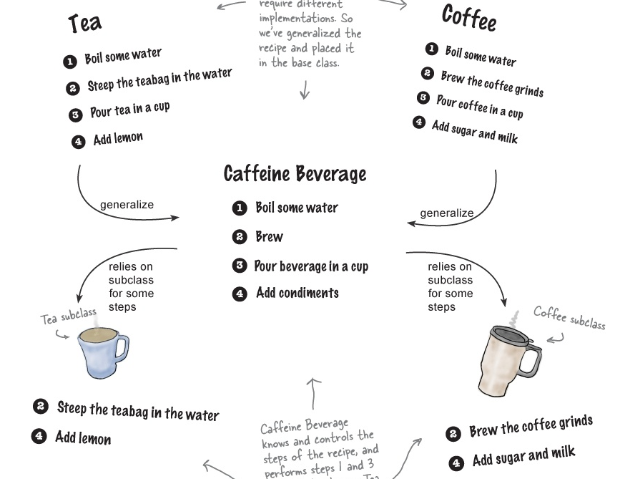
Template Method
“The Template Method Pattern defines the skeleton of an algorithm in a method, deferring some steps to subclasses.
Template Method lets subclasses redefine certain steps of an algorithm without changing the algorithm’s structure.”

Slide 4
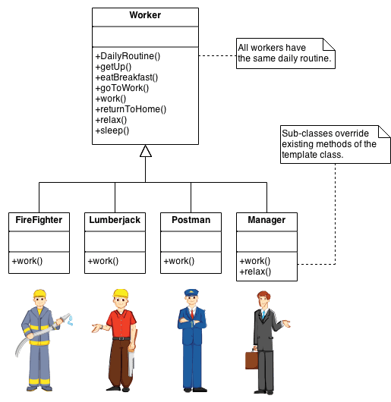
Template Method
“A Template is a method that defines an algorithm as a set of steps.
One or more of these steps is defined to be abstract and implemented by a subclass.
This ensures the algorithm’s structure stays unchanged, while subclasses provide some part of the implementation”

Slide 5
Benefits of the Template method
Underpowered Tea & Coffee implementation | New, hip CaffeineBeverage powered by Template Method
Coffee and Tea are running the show; they control the algorithm. | The CaffeineBeverage class runs the show; it has the algorithm, and protects it.
Code is duplicated across Coffee and Tea. | The CaffeineBeverage class maximizes reuse among the subclasses.
Code changes to the algorithm require opening the subclasses and making multiple changes. | The algorithm lives in one place and code changes only need to be made there.
Classes are organized in a structure that requires a lot of work to add a new caffeine beverage. | The Template Method version provides a framework that other caffeine beverages can be plugged into. New caffeine beverages only need to implement a couple of methods.
Knowledge of the algorithm and how to implement it is distributed over many classes. | The CaffeineBeverage class concentrates knowledge about the algorithm and relies on subclasses to provide complete implementations.

Slide 6
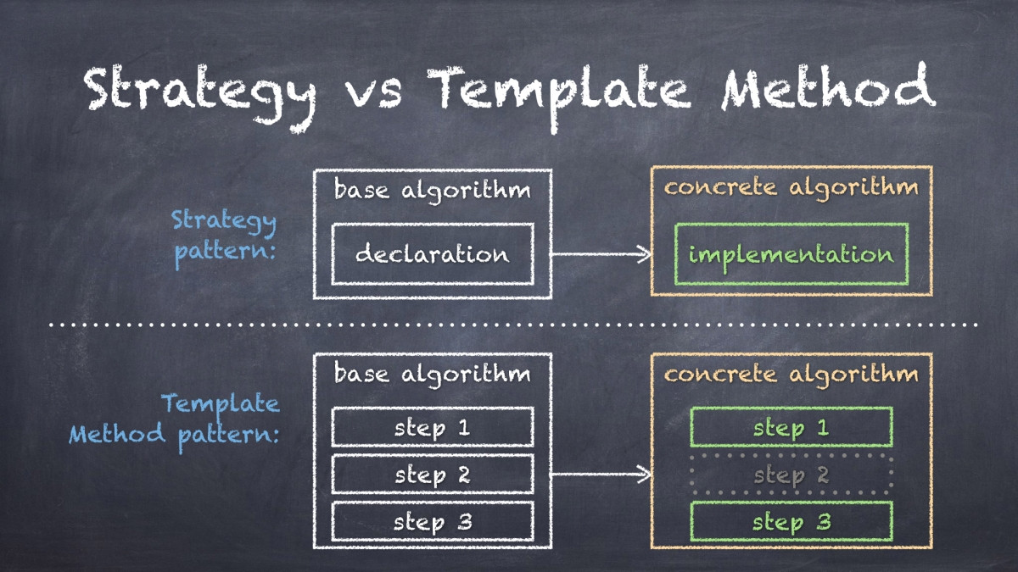

Slide 7
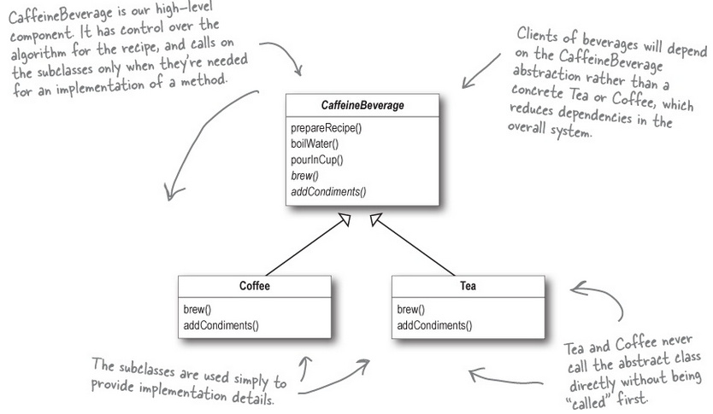
Starbuzz Coffee Example
https://dev.azure.com/spektrix/spektrix/_git/patterns-study-group?path=%2FTemplateMethod&version=GBmaster

Slide 8
Next Session
Let’s talk about… Abstract Factory Pattern

