Slide 1


Welcome to the Spektrix Patterns Group
Composite with Iterator and Recap

Slide 2
Agenda
To discuss and improve our understanding of design patterns. Initially we'll follow the 23 week guide covering the Gang of Four Design Patterns laid out by Joshua Kerievsky here - https://www.industriallogic.com/papers/learning.html
Although we'll introduce the Pattern with a code example at the start of the meeting, this is not designed to be a training session, it's intended to be a Study group to consider various questions about the pattern. In doing so we'll benefit from the wisdom of the crowd and hopefully improve our understanding.
Deep knowledge of patterns isn't required, and a diverse range of perspectives is encouraged, but it would be useful preparation if you have studied the pattern that'll be discussed before each session.
1 hour approximately
Demonstration of a problem that can be solved or avoided using the decorator pattern.
We will walk through the decision process and design process whixh leads to the Strategy Pattern emerging

Slide 3
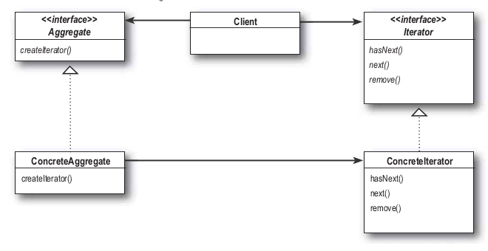
Iterator Pattern
“The Iterator Pattern provides a way to access the elements of an aggregate object sequentially without exposing its underlying representation. ”
This pattern allows traversal of the elements of an aggregate without exposing the underlying implementation.
It also places the task of traversal on the iterator object, not on the aggregate, which simplifies the aggregate interface and implementation, and places the responsibility where it should be.

Slide 4
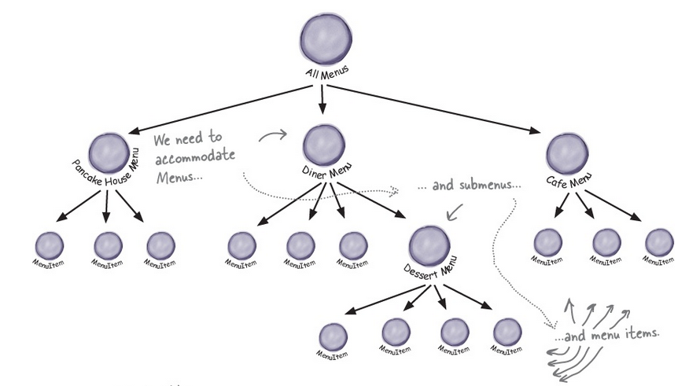
Composite Pattern
“The Composite Pattern allows you to compose objects into tree structures to represent part-whole hierarchies. Composite lets clients treat individual objects and compositions of objects uniformly.”
This pattern allows us to build structures of objects in the form of trees that contain both compositions of objects and individual objects as nodes.

Slide 5
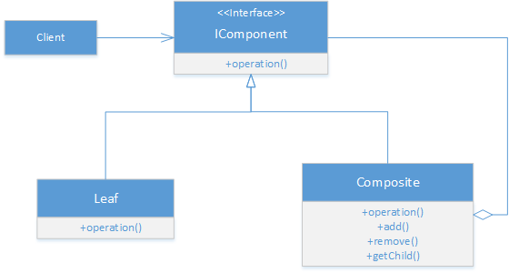
Composite Pattern
Using a composite structure, we can apply the same operations over both composites and individual objects.
In other words, in most cases we can ignore the differences between compositions of objects and individual objects.

Slide 6
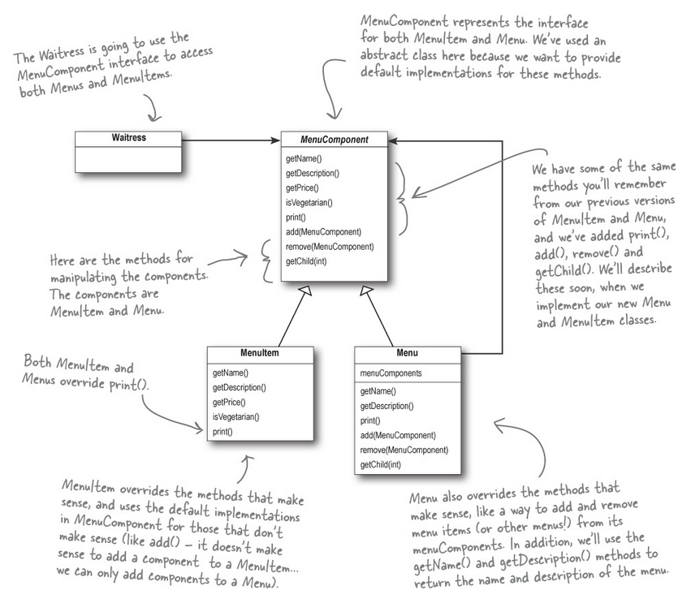
Restaurant Example
https://dev.azure.com/spektrix/spektrix/_git/patterns-study-group?path=%2FCompositeIterator&version=GBmaster

Slide 7
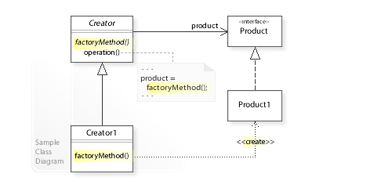
Factory Method
The Creator class that requires a Product object doesn't instantiate the Product1 class directly.
Instead, the Creator refers to a separate factoryMethod()to create a product object

Slide 8
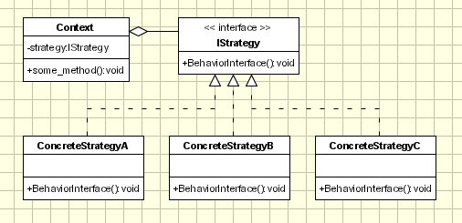
Strategy Pattern
“The Strategy Pattern defines a family of algorithms, encapsulates each one, and makes them interchangeable. Strategy lets the algorithm vary independently from clients that use it.” the Context class doesn't implement an algorithm directly.
Instead, Context refers to the Strategy interface for performing an algorithm (strategy.algorithm()), which makes Context independent of how an algorithm is implemented.
Notes:
Strategy is a Behavioural design pattern Iterator Template Method
Observer

Slide 9
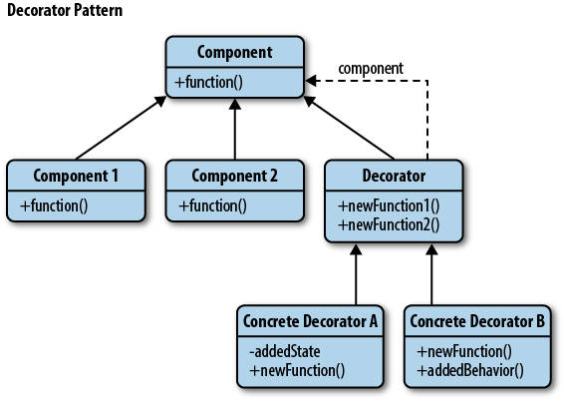
Decorator Pattern
“The Decorator Pattern attaches additional responsibilities to an object dynamically. Decorators provide a ﬂexible alternative to subclassing for extending functionality.” This pattern is designed so that multiple decorators can be stacked on top of each other, each time adding a new functionality to the overridden method(s).
Notes:
Strategy is a Behavioural design pattern Iterator Template Method
Observer

Slide 10
Next Session
Let’s talk about… Template Method Pattern
abstract class PatternsStudyGroup
{
protected void Run()
{
Introduction();
HandsOnCode();
ReviewAndQuestions();
}
abstract void Introduction() {}
abstract void HandsOnCode() {}
abstract void ReviewAndQuestions() {}
}

