Slide 1


Welcome to the Spektrix Patterns Group
Decorator Pattern

Slide 2
Agenda
To discuss and improve our understanding of design patterns. Initially we'll follow the 23 week guide covering the Gang of Four Design Patterns laid out by Joshua Kerievsky here - https://www.industriallogic.com/papers/learning.html
Although we'll introduce the Pattern with a code example at the start of the meeting, this is not designed to be a training session, it's intended to be a Study group to consider various questions about the pattern. In doing so we'll benefit from the wisdom of the crowd and hopefully improve our understanding.
Deep knowledge of patterns isn't required, and a diverse range of perspectives is encouraged, but it would be useful preparation if you have studied the pattern that'll be discussed before each session.
1 hour approximately
Demonstration of a problem that can be solved or avoided using the decorator pattern.
We will walk through the decision process and design process whixh leads to the Strategy Pattern emerging

Slide 3
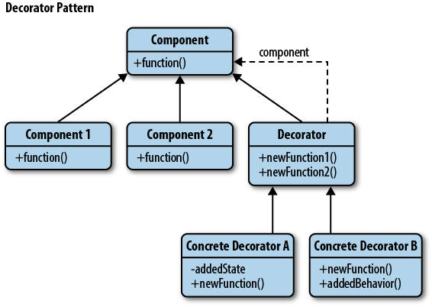
Decorator Pattern
“The Decorator Pattern attaches additional responsibilities to an object dynamically. Decorators provide a ﬂexible alternative to subclassing for extending functionality.” This pattern is designed so that multiple decorators can be stacked on top of each other, each time adding a new functionality to the overridden method(s).
Notes:
Strategy is a Behavioural design pattern Iterator Template Method
Observer

Slide 4
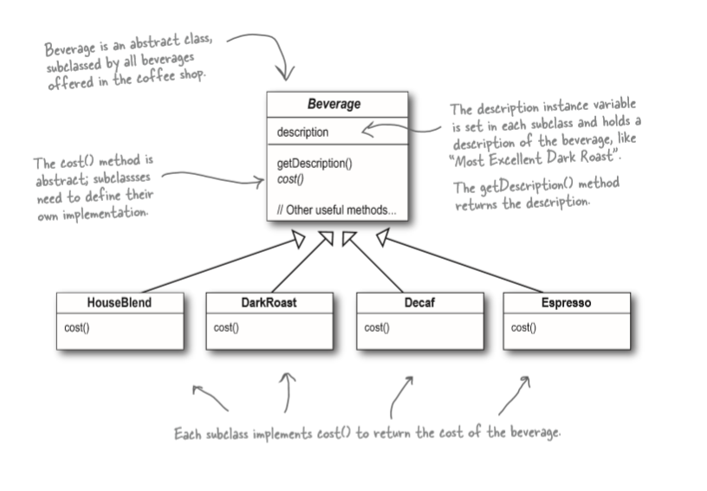
StarBuzz Coffee Example
https://github.com/ronheywood/patternsgroup-decorator

Slide 5
Next Session
Let’s talk about… Composite
Spektrix.PatternsGroup.Members.ForEach(m =>
m.Traverse(patterns)
)

