Slide 1

Active Directory Automation Using Python Tutorial 15
Bulk User Load From Csv

Slide 2
Load Bulk user from csv
Dynamic cv, samaccountname, email generation
Validate against duplicate
Identify exceptions

Slide 3
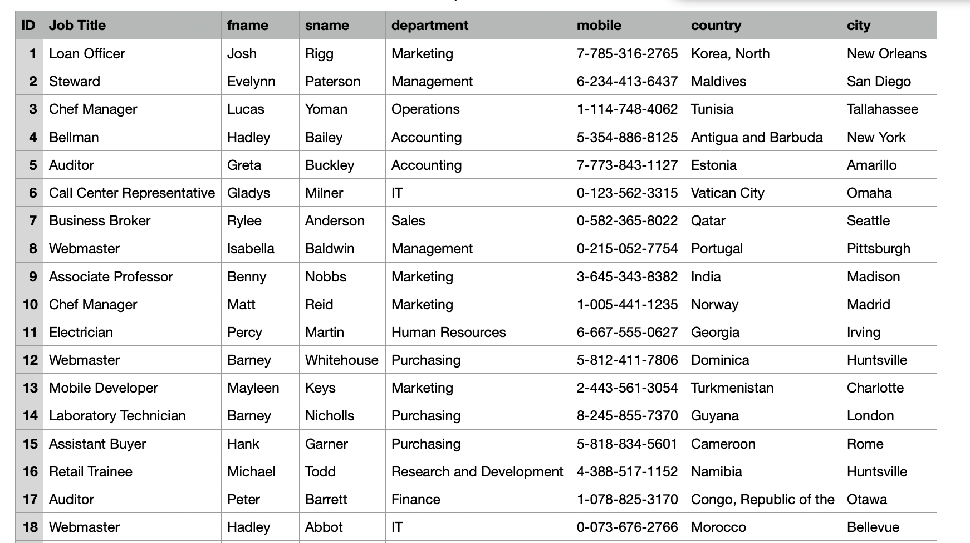
Csv file format

