Slide 1
CrewAI Complete Tutorial
Introduction
Tutorial :1

Slide 2
What is CrewAI
CrewAI is an open-source framework for orchestrating role-playing and autonomous AI agents. It helps create collaborative AI agents to accomplish complex goals with ease.
https://crewai.com/

Slide 3
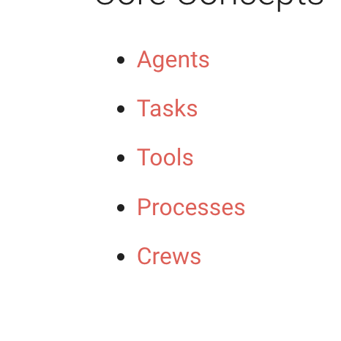
Components

Slide 4
installation
pip install crewai
pip install 'crewai[tools]'

