Slide 1
CrewAI Complete Tutorial
Generate Blog Post On Any Topic Using CrewAI
Tutorial :1

Slide 2
What is CrewAI
CrewAI is an open-source framework for orchestrating role-playing and autonomous AI agents. It helps create collaborative AI agents to accomplish complex goals with ease.
https://crewai.com/
https://docs.crewai.com/

Slide 3
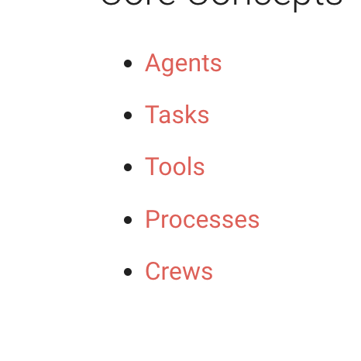
Components

Slide 4
installation
pip install crewai
pip install 'crewai[tools]'

Slide 5
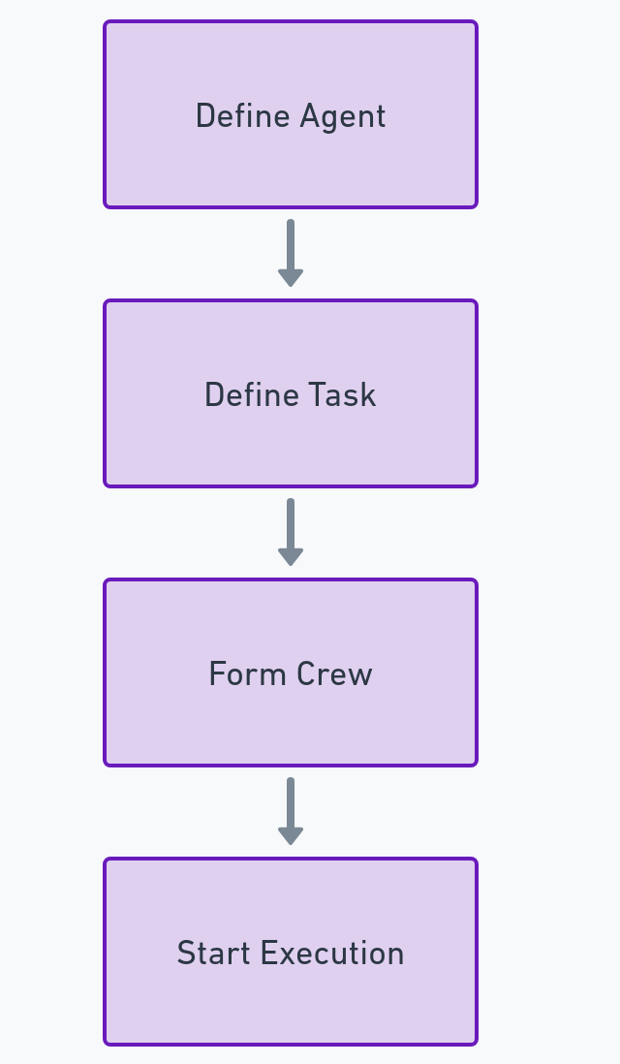
Forming one crew with enhanced configurations to research and write blog post on any topic

Slide 6
Source code
https://github.com/ronidas39/CrewAITutorial/tree/main/tutorial1

