Slide 1

Graphql With Python Fastapi Tutorial 5
Create Weather Api Using Graphql

Slide 2
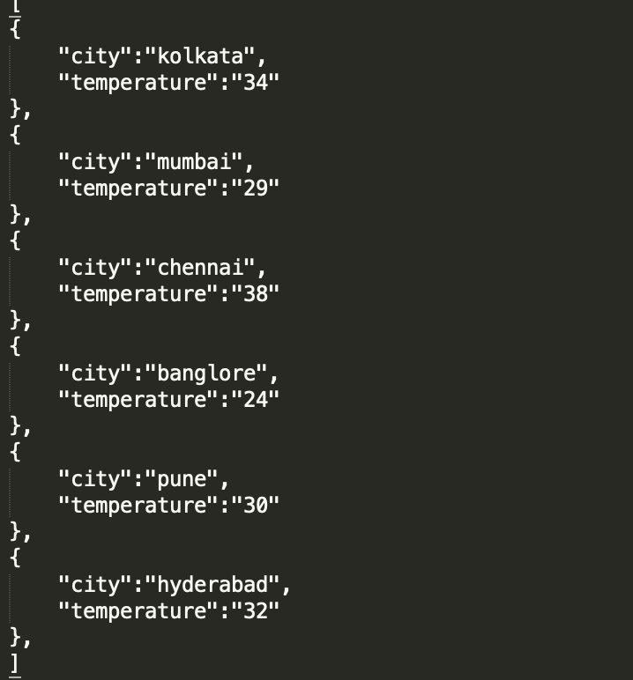
Dummy Data

Slide 3
How to work with graphql and fastapi
Install graphene
Install fastapi
Install uvicorn

Slide 4
Sample code
https://github.com/ronidas39/Graphql_Python

