Slide 1

Graphql With Python Fastapi Tutorial 2
ObjectType In Grapehene

Slide 2
What is ObjectType
A Graphene ObjectType is the building block used to define the relationship between Fields in your Schema and how their data is retrieved.
The basics:
Each ObjectType is a Python class that inherits from graphene.ObjectType.
Each attribute of the ObjectType represents a Field.
Each Field has a resolver method to fetch data (or Default Resolver).

Slide 3
How to work with graphql and fastapi
Install graphene
Install fastapi
Install uvicorn

Slide 4
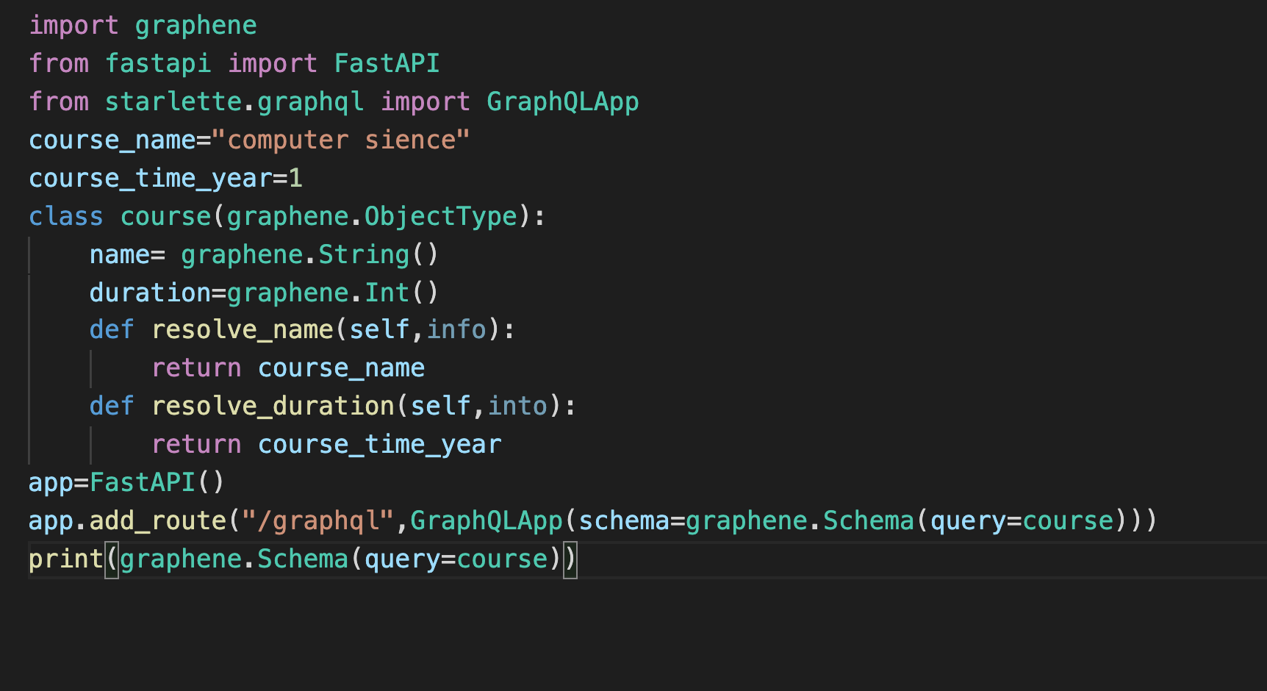
Sample code for use case 1

Slide 5
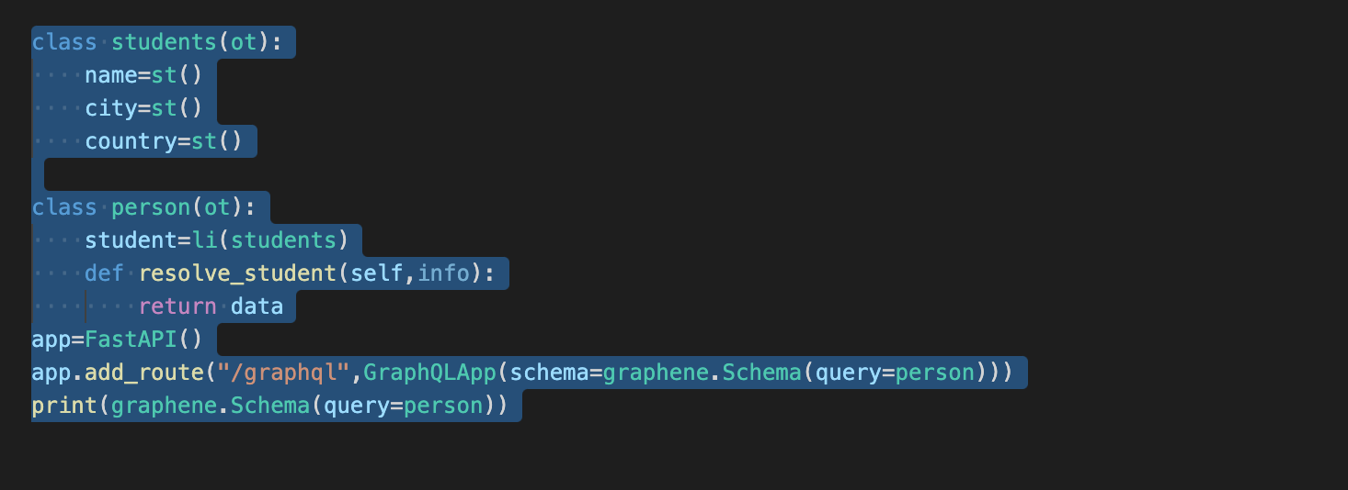
Sample code for use case 2

