Slide 1

Graphql With Python Fastapi Tutorial 6
Metaclass In Graphql /Graphene

Slide 2
Graphql documentation

Slide 3
How to work with graphql and fastapi
Install graphene
Install fastapi
Install uvicorn

Slide 4
Uses of Metaclass
By default the type name in the GraphQL schema will be the same as the class name that defines the ObjectType. This can be changed by setting the name property on the Meta class
The schema description of an ObjectType can be set as a docstring on the Python object or on the Meta inner class.

Slide 5
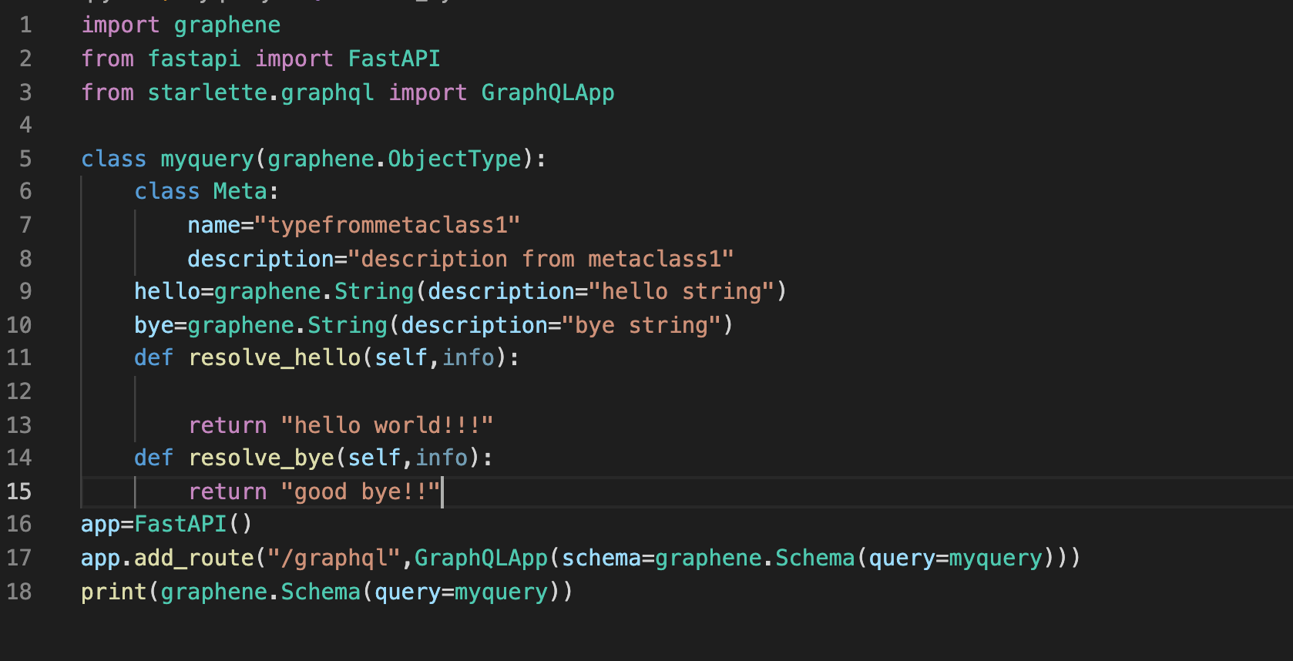
Source code

