Slide 1

Graphql With Python Fastapi Tutorial 9
Resolving data objects to types
In Graphql /Graphene

Slide 2
Resolving data objects to types
As you build out your schema in Graphene it’s common for your resolvers to return objects that represent the data backing your GraphQL types rather than instances of the Graphene types ObjectType and Scalar fields, however when you start using Interfaces you might come across this error:
"Abstract type Character must resolve to an Object type at runtime for field Query.xxx ..."
This happens because Graphene doesn’t have enough information to convert the data object into a Graphene type needed to resolve the Interface. To solve this you can define a resolve_type class method on the Interface which maps a data object to a Graphene type

Slide 3
How to work with graphql and fastapi
Install graphene
Install fastapi
Install uvicorn

Slide 4
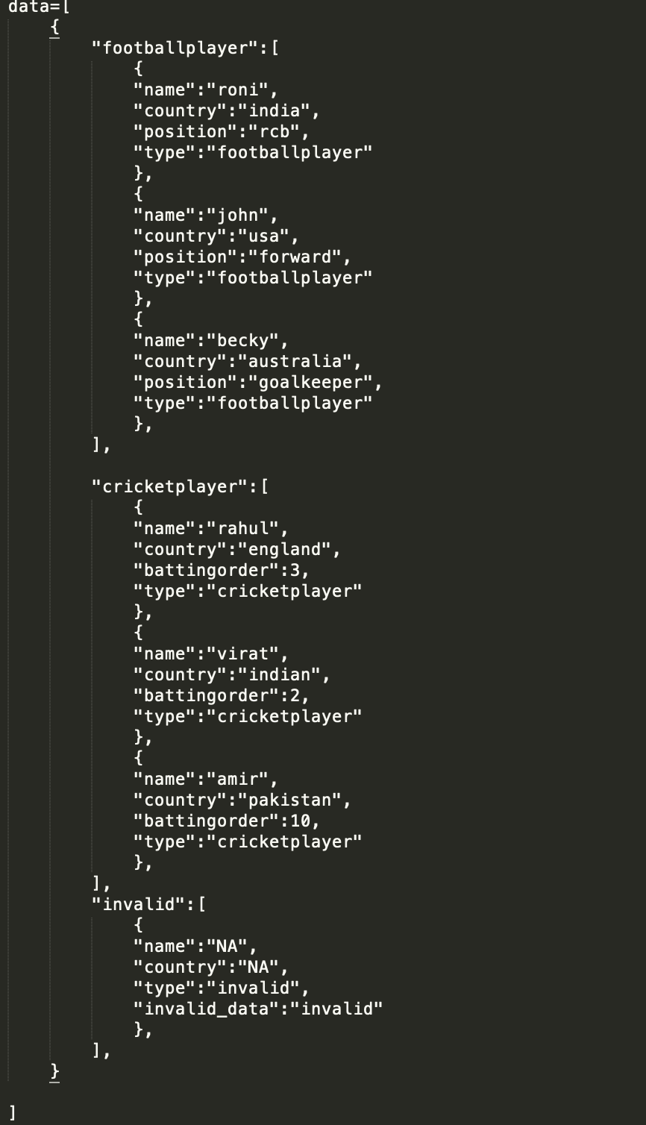
data

Slide 5
Source code
https://github.com/ronidas39/Graphql_Python/tree/main/tutorial9

