Slide 1

Graphql With Python Fastapi Tutorial 1
Introduction

Slide 2
What is Graphql
GraphQL is a query language for APIs and a runtime for fulfilling those queries with your existing data. GraphQL provides a complete and understandable description of the data in your API, gives clients the power to ask for exactly what they need and nothing more, makes it easier to evolve APIs over time, and enables powerful developer tools.
Ask for what you need, get exactly that Send a GraphQL query to your API and get exactly what you need, nothing more and nothing less. GraphQL queries always return predictable results. Apps using GraphQL are fast and stable because they control the data they get, not the server.
https://graphql.org/

Slide 3
How to use with Python to work with graphql and fastapi
Install graphene
Install fastapi
Install uvicorn

Slide 4
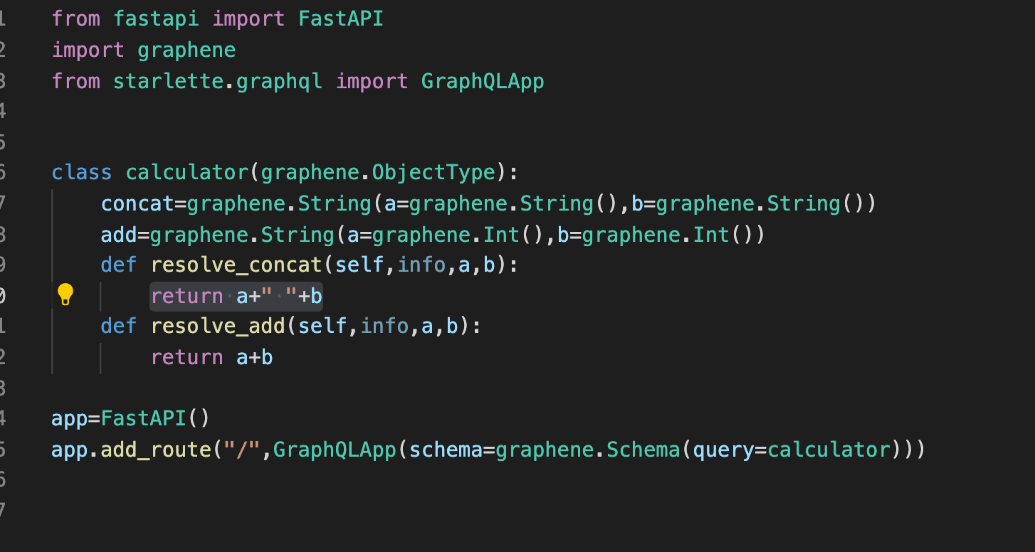
Sample code

