Slide 1

Graphql With Python Fastapi Tutorial 8
Interface with List type In Graphql /Graphene

Slide 2
Interface in graphene
An Interface is an abstract type that defines a certain set of fields that a type must include to implement the interface.
For example, you can define an Interface player that represents any player from different sports like football or cricket
Any ObjectType that implements player will have these exact fields, with these arguments and return types.
For example, here are some types that might implement player , Both of these types have all of the fields from the player interface, but also bring in extra fields like position and battingorder, that are specific to that particular type of sports player.

Slide 3
How to work with graphql and fastapi
Install graphene
Install fastapi
Install uvicorn

Slide 4
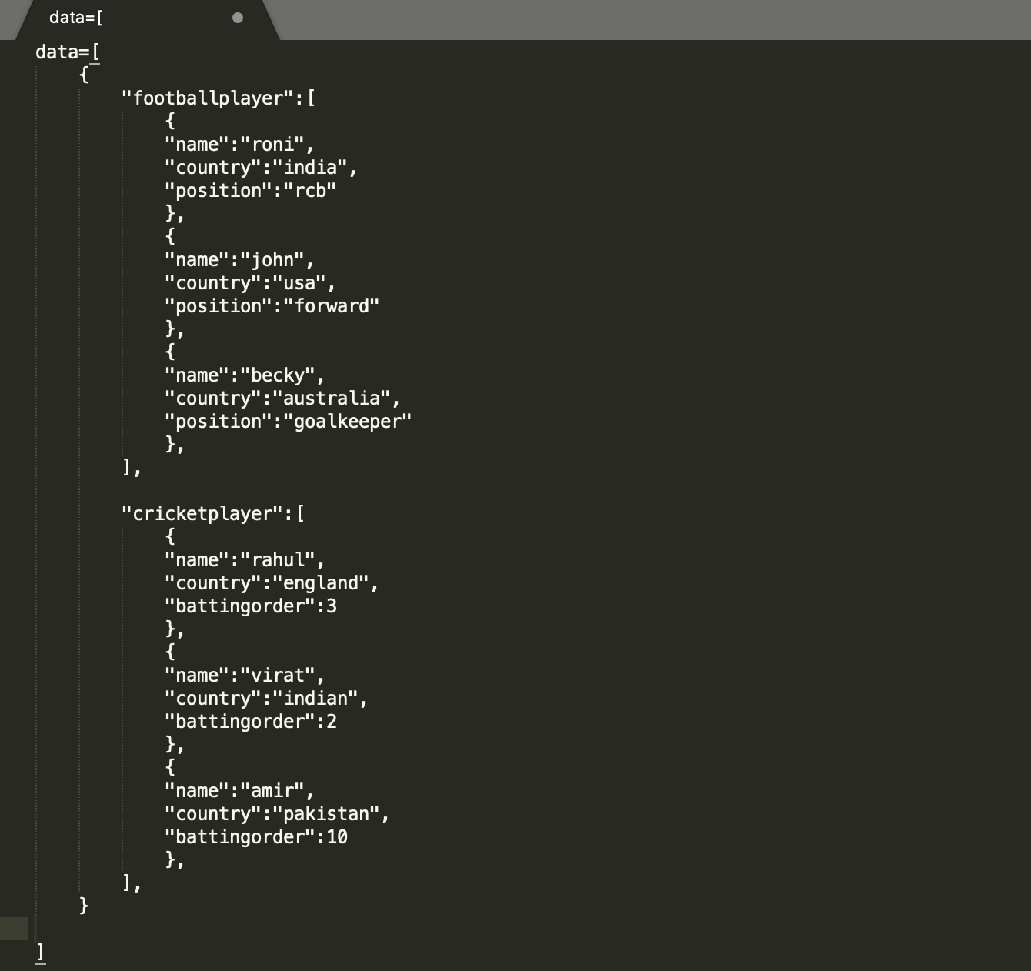
data

Slide 5
Source code
https://github.com/ronidas39/Graphql_Python/tree/main/tutorial8

