Slide 1

NEO4J With Python Tutorial 104
Creating Dashboard From Neo4j Graph Using Python

Slide 2
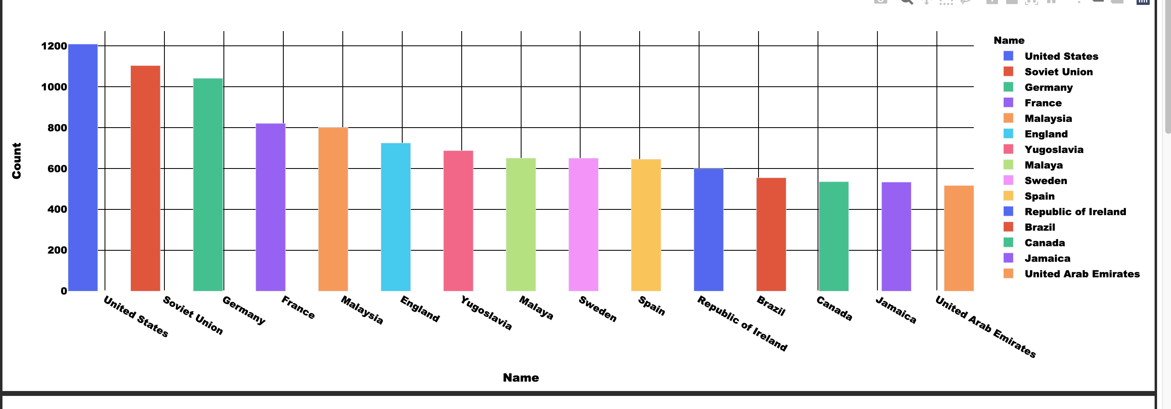
Sample Dashboard

Slide 3
Data Loading
Csv File load using apoc
apoc.import.file.enabled=true
apoc.import.file.use_neo4j_config=false

Slide 4
Dashboard Generation Using Dash Plotly
https://plotly.com/dash/
https://pypi.org/project/dash/

Slide 5
Dashboard code
Github link:
from neo4j import GraphDatabase import dash import dash_core_components as dcc import dash_html_components as html import plotly.express as px import pandas as pd import dash_table import datetime import json from dash.dependencies import Input, Output

