Slide 1

NEO4J With Python Tutorial 104
Creating Dashboard From Neo4j Graph Using Python

Slide 2
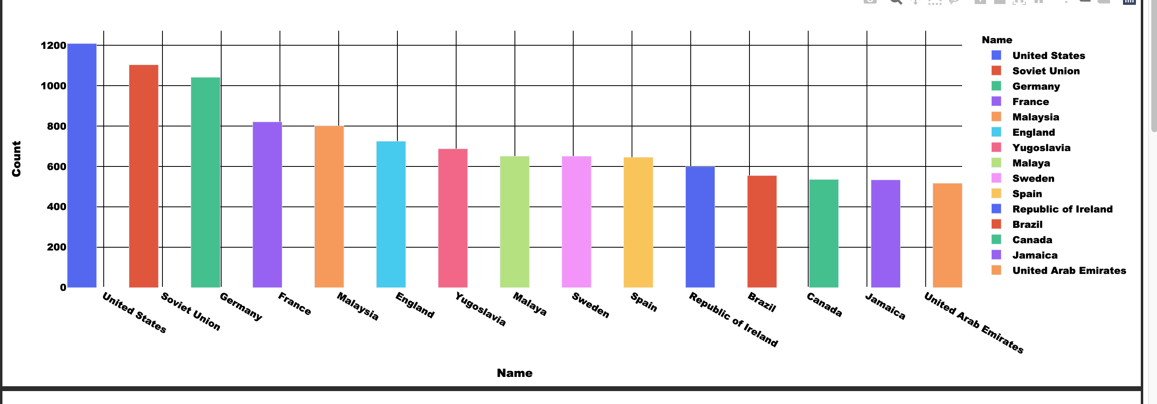
Sample Dashboard

Slide 3
Data Loading
Csv File load using apoc

Slide 4
Dashboard Generation Using Dash Plotly
https://plotly.com/dash/
https://pypi.org/project/dash/

Slide 5
Dashboard code
Github link:

