Slide 1

NEO4J With Python Tutorial 108
Delete Single node in neo4j Graph using fastapi

Slide 2
Pre-requisite
Python >3.6
Install fastapi
Install uvicorn
Install neo4j python driver

Slide 3
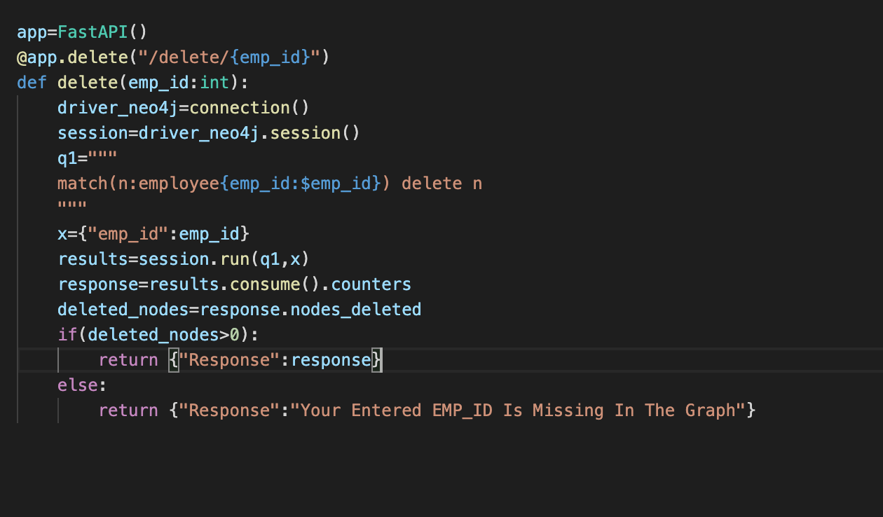
Simple Rest Endpoint Using FastAPI to Delete One Existing Node In Neo4j

