Slide 1

NEO4J With Python Tutorial 110
Neo4j apoc.do.case Procedure

Slide 2
uses of apoc.do.case
apoc.do.case([condition, query, condition, query, …​], elseQuery:'', params:{}) yield value - given a list of conditional / writing query pairs, executes the query associated with the first conditional evaluating to true (or the else query if none are true) with the given parameters

Slide 3
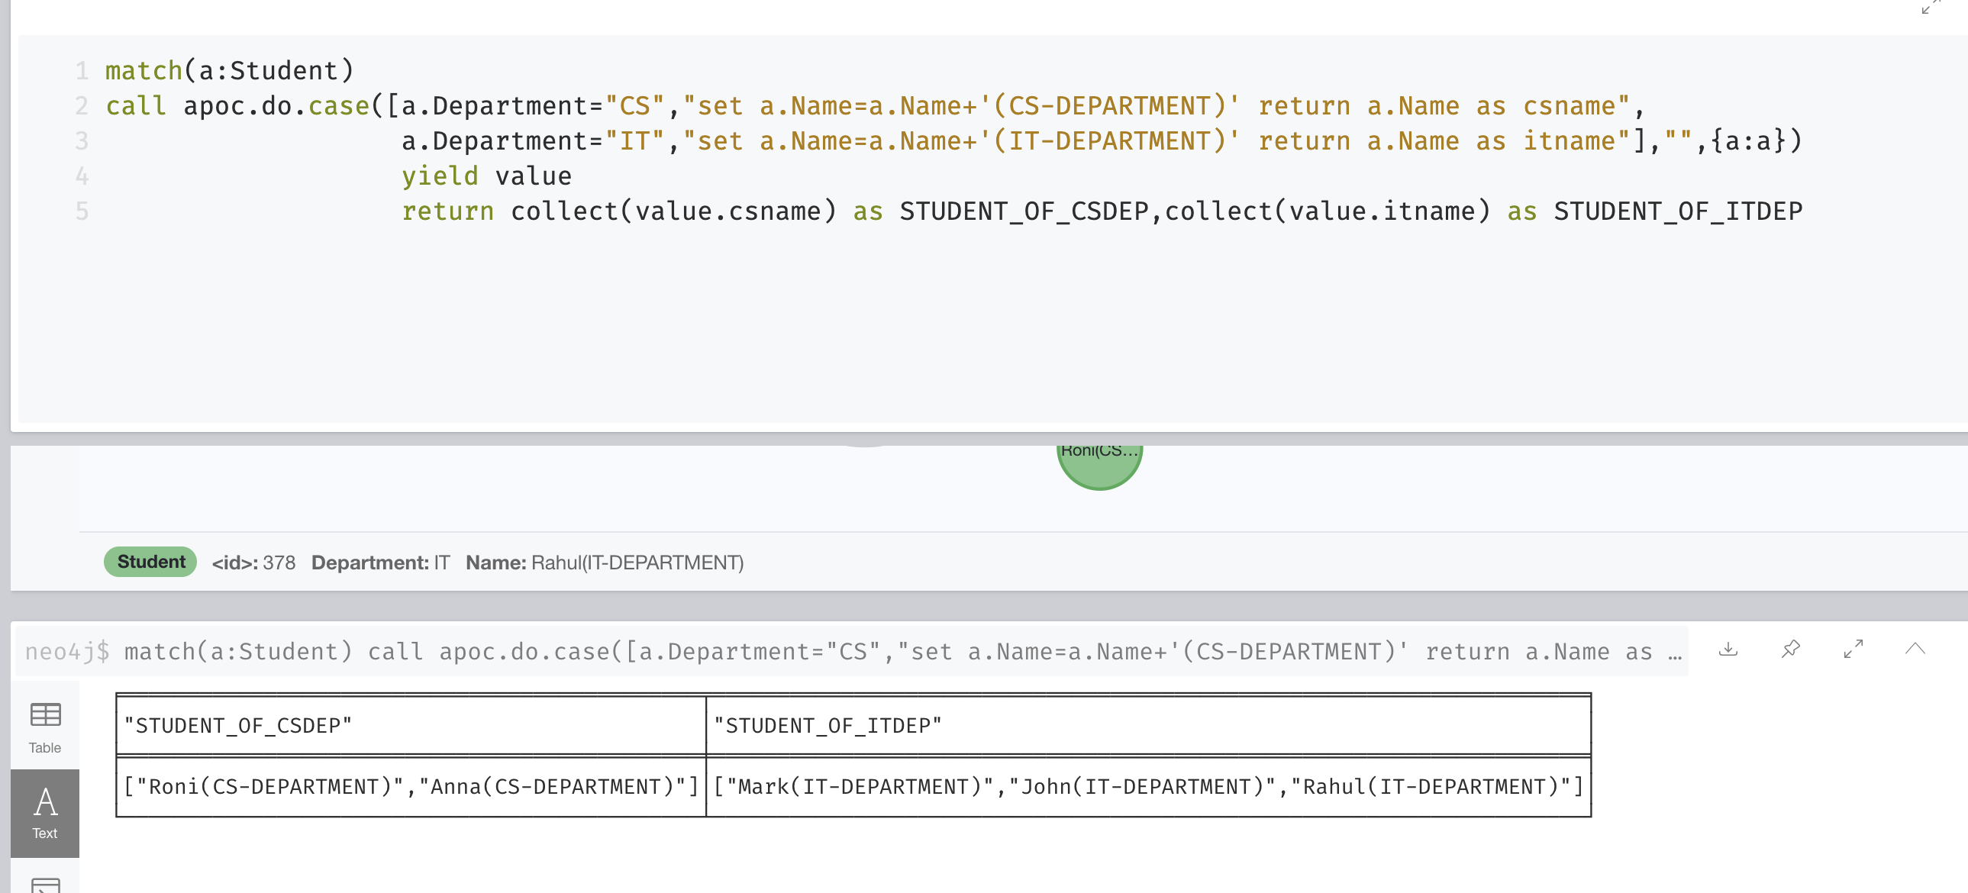
Example of apoc.do.case procedure

