Slide 1
NUMPY COMPLETE TUTORIAL MACHINE LEARNING PREREQUISITE
Numpy argmin & argmax Function
Tutorial 20

Slide 2
What is argmin function
Returns the indices of the minimum values along an axis.

Slide 3
Exercise 1
array([[ 0, 1, 2, 3],
[ 4, 5, 6, 7],
[ 8, 9, 10, 11],
[12, 13, 14, 15],
[16, 17, 18, 19]])
a.argmin(axis=0)
array([0, 0, 0, 0])

Slide 4
Exercise 2
array([[1, 4, 5],
[2, 0, 1],
[0, 2, 1]])
a.argmin(axis=0)
array([2, 1, 1])

Slide 5
Exercise 3
Argmin on axis=1
array([[1, 4, 5],
[2, 0, 1],
[0, 2, 1]])
a.argmin(axis=1)
array([0, 1, 0])

Slide 6
What is argmax function
Returns the indices of the maximum values along an axis.

Slide 7
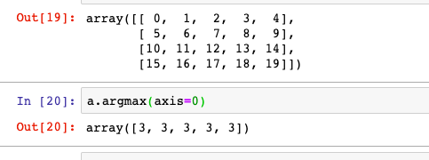
Exercise 1
Argmax on axis=0

Slide 8
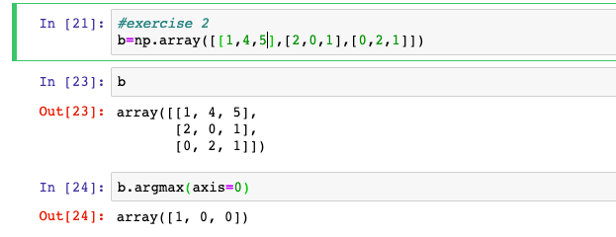
Exercise 2
Argmax on axis=0

Slide 9
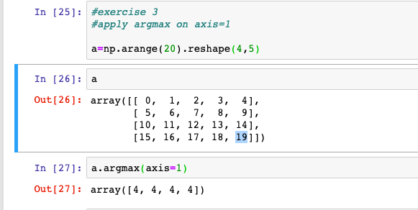
Exercise 2
Argmax on axis=1

