Slide 1
NUMPY COMPLETE TUTORIAL MACHINE LEARNING PREREQUISITE
Numpy vsplit & hsplit
Tutorial 17

Slide 2
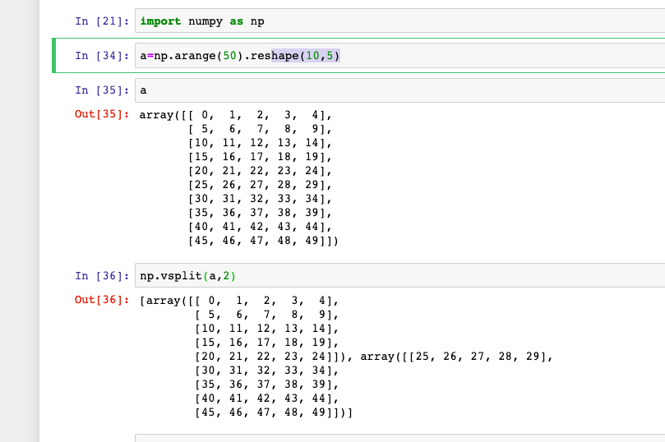
What is vsplit
Split an array into multiple sub-arrays vertically (row-wise). Please refer to the ``split`` documentation. ``vsplit`` is equivalent to ``split`` with `axis=0` (default), the array is always split along the first axis regardless of the array dimension.

Slide 3
Examples

Slide 4
What is hsplit
Split an array into multiple sub-arrays horizontally (column-wise). Please refer to the `split` documentation. `hsplit` is equivalent to `split` with ``axis=1``, the array is always split along the second axis regardless of the array dimension.

Slide 5
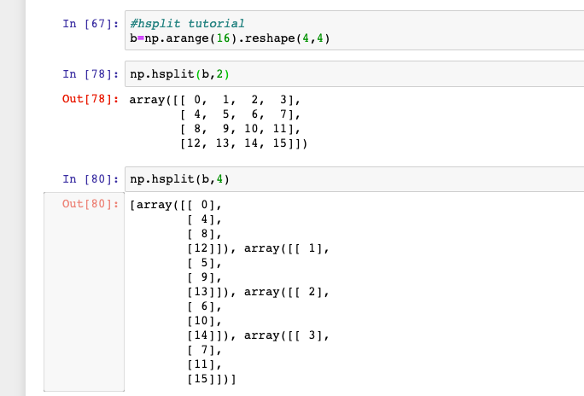
Examples

