Slide 1
NUMPY COMPLETE TUTORIAL MACHINE LEARNING PREREQUISITE
Numpy Masking
Tutorial 15

Slide 2
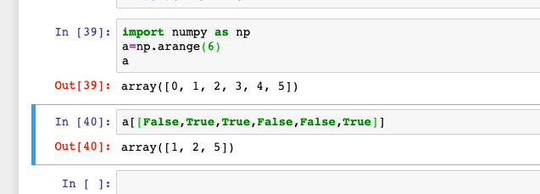
What is masking
NumPy offers one more indexing facilities with arrays with Boolean indicies ,it is useful when you want to decide which item is required and which is not.
Example:1

Slide 3
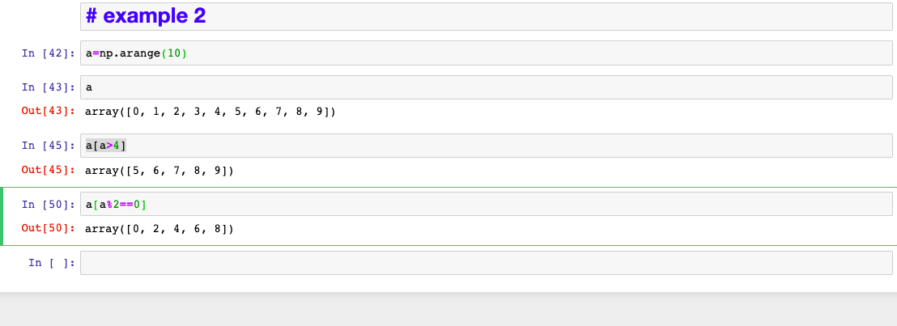
Masking with condition
Example:2

Slide 4
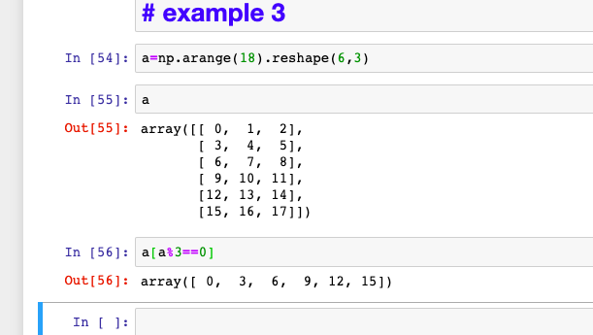
Masking with condition with 2d array
Example:3

