Slide 1
NUMPY COMPLETE TUTORIAL MACHINE LEARNING PREREQUISITE
Numpy amin & amax Function
Tutorial 18

Slide 2
What is amax function
Return the maximum of an array or maximum along an axis.

Slide 3
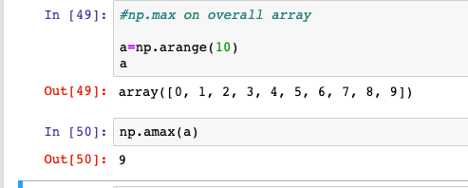
Exercise 1

Slide 4
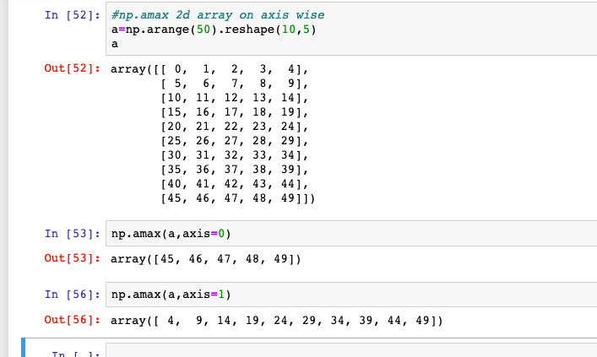
Exercise 2

Slide 5
What is amin function
Return the minimum of an array or minimum along an axis.

Slide 6
Exercise 1
#amin
#on 1 d array
a=np.arange(10,50)
np.min(a)

Slide 7
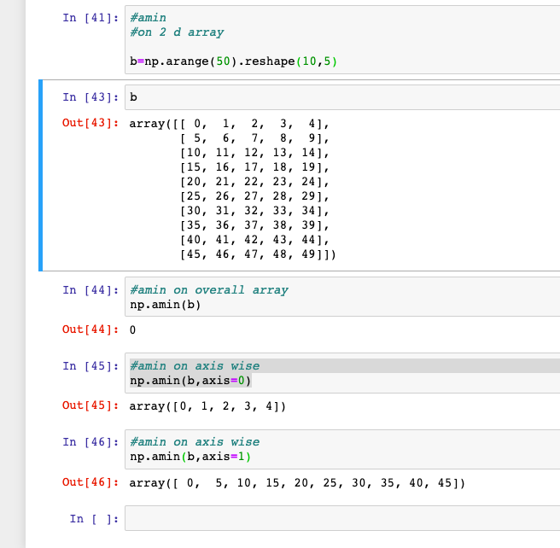
Exercise 2
#amin
#on 2 d array

