Slide 1
NUMPY COMPLETE TUTORIAL MACHINE LEARNING PREREQUISITE
Numpy tile function
Tutorial 18

Slide 2
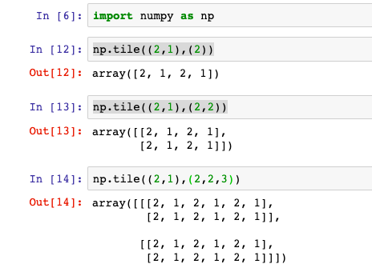
What is tile function in numpy
Construct an array by repeating A the number of times given by reps

Slide 3
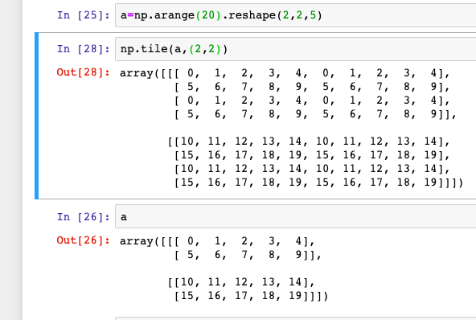
Examples 1

