Slide 1
NUMPY COMPLETE TUTORIAL MACHINE LEARNING PREREQUISITE
Numpy Masking Exercise
Tutorial 16

Slide 2

Exercise 1
Set 0 on the below numpy array where elements are completely divisible by 3

Slide 3
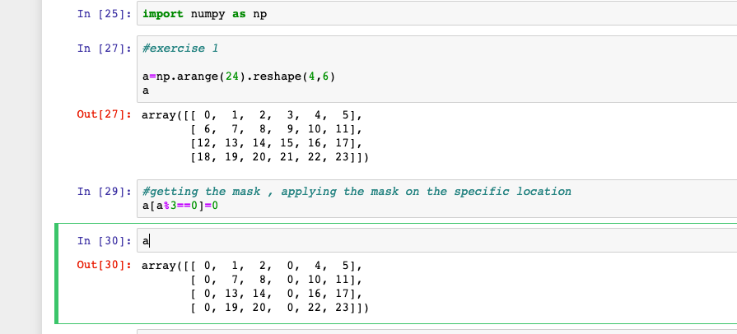
Exercise 1 solution

Slide 4

Exercise 2
Set element*2 for every location where the element is completely divisible by 3
Input array:
Out put array:

Slide 5
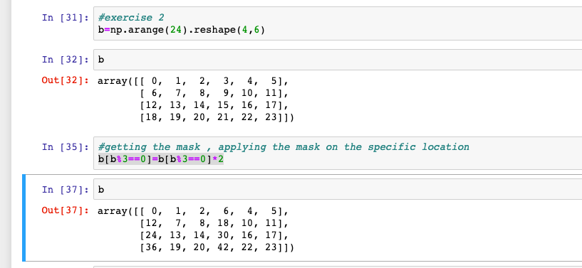
Exercise 2 solution

