Slide 1
Python Gui Using HTML ,CSS,JAVASCRIPT & EEL
Corona App For Live Status Using Python Eel
Tutorial 4

Slide 2
Objective
Create a desktop application to get the live corona virus status for the given country

Slide 3
Structure
https://rapidapi.com/api-sports/api/covid-193
Frontend :Html ,csss,javascript
Backend :Python
Modules:platform,psutil,eel,matplotlib,pandas,requests,json
Module required for packaging :pyinstaller
pip install PyInstaller

Slide 4
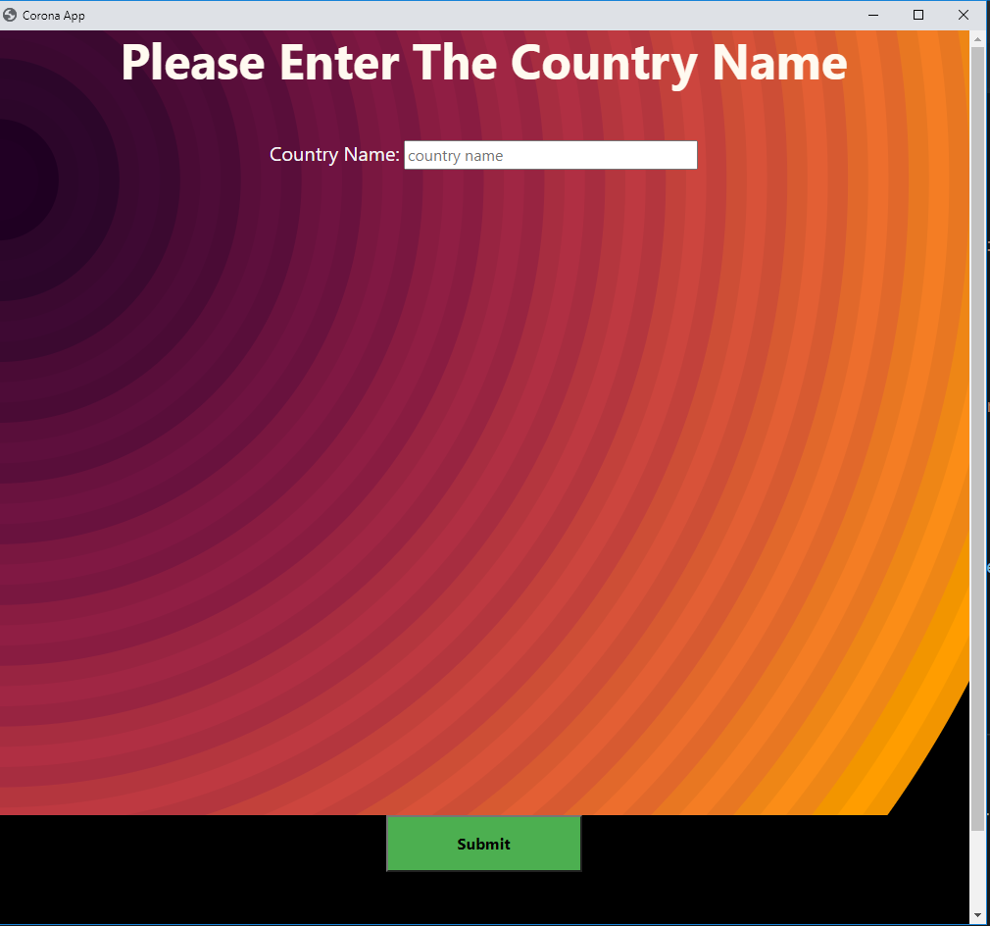
Screenshots

Slide 5
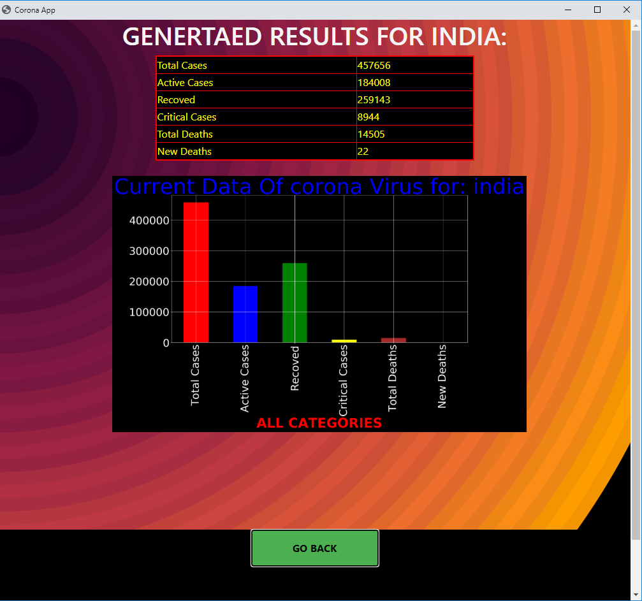
Screenshots

