Slide 1
Python Gui Using HTML ,CSS,JAVASCRIPT & EEL
Python Gui Project ,System Information Generator
Tutorial 2

Slide 2
Objective
Create an python gui application to generate system related information

Slide 3
Structure
Frontend :Html ,csss,javascript
Backend :Python
Modules:platform,psutil

Slide 4
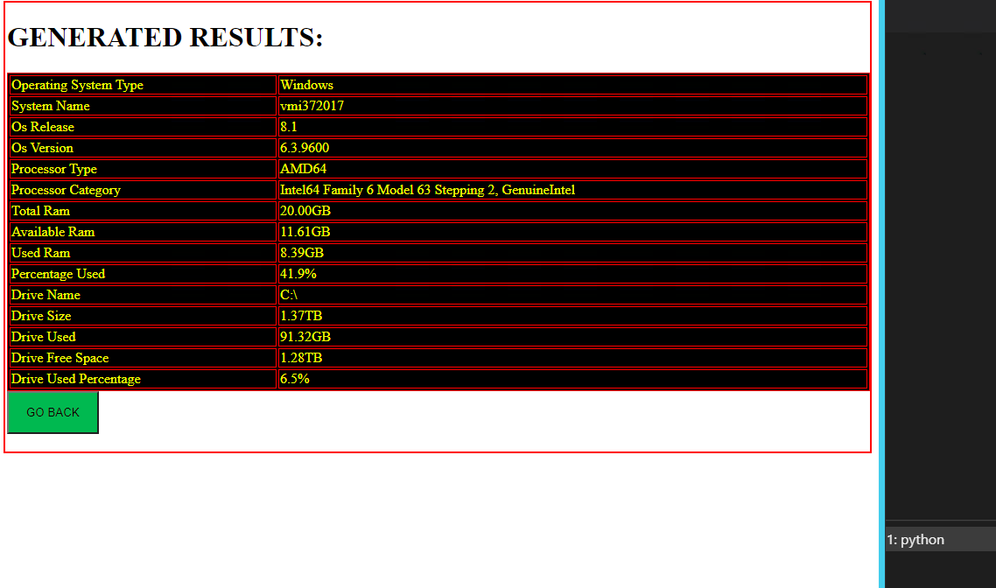
screenshots

