Slide 1
RUST PROGRAMMING COMPLETE TUTORIAL
Exercise On Rust Leap Year Check
Tutorial 42

Slide 2
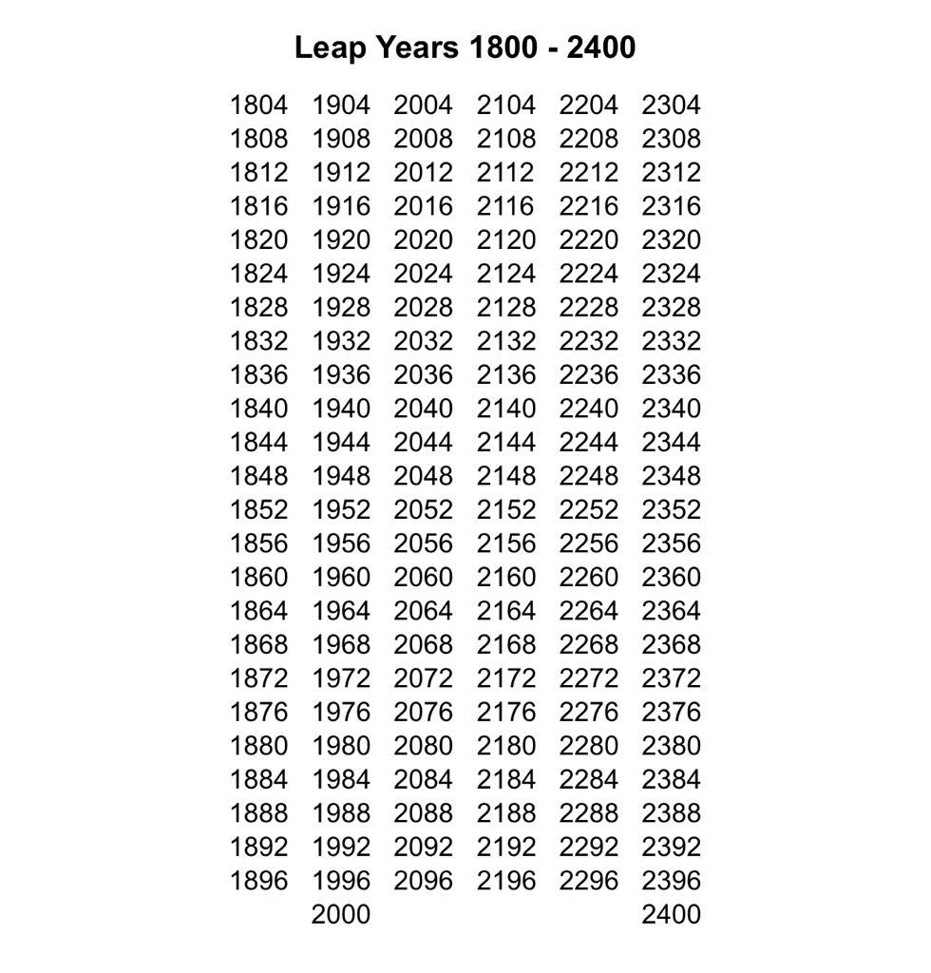
how to check if an year is a leap year

Slide 3
how to check if an year is a leap year
https://github.com/ronidas39/RUST_TUTORIAL

