Slide 1

Smart Contract / Solidity Complete Tutorial
Introduction to smart contracts and solidity
Tutorial :1

Slide 2
What is Smart Contract
A "smart contract" is simply a program that runs on the Ethereum blockchain. It's a collection of code (its functions) and data (its state) that resides at a specific address on the Ethereum blockchain.
A smart contract is a computer program or a transaction protocol which is intended to automatically execute, control or document legally relevant events and actions according to the terms of a contract or an agreement.

Slide 3
Smart Contract Examples
Funding For Startup
New Car Booking

Slide 4
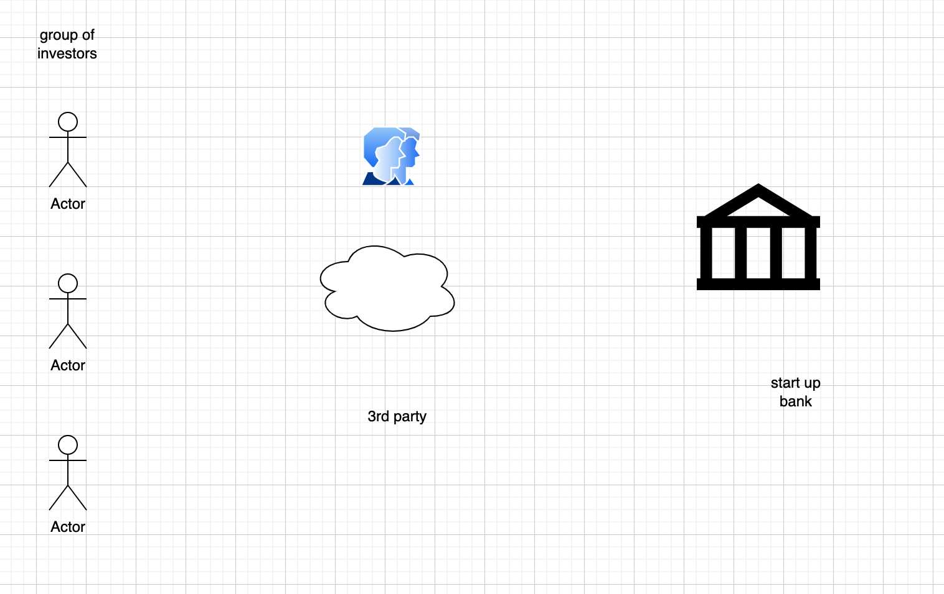
Funding For Startup(classical approach)

Slide 5
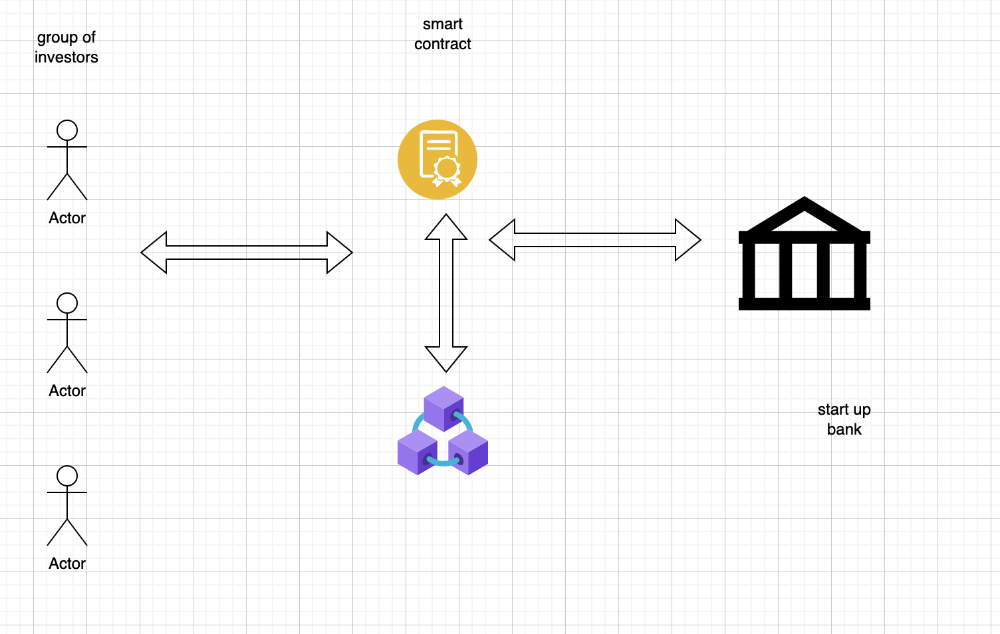
Funding For Startup(smart contract)

Slide 6
Important Terms
Blockchain
Ethereum
Solidity

