Slide 1


Telegram Bot /Automation Using Python
How To Set Commands For Telegram Bot Using Python
TUTOR IAL 3

Slide 2
Set up telegram
Setup bot using bot father
Install pip3 install python-telegram-bot
https://core.telegram.org/bots/api
Setup connection with bot using token
Send sample message using bot

Slide 3
USE CASE
HOW TO SETUP COMMANDS MANUALLY USING BOT FATHER
USES
HOW TO SETUP COMMANDS USING API & PTB PACKAGE

Slide 4

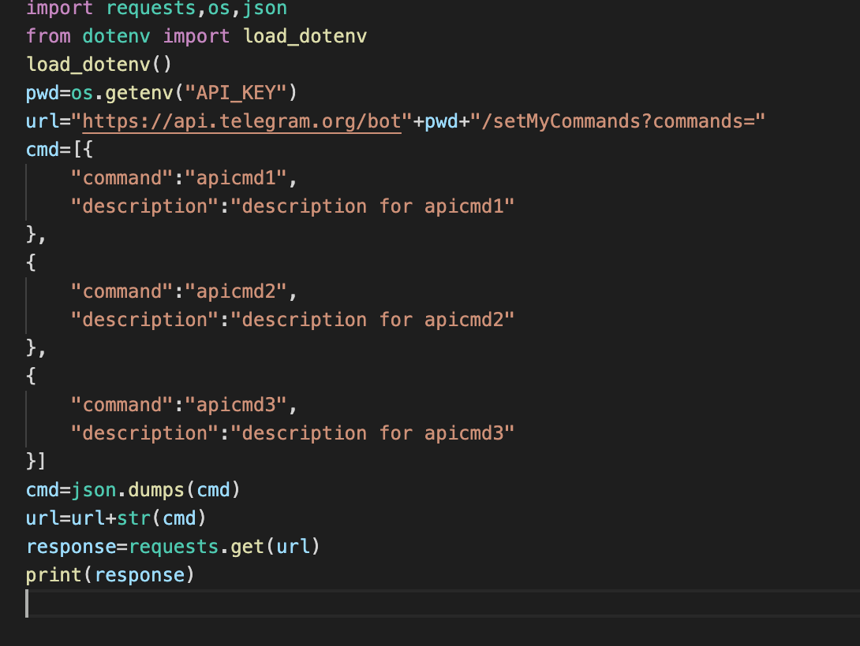
HOW TO SETUP COMMANDS USING API

Slide 5
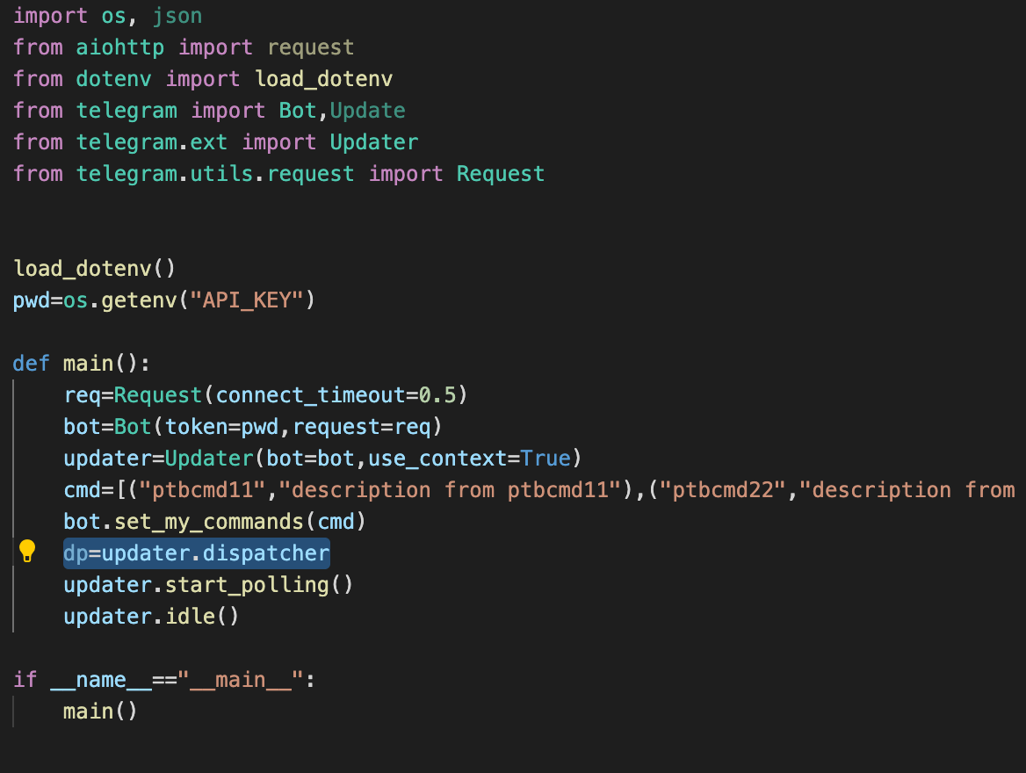
HOW TO SETUP COMMANDS USING PTB PACKAGE

