Slide 1


Telegram Bot /Automation Using Python
How To Respond On Command Using Telegram Bot
Tutorial 4

Slide 2
Set up telegram
Setup bot using bot father
Install pip3 install python-telegram-bot
https://core.telegram.org/bots/api
Setup connection with bot using token
Send sample message using bot

Slide 3
Previous USE CASE
HOW TO SETUP COMMANDS MANUALLY USING BOT FATHER
USES
HOW TO SETUP COMMANDS USING API & PTB PACKAGE

Slide 4

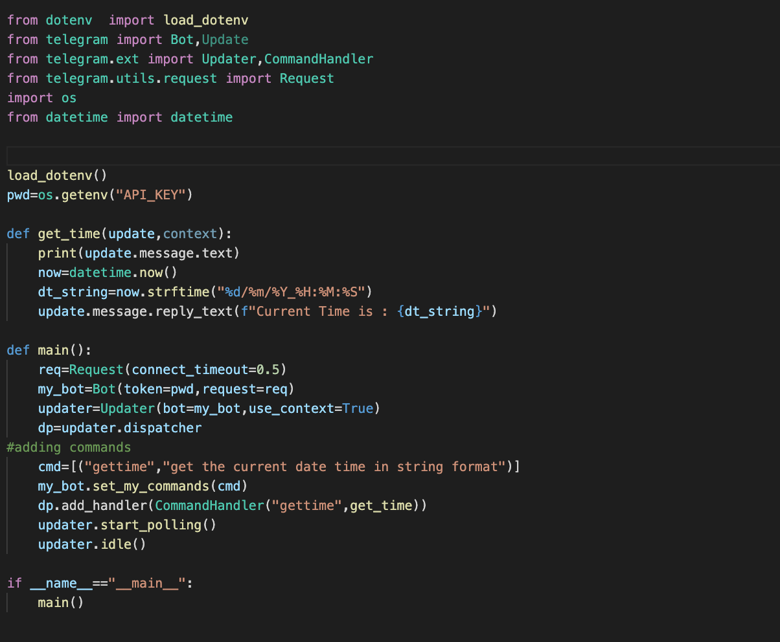
HOW TO Respond on commands using telegram bot

