Slide 1

Interactive Data Visualization In Python Using Bokeh Bokeh Plot Axes Styling Tutorial :10

Slide 2
What is Bokeh
Bokeh is an interactive visualization library for modern web browsers. It provides elegant, concise construction of versatile graphics, and affords high-performance interactivity over large or streaming datasets. Bokeh can help anyone who would like to quickly and easily make interactive plots, dashboards, and data applications.

Slide 3
Link
https://docs.bokeh.org/en/latest/docs/user_guide/quickstart.html

Slide 4
X axis Styling
In this section, we will learn how to change various visual properties of Bokeh plot axes.
test_plot.xaxis.axis_label_text_color="green"
test_plot.xaxis.axis_line_color="green"
test_plot.xaxis.axis_line_width=4
test_plot.xaxis.major_label_text_color="blue"
test_plot.xaxis.major_label_text_font_size="20pt"
test_plot.xaxis.axis_label_text_font_size="20pt"
_font_size="20pt"
test_plot.yaxis.axis_label_standoff=15

Slide 5
y axis Styling
In this section, we will learn how to change various visual properties of Bokeh plot axes.
test_plot.yaxis.axis_label_text_color="yellow"
test_plot.yaxis.axis_line_color="yellow"
test_plot.yaxis.axis_line_width=4
test_plot.yaxis.major_label_text_color="orange"
test_plot.yaxis.major_label_text_font_size="20pt"
test_plot.yaxis.axis_label_text_font_size="20pt"
test_plot.yaxis.axis_label_standoff=15

Slide 6
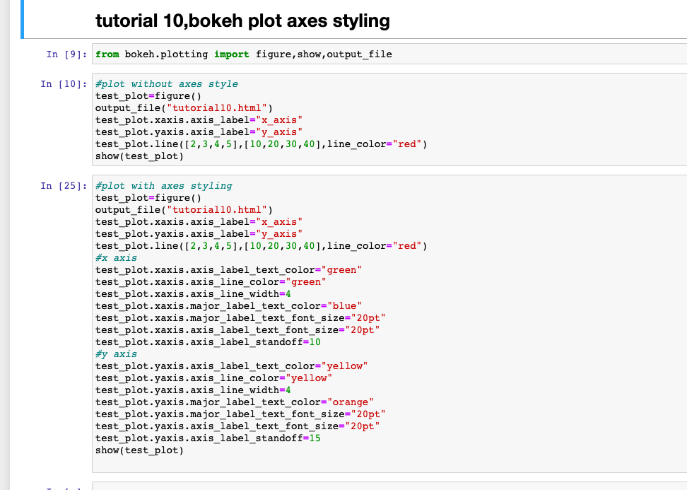
How to style axes

Slide 7
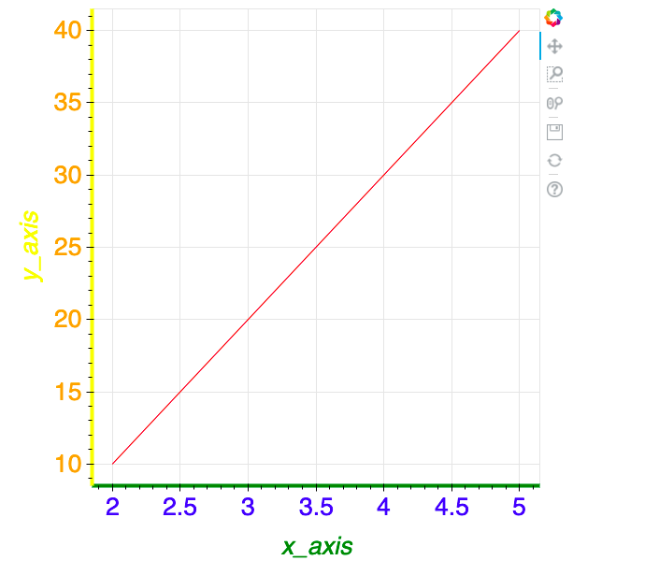
output

