Slide 1

Interactive Data Visualization In Python Using Bokeh How To Change Background Style For Bokeh Plot Tutorial :6

Slide 2
What is Bokeh
Bokeh is an interactive visualization library for modern web browsers. It provides elegant, concise construction of versatile graphics, and affords high-performance interactivity over large or streaming datasets. Bokeh can help anyone who would like to quickly and easily make interactive plots, dashboards, and data applications.

Slide 3
Link
https://docs.bokeh.org/en/latest/docs/user_guide/quickstart.html

Slide 4
Background Styling
The background fill style is controlled by the background_fill_color and background_fill_alpha properties of the Plot object

Slide 5
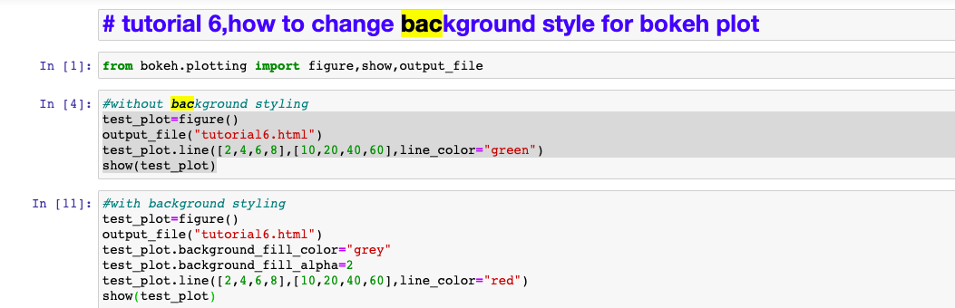
How to style bokeh plot background

Slide 6
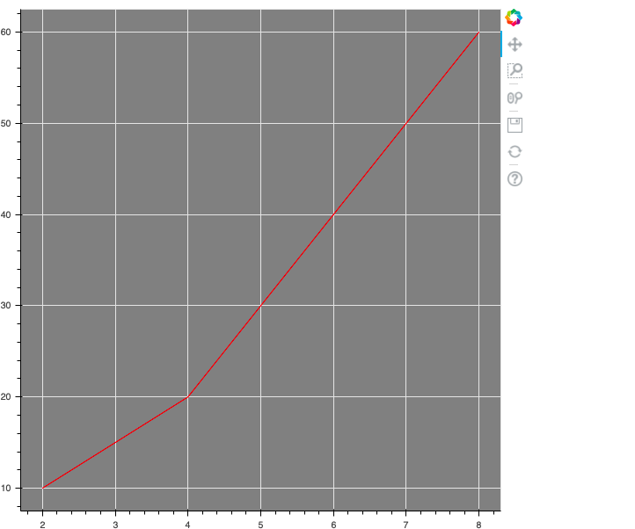
output

