Slide 1

Interactive Data Visualization In Python Using Bokeh Bokeh Plot Border Styling Tutorial :7

Slide 2
What is Bokeh
Bokeh is an interactive visualization library for modern web browsers. It provides elegant, concise construction of versatile graphics, and affords high-performance interactivity over large or streaming datasets. Bokeh can help anyone who would like to quickly and easily make interactive plots, dashboards, and data applications.

Slide 3
Link
https://docs.bokeh.org/en/latest/docs/user_guide/quickstart.html

Slide 4
Border Styling
test_plot.border_fill_color="skyblue"
test_plot.min_border_left=70
test_plot.min_border_right=70
test_plot.min_border_top=40
test_plot.min_border_bottom=40

Slide 5
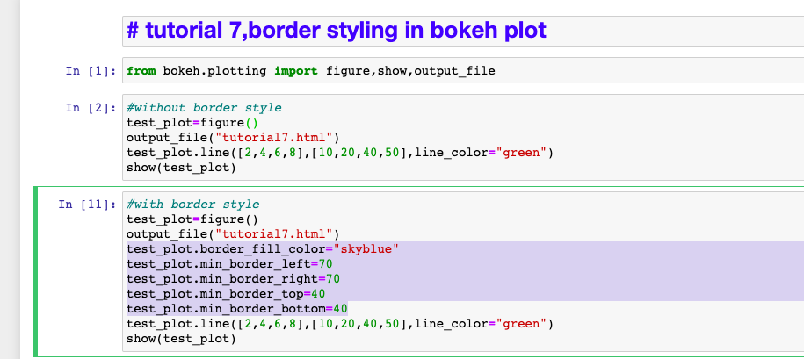
How to style bokeh plot border

Slide 6
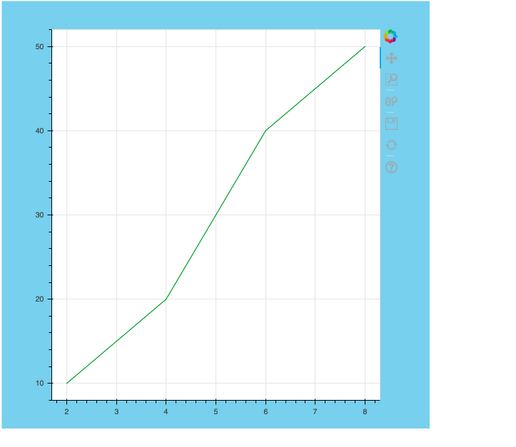
output

