Slide 1

Interactive Data Visualization In Python Using Bokeh Bokeh Plot Grid Styling Tutorial :9

Slide 2
What is Bokeh
Bokeh is an interactive visualization library for modern web browsers. It provides elegant, concise construction of versatile graphics, and affords high-performance interactivity over large or streaming datasets. Bokeh can help anyone who would like to quickly and easily make interactive plots, dashboards, and data applications.

Slide 3
Link
https://docs.bokeh.org/en/latest/docs/user_guide/quickstart.html

Slide 4
Grid Styling
test_plot.xgrid.grid_line_color="red"
test_plot.xgrid.grid_line_width=5
test_plot.ygrid.grid_line_color="green"
test_plot.ygrid.grid_line_width=5

Slide 5
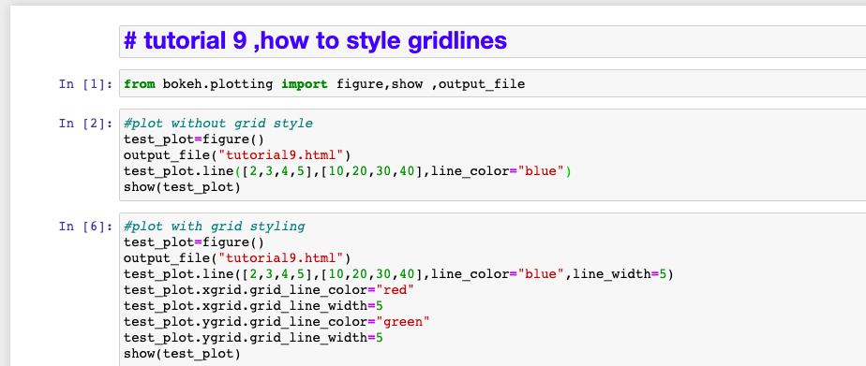
How to style gridlines

Slide 6
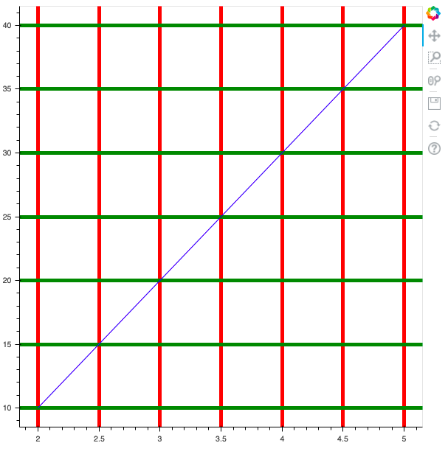
output

