Slide 1
Elasticsearch Complete Tutorial With Python(Hands On /With Source Codes)
Introduction/Course Outline

Slide 2
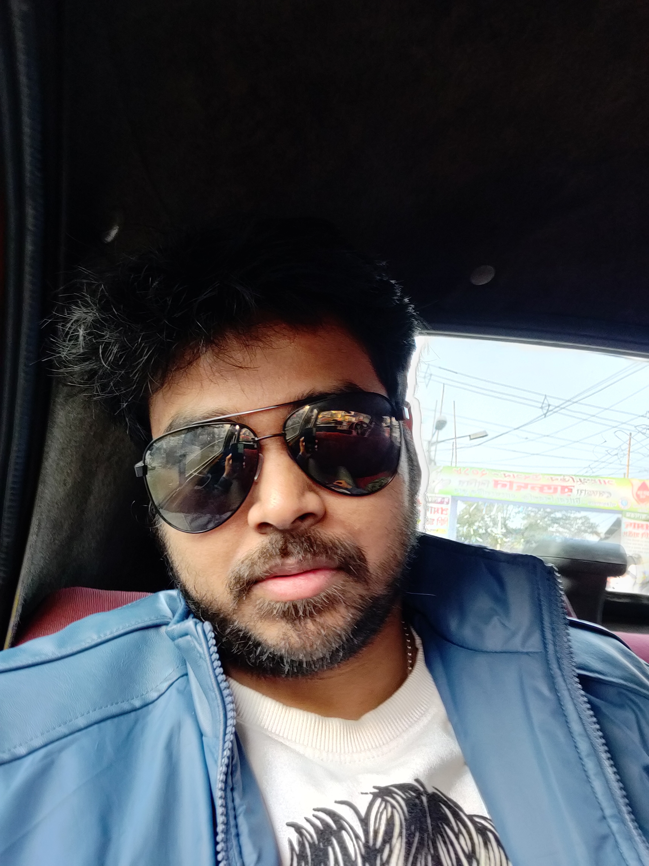
RONI DAS
More than ten years experience in programming , application development.
At present working as consulting engineer.
Started teaching in udemy last year.
https://www.udemy.com/user/ronidas071gmailcom/
Mostly focusing on the topics which are not available .
https://www.linkedin.com/in/roni-das-08b3b866/

Slide 3
Elasticsearch Complete Tutorial With Python
1.Pre-requisites,
2.Setting up the environment
3.What is Elkstack
4.Why it is popular and uses
5.Hands on demonstration of all different use cases
6.All tutorial will contain source code

Slide 4
Thank You
Will see you all in the next tutorial.

