Slide 1

Elasticsearch complete tutorial with python
Introduction To Easticsearch Api
Tutorial :6

Slide 2
Introduction
What is Elasticsearch
ElasticSearch (ES) is a distributed and highly available open-source search engine that is built on top of Apache Lucene. It’s an open-source which is built in Java thus available for many platforms. You store unstructured data in JSON format which also makes it a NoSQL database. So, unlike other NoSQL databases ES also provides search engine capabilities and other related features.
ElasticSearch Use Cases
You can use ES for multiple purposes, a couple of them given below:
You are running a website that provides lots of dynamic content; be it an e-commerce website or a blog. By implementing ES you can not only provide a robust search engine for your web app but can also provide native auto-complete features in your app.
You can ingest different kinds of log data and then can use to find trends and statistics.

Slide 3
Installation
Installation steps
https://www.elastic.co/downloads/elasticsearch
https://www.elastic.co/downloads/kibana
Run the executeables from bin folder
Installation validation
Elasticsearch runs on port 9200
Kibana runs on 5601

Slide 4
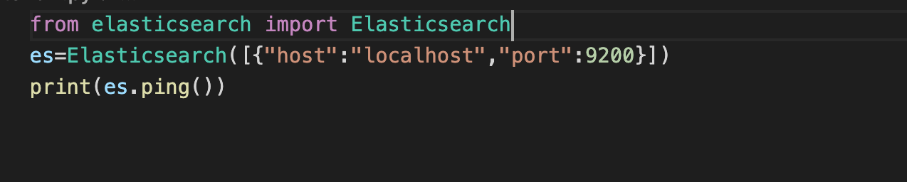
Python setup
Install elasticsearch module using pip
Connect to the elasticsearch cluster

Slide 5
What is index
The very first thing you have to do is creating an Index. Everything is stored in an Index. The RDBMS equivalent of Index is a database so don’t confuse it with the typical indexing concept you learn in RDBMS.

Slide 6
Enable minimal security
https://www.elastic.co/guide/en/elasticsearch/reference/current/security-minimal-setup.html

Slide 7
Introduction to elasticsearch api using using python
Link:
https://www.elastic.co/guide/en/elasticsearch/reference/current/rest-apis.html

Slide 8
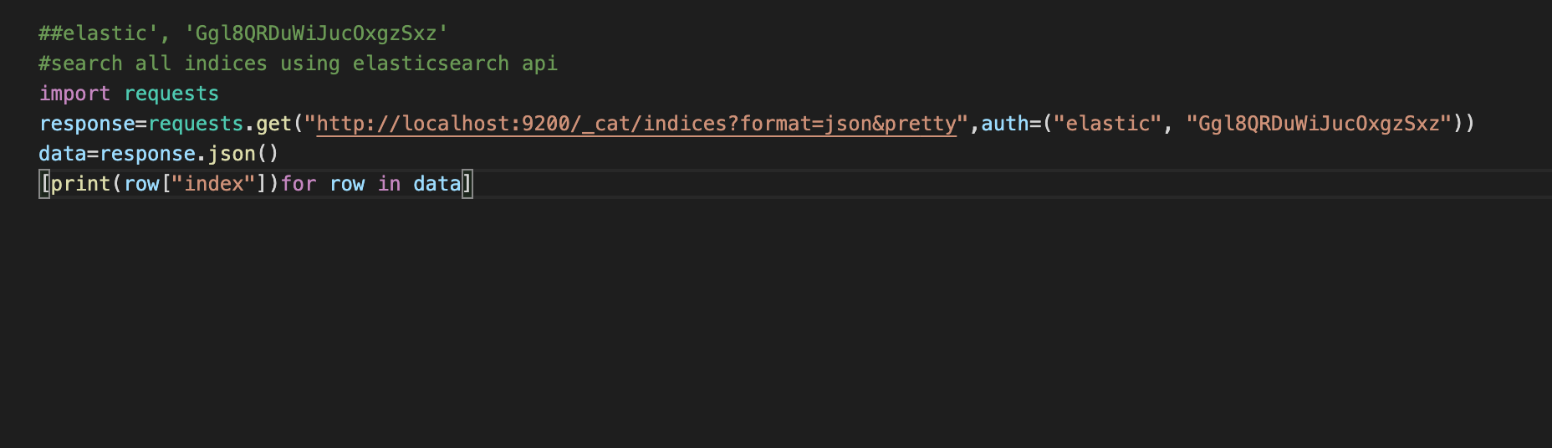
Get all index

Slide 9
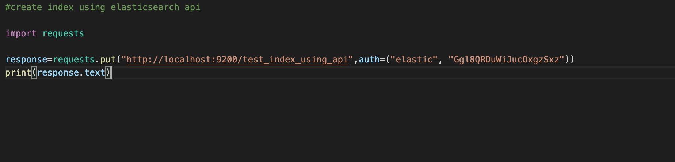
Create Index

Slide 10
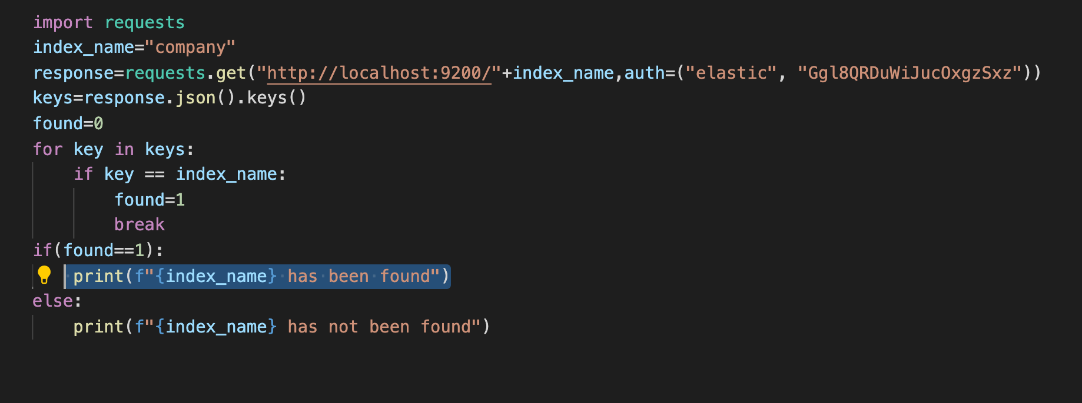
Search Index

