Slide 1
FastApi Python Complete Tutorial
Introduction/Course Outline

Slide 2
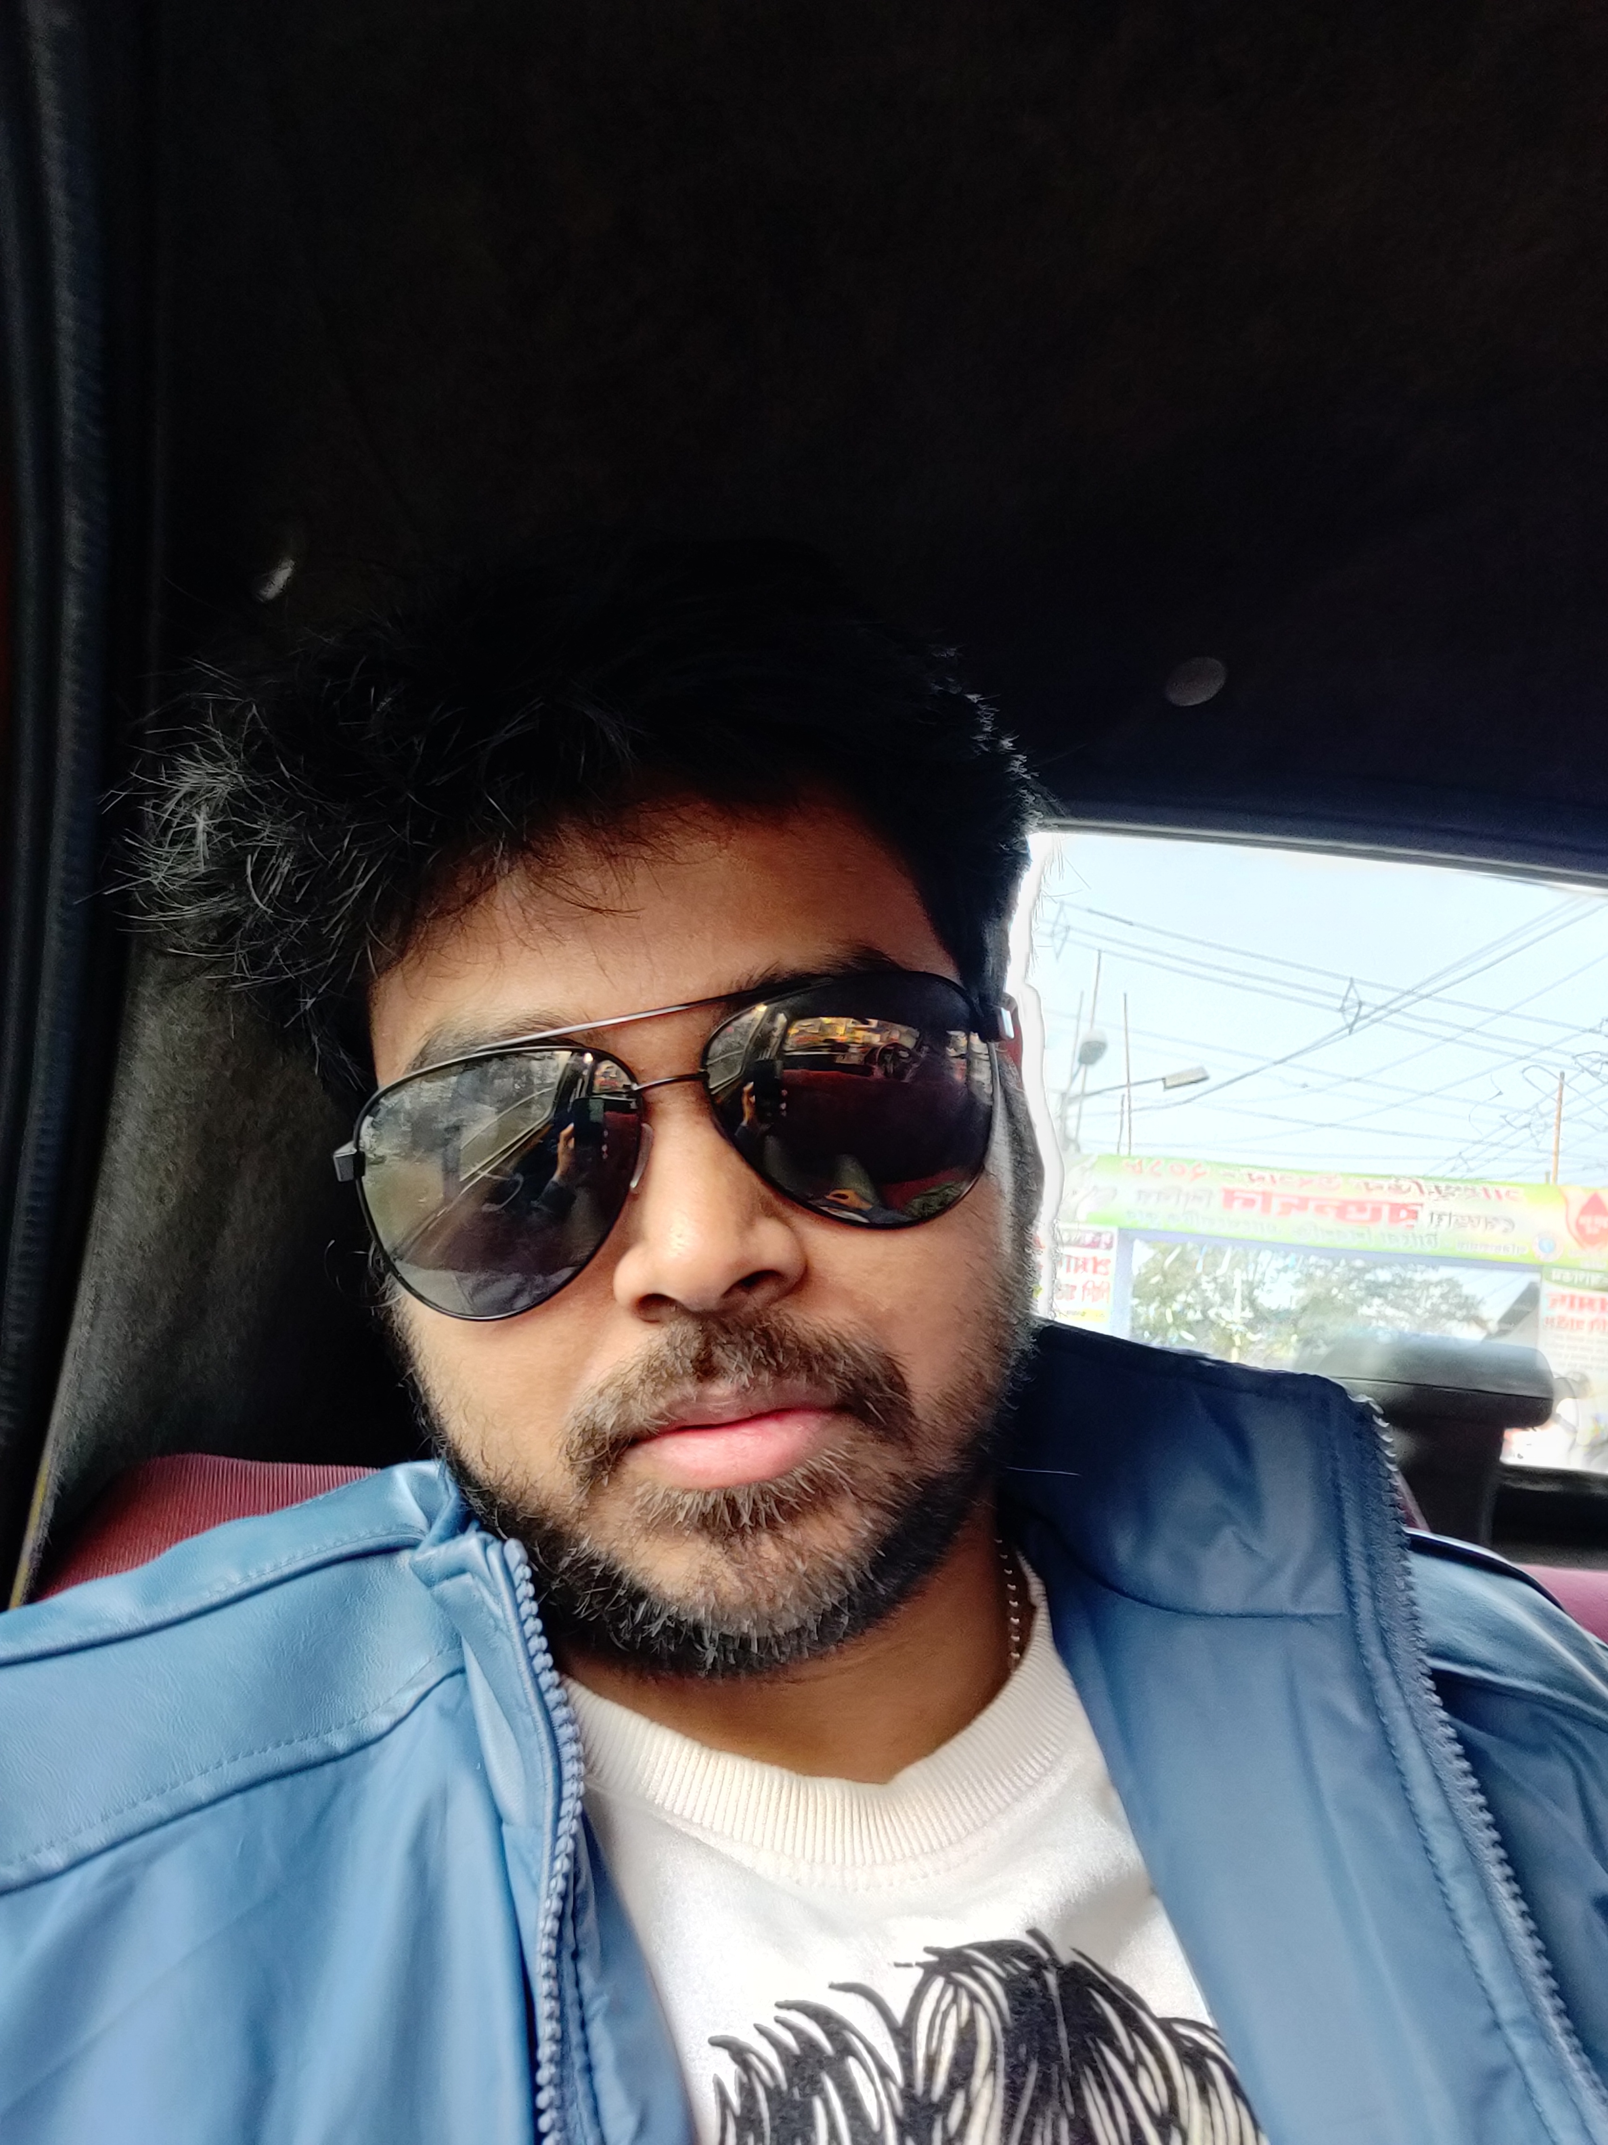
RONI Das
More than ten years experience in programming , application development.
At present working as consulting engineer.
Started teaching in udemy last year.
https://www.udemy.com/user/ronidas071gmailcom/
Mostly focusing on the topics which are not available .
https://www.linkedin.com/in/roni-das-08b3b866/

Slide 3
FastApi Python Complete Tutorial
1.Pre-requisites,
2.Setting up the environment
3.What is fastapi
4.Why it is popular
3.Hands on demonstration of all different use cases from FastApi framework.
4.All tutorial will contain source code

Slide 4
Thank You
Will see you all in the next tutorial.

