Slide 1

Fastapi Python Complete Tutorial How To Build and Run Simple Fastapi App Using Uvicorn Tutorial :2

Slide 2

Official doc link :https://fastapi.tiangolo.com/

Slide 3
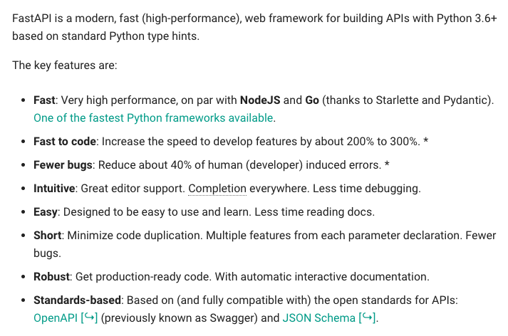
What is Fastapi

Slide 4
Pre-requisite
Python 3.6 or higher required
Install fastapi using pip
Install uvicorn using pip

Slide 5
Simple Fastapi App
from fastapi import FastAPI
app=FastAPI()
@app.get("/")
def show():
return {"NAME":"RONI DAS","COUNTRY":"INDIA","company":"abc"}
@app.get("/about")
def show_about():
return {"ABOUT":"TEST PAGE FOR ABOUT"}

Slide 6
How to run
uvicorn main:app --port 8700 --reload

