Slide 1

Fastapi Python Complete Tutorial Debugging In Fastapi Tutorial :8

Slide 2

Official doc link :https://fastapi.tiangolo.com/

Slide 3
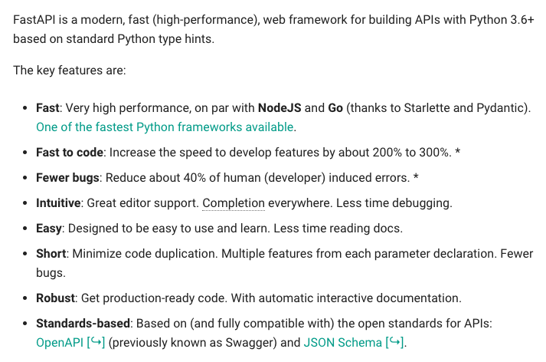
What is Fastapi

Slide 4
Pre-requisite
Python 3.6 or higher required
Install fastapi using pip
Install uvicorn using pip

Slide 5
Debugging In FastApi

