Slide 1

Fastapi Python Complete Tutorial How To Use Fastapi Documentation Using Swagger Ui Tutorial :5

Slide 2

Official doc link :https://fastapi.tiangolo.com/

Slide 3
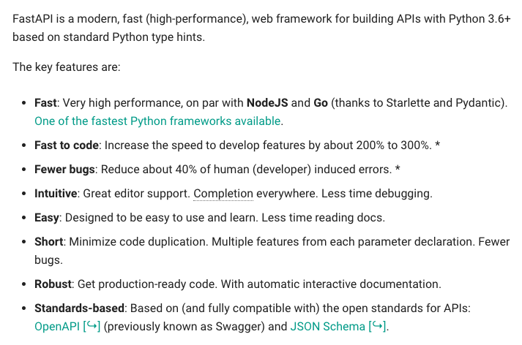
What is Fastapi

Slide 4
Pre-requisite
Python 3.6 or higher required
Install fastapi using pip
Install uvicorn using pip

Slide 5
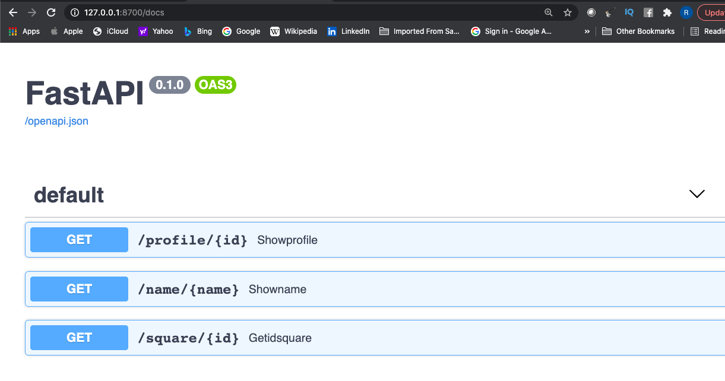
Fastapi Documentayion

Slide 6
How to run
uvicorn main:app –port 8700 --reload

